Slide 1
Boost Your Neuropathy Closing Rate with This Simple
4-Option Approach!
With Dr. Todd Singleton

Slide 2
First, let’s discuss some general closing strategies…

Slide 3

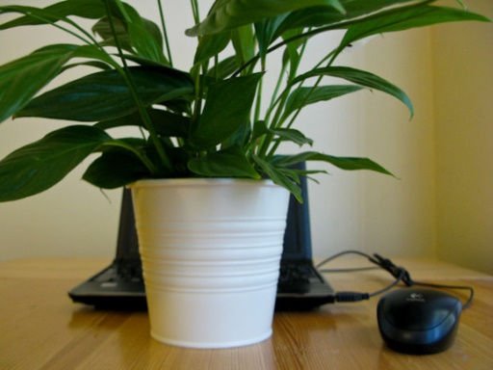
The Sales & Evaluation Setting
How your office looks (and where you and your patients sit) matters:
Create a warm and inviting space with lamp lighting and plants.
Make your office personal with family photos, pictures of your dogs, etc. Be relatable and real.
Hang successful “Before and After” photos and testimonials behind your desk where your client will see them. This is a visual proof of performance.
Do not sit behind a desk. Have a comfortable and inviting chair pulled up to the side so there is no barrier between you and your client.
It can also help to have your potential patient watch a short video presentation that introduces them to the services you offer.

Slide 4

Build Rapport & Trust
Take a few minutes to get to know them and note your commonalities. Laugh, commiserate, and search for common ground.
People are much more likely to buy from you if they like you and can tell that you care.
Tell them what is going to happen during the evaluation.
Tell them during the evaluation you will determine if they are a good candidate for your program and if they are, you will let them know and make a recommendation.

Slide 5

Communication Strategies
Before you even look at the patient’s file in front of you, you need to help them feel comfortable. Offer water or other refreshments if available.
Ask questions like:
“How did you find us?”
“Which one of our patients referred you?”
“Tell me about your family…”

Slide 6

Listen and Remember!
As they begin to talk with you, remember what they say! You can use this information later when you’re closing them on a program.
For example, you might explain that it’s not just about them. Their health affects everyone around them, including family members and friends. There’s a ripple effect.

Slide 7

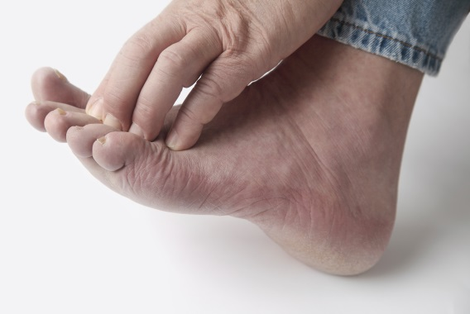

Uncover Their “Pain Points”
Ask questions that will get them to tell you how painful and miserable their life is because they’re overweight and unhealthy.
Use the New Patient Intake Form to help you find the best questions to get to the root of your patient’s pain.
For every answer they give, follow up with another question or two to really get to the pain hidden in their answer.
It is imperative they tell you this information so you will have the ammunition you need to overcome any objection they may have at your close.

Slide 8
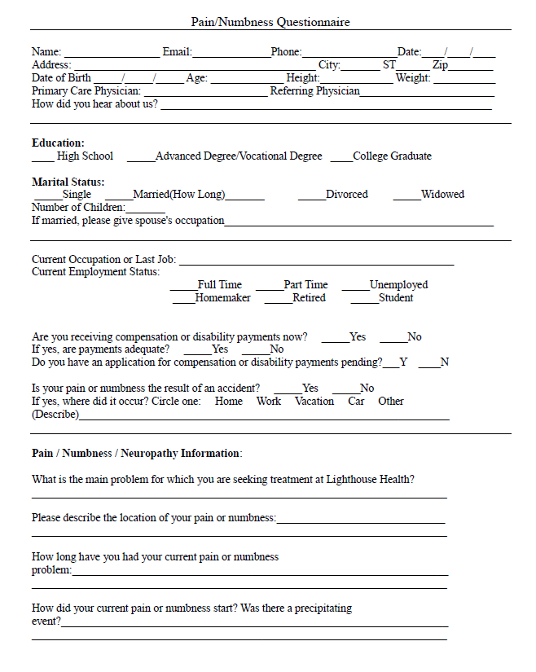
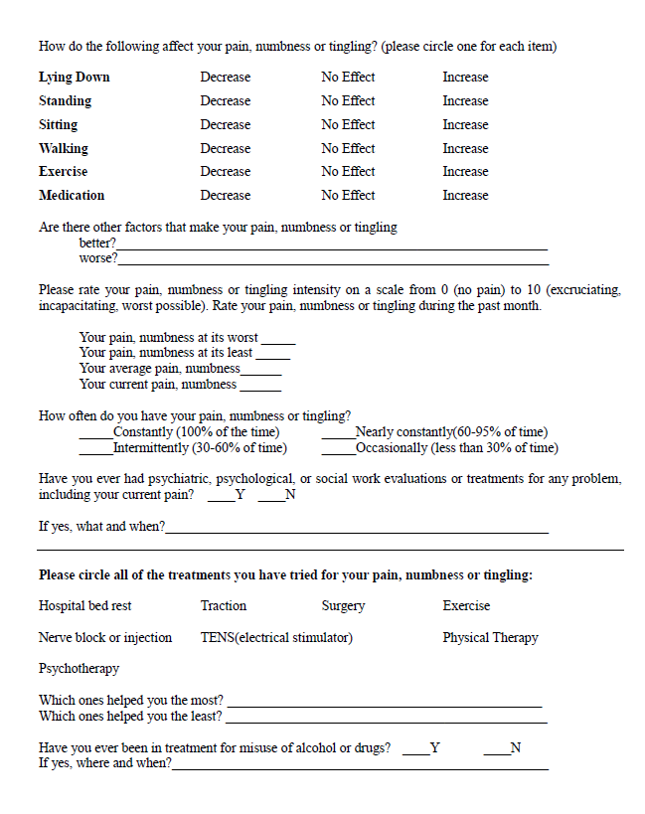
Patient Intake Form

Slide 9
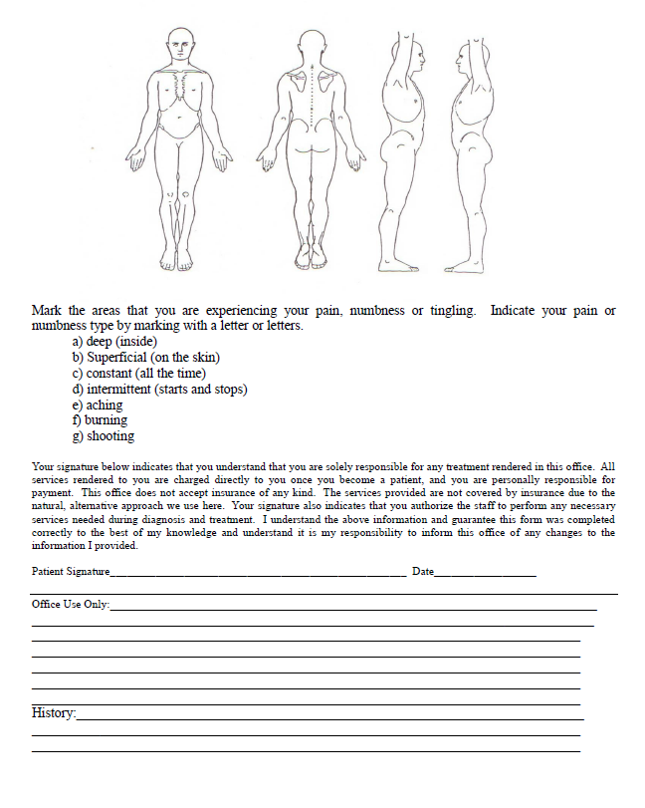
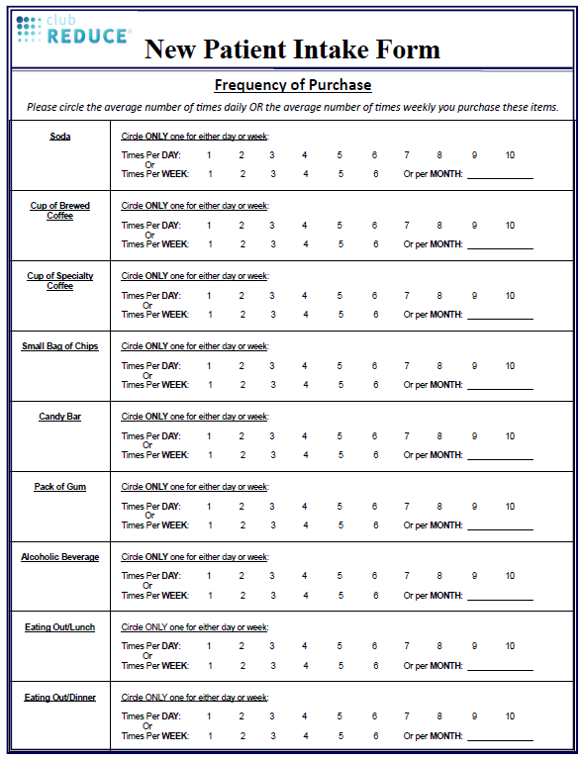
Patient Intake Form

Slide 10

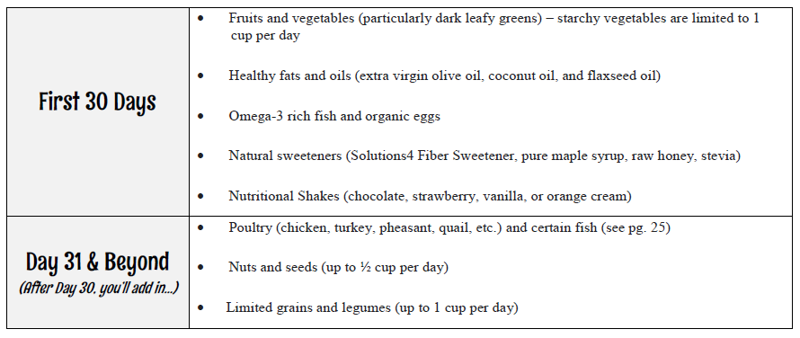
Build Value
Go through the program step-by-step, detail-by-detail to emphasize everything they will gain.
Let them know you will get to the bottom of their problem and address it directly.

Slide 11


Dealing with Objections
Remember “No” does not mean “No” forever…
Always agree with an objection. The patient will drop their guard and it will leave you to step in and reassure them.
Once you understand them, what motivates them and what causes their doubts, make adjustments and assurances as you see fit.
Acknowledge the downside, the things they’ll have to give up and overcome, but emphasize how you, the clinic, and staff will help them pull through and change their life!

Slide 12


Have Them Share Their Vision
Get them to tell you just how glorious and beautiful their life will be when they lose the weight, feel better, and have more energy.
Have them paint a picture for you of what they will do, where they will go, what they will be wearing, and who they will be with.
It is imperative that THEY TALK and YOU LISTEN.
Text from one of our docs: “It was really hard to shut up! But it worked! I closed all 3 evaluations tonight.”

Slide 13

Make Use of the
4-Option Approach!
To implement, you will paint a picture of four different possible futures for your patient. Let’s discuss each option now…

Slide 14



Option 1: Move in with Family

Slide 15
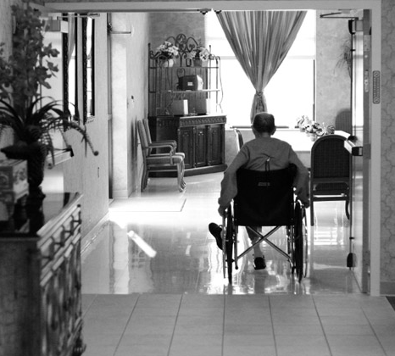

Option 2: Move into an Assisted Living Facility

Slide 16

Nursing home costs top 80K a year.
Over the past 5 years, the median annual cost of private nursing home care has jumped 24% from 67,527 to 83,950 according to Glenworth's 2013 Cost of Care Survey.
It’s not much cheaper for a semi-private room at a nursing home.

Slide 17
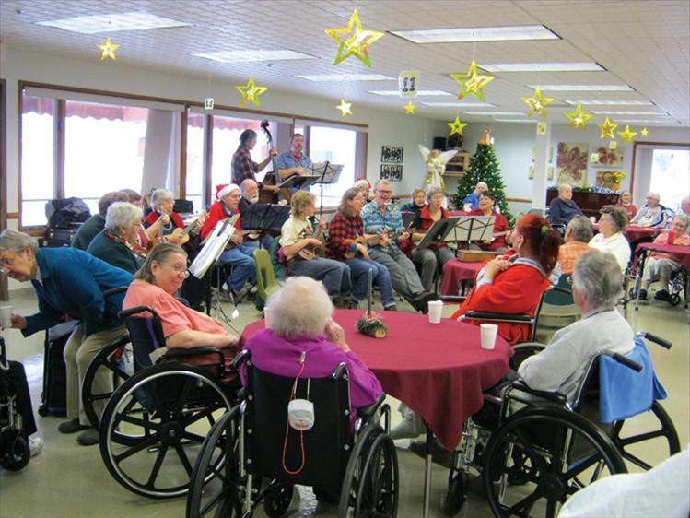
Assisted living facilities are a less expensive alternative to nursing homes because they don’t offer the same level of care.

Slide 18

The median annual cost of care in an assisted living facility is 40K — up 5% from last year and 23% higher than 5 years ago.

Slide 19
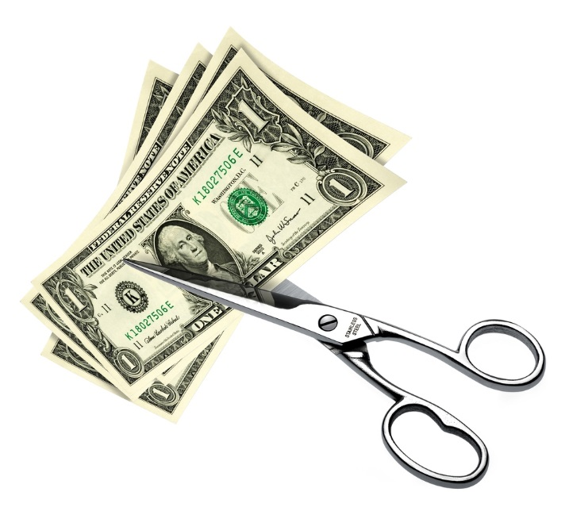
$2500 to $4000 to treat your neuropathy is probably sounding pretty good right now.
The other option is to pay $5,500 to $6,900 for private nursing home care or $3,300 per month for assisted living facilities.

Slide 20
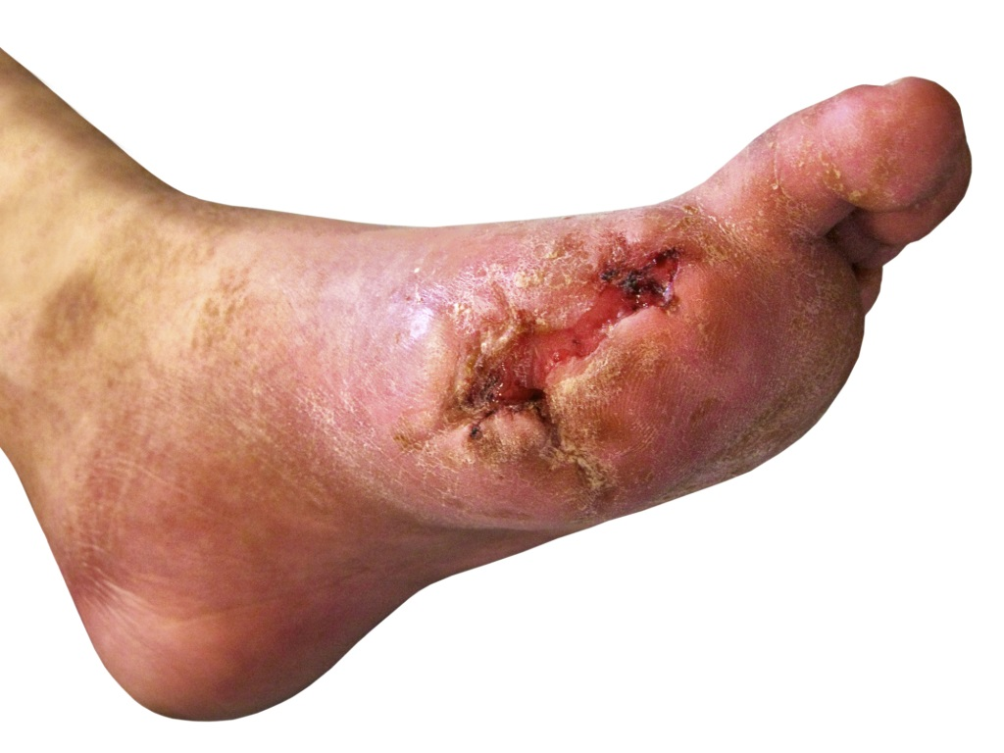
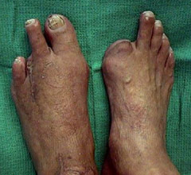
Option 3: Prepare for Amputation

Slide 21
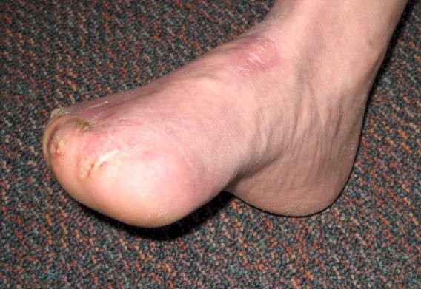
84% of all amputations begin with a diabetic foot wound preceded with neuropathy symptoms.

Slide 22
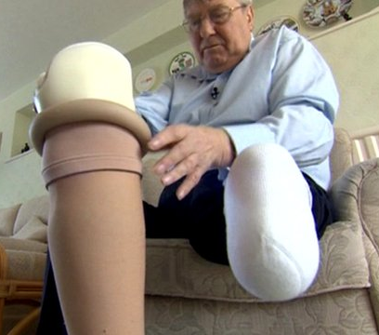
In the USA, 10,000 amputations are performed each month!

Slide 23
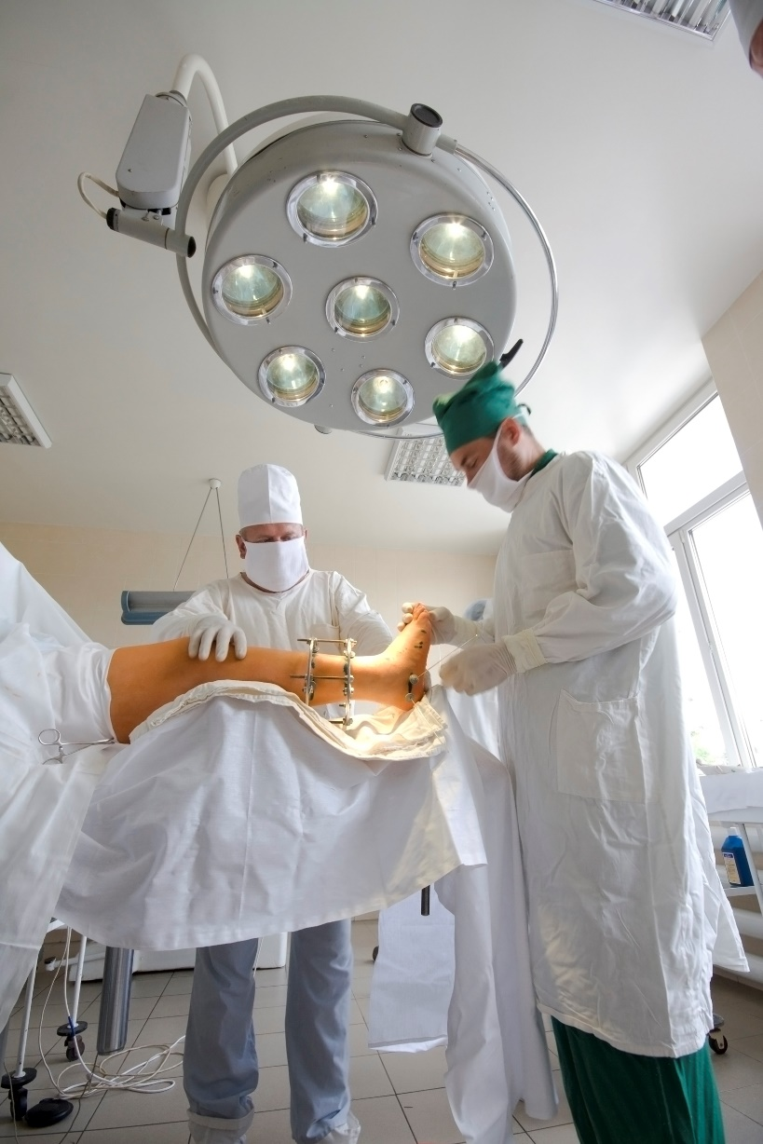
Once an amputation occurs, the majority of patients will have a second amputation within two years (along with concurrent multiple admissions and increased hospital length of stay).

Slide 24

The cost per lower limb amputation is 30K to 60K, with an additional 43K to 60K in follow-up care!

Slide 25


Option 4: Do a Program Here

Slide 26
Now, let’s discuss a few additional closing tools you may not be aware of…

Slide 27
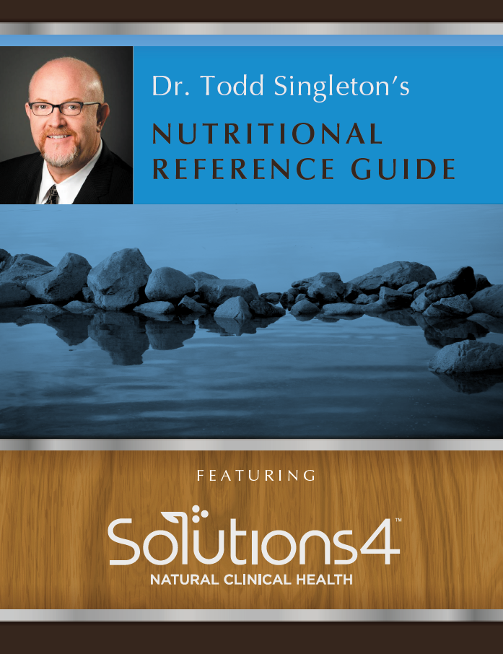
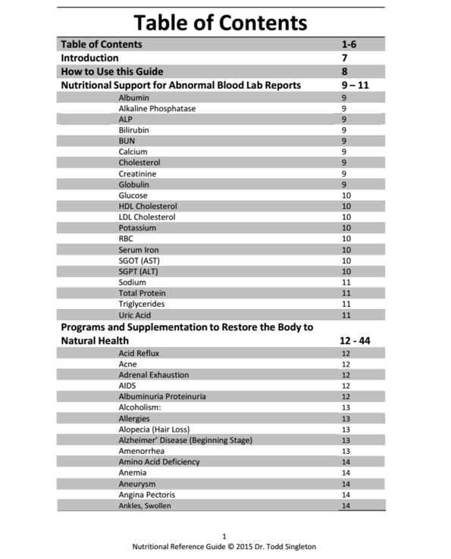
Nutritional Reference Guide

Slide 28
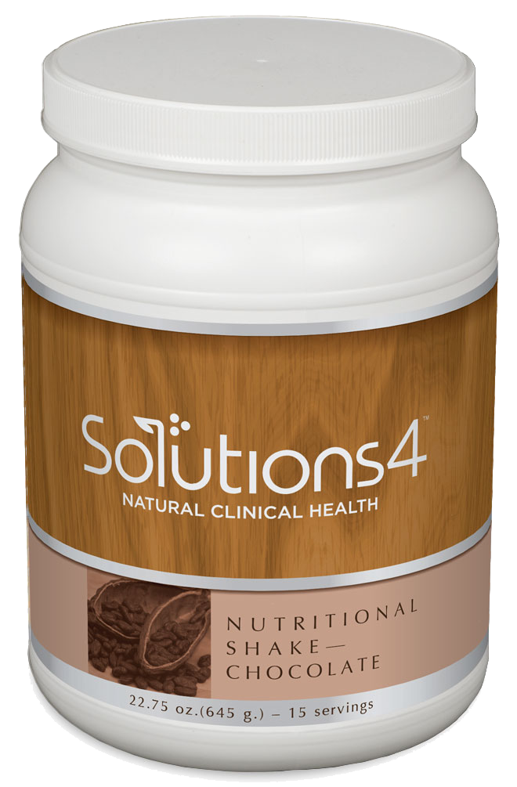
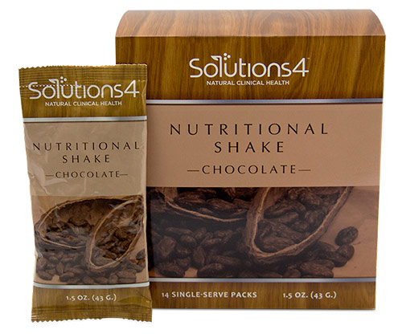
The Nutritional Shake

Slide 29
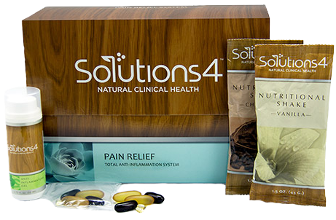
The Pain Relief System

Slide 30

Cardio Health Essentials

Slide 31
Finally, let’s wrap this up with a few final tips and some info on where to find additional training…

Slide 32

Don’t Forget That Your Headspace Matters.
With all the tools in your tool belt and with the best closer ever there a few important things you still need to do to be a successful closer:
LOVE your client and truly care about them!
Have a positive HEADSPACE! (Listen to SMT daily)
BELIEVE in what you are are selling and they will believe in it too!

Slide 33

Practice What You Preach!
The busiest clinics in the country are run by energetic doctors who love what they do.
To achieve this level of passion and enthusiasm, you should try a program yourself.
You’ll have more energy and you’ll be more excited about what you do!

Slide 34

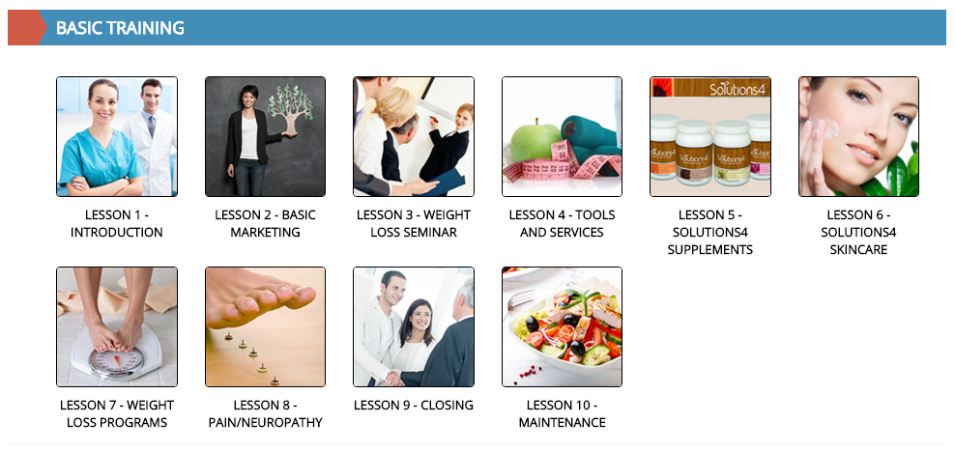
Learn Closing Through Basic Training

Slide 35
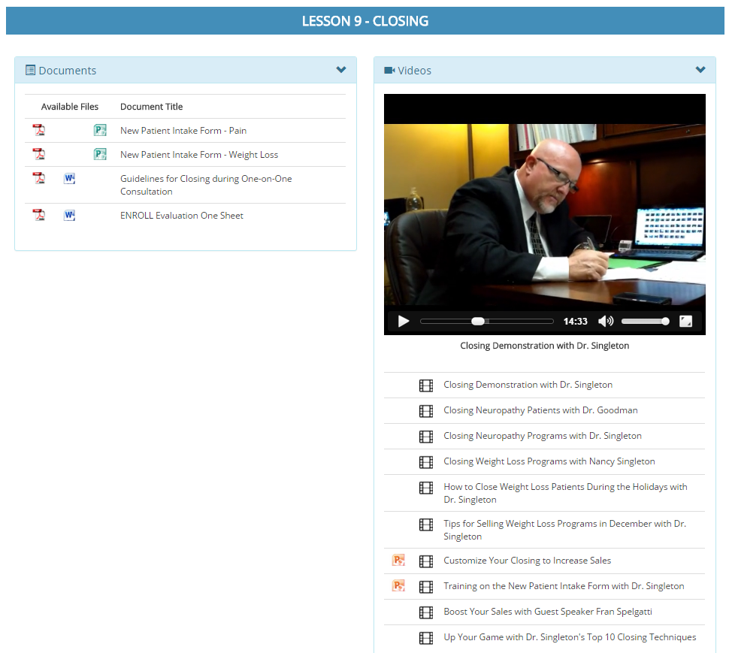

Learn Closing Through Basic Training

Slide 36

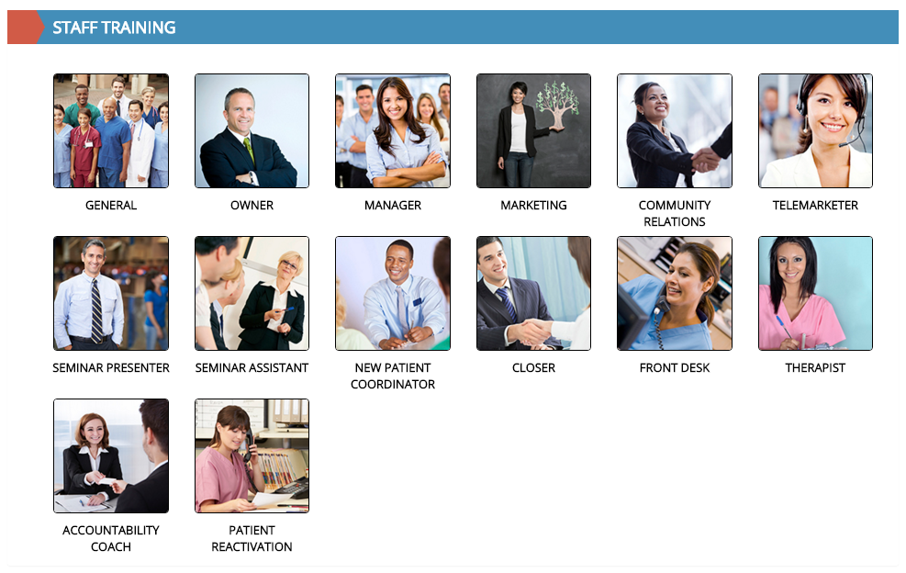
Learn Closing Through Staff Training

Slide 37
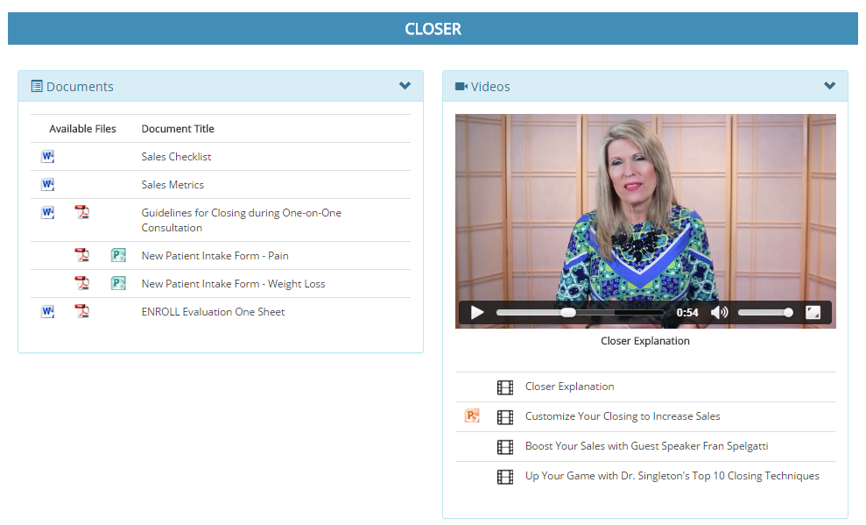

Learn Closing Through Staff Training

Slide 38

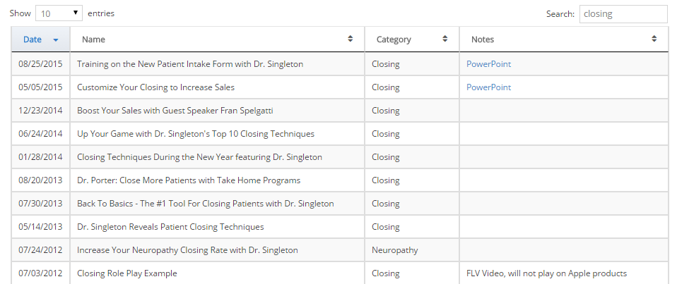
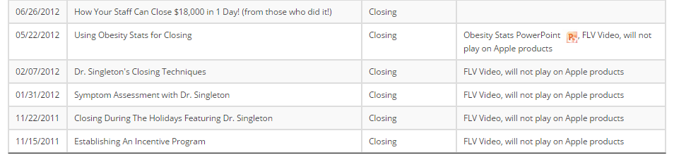
Learn “Closing” Through Webinars

Slide 39

Any Questions?
(Type into the Webinar Question Box)

Slide 40
Additional Questions?
Dr. Todd Singleton
(801) 903-7141

