Slide 1
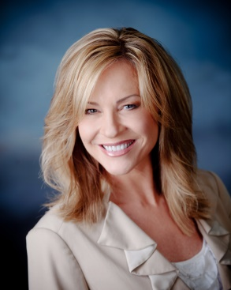
Skyrocket Your Business through Setting Goals
Business Building Activities for Every Member of your Team
Shar Lewis Club Reduce Consultant Vice President of Marketing

Slide 2


When you are trying to grow your business… Whose job is it anyway?
Most people will say it is Marketing & Sales
They are correct…in part:
Without someone responsible for MARKETING AND FILLING YOUR SEMINARS you have no one to sell programs to…therefore the business doesn’t grow
Without someone responsible for SALES AND CLOSING NEW PATIENTS on programs you have no new patients to service…therefore the business doesn’t grow

Slide 3

However, There is more to it than that!
Every member of your team is responsible to help grow the business every day.
That includes:
Marketing
Seminar Assistant
Sales/Closer
Weight Loss Coach
Spa Technicians
Front Desk
Office Manager
Chiropractic and other staff

Slide 4
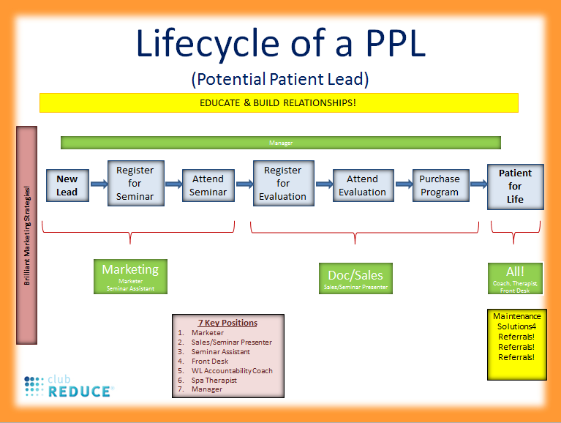
Let’s have a quick refresher course
*If you are not familiar with this watch my webinar titled “Back to Basics”

Slide 5
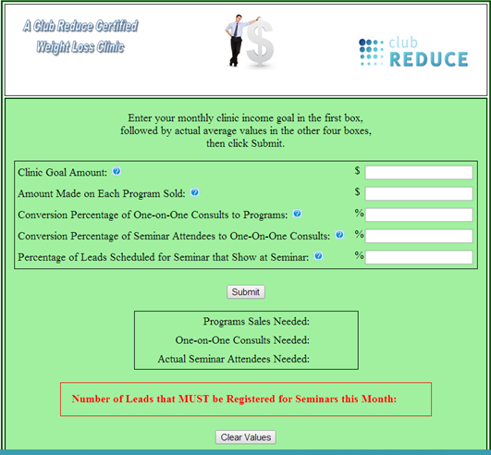
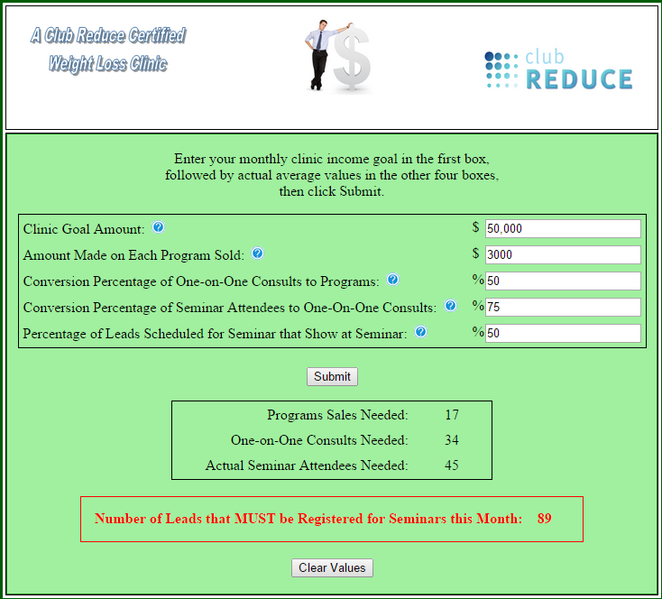
Have Goals & Stats for every position
Start by using the MONTHLY MARKETING PLANNING TOOL on Club Reduce
Goals for MARKETING & SALES start here!

Slide 6
What about everyone else?
Start by using their Daily Checklists & Metrics to identify Goals:
Weight Loss Coach
# Patients on Programs, # Active, # Inactive, # Called weekly, #Maintenance
# Maintenance Programs Sold, # Referrals, # Programs Sold
Spa Technician
# Services, # Referral Cards, #/$ Product Sold, # Seminar Attendees
Front Desk
# Appointments Scheduled, # Appointments Showed, # Appointments Rescheduled, # New Arrivals, # New Arrivals Showed…(Front Desk Log, New Patient Value Form, etc)
# Referral Cards, #/$ Product Sold, # Seminar Attendees, Promotional flyers
*Checklists and metrics for each position may be found on Club Reduce, under Training, Staff Training, then by Job Type.

Slide 7

Business Building Activities
Referrals: “Who do you know?” and Business Cards with body wrap offer
Everyone can schedule for seminar
Upsell Product & Holiday Special product packages
Monthly Specials with $200 or 20% off promotions (Like the Holiday Little Black Dress campaign)
Monthly Drawing based on Tickets and Points

Slide 8
Monthly Drawing with Tickets for a Prize
Goal #1
Encourage and reward our patients to be successful on their programs.
Goal #2
Encourage and reward our patients to help us build our business by giving us referrals.

Slide 9
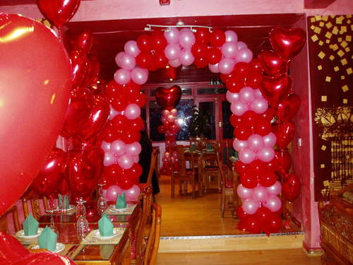

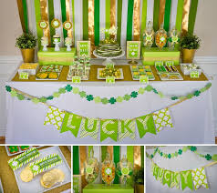
Pick a fun theme for every Month and Decorate
New Year’s
Valentine’s Day
St. Patrick’s Day
Spring Fever/Easter
Mother’s Day
Summer Fun/Father’s Day
4th of July
Back to School
Labor Day
Halloween
Thanksgiving
Holiday/Christmas

Slide 10




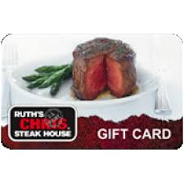

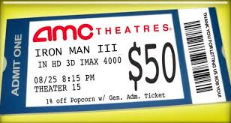
Choose a Prize for the Drawing
Gift basket of Solutions4 Skin Care Products
Electronics such as: Flat screen TV, Ipod , Ipad or Tablet, Kindle, etc
Night on the town with Dinner Gift Certificate and movie tickets
Getaway with a night stay at a fancy or themed hotel with tickets to the symphony or a musical
Be creative! Ask for suggestions from your patients!

Slide 11

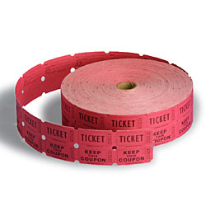
Determine how many tickets they earn for each activity
Goal #1 Patient Success
1 ticket arriving on time
1 ticket keeping their weekly appointment
1 ticket for each pound and inch lost that week
Goal #2 Build the Business
8 tickets for referral that shows to seminar
*Remember, your goal is to reward the desired behavior

Slide 12

Hold the drawing every month and make a big deal about it!

Slide 13
Remember…
Every member
of your team should have
GOALS
to help
BUILD THE BUSINESS
every day!

Slide 14

Goals! Goals! Goals!
Personal Goals
Department Goals
Team Goals
Clinic Goals
Celebrate your success & fix the problems as they arise

Slide 15



“Once you make a decision, the universe conspires to make it happen.” –Ralph Waldo Emerson
“You have always had, you have at this moment, you will always have in the future the power to achieve, to accomplish, to have anything and everything you want.”

Slide 16

Three additional Success Strategies to Grow your Business
NEW SUCCESS CHECKLIST
NEW MARKETING QUICKSTART GUIDE
HIRE ME to come to your clinic to provide personal, one-on-one COACHING and CONSULTING

Slide 17

SUCCESS STRATEGY THREE: On-Site Personal Consulting
Are you making $25,000, $50,000, $100,000 or more each month with Club Reduce?
Do you want to be?
I can personally help you DOUBLE, TRIPLE or even QUADRUPLE your Club Reduce business in just a few short months.

Slide 18


I Can Help You!
Personal
training and coaching
at your clinic
for you and your staff
specific to your needs
and goals

Slide 19

Sign Up Today!
Train your staff NOW to take advantage of New Year’s resolutions, getting ready for Spring and implementing the latest and greatest Club Reduce 4.0!
www.ClubReduceConsulting.com
801.917.0900

Slide 20

Thank You!

