Slide 1
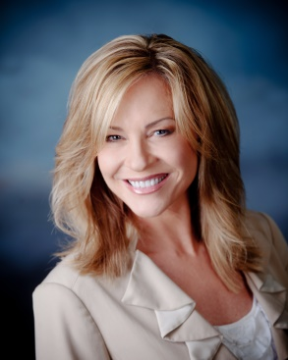
Getting Started with Marketing Using These Easy Steps!
Shar Lewis
Club Reduce Consultant
Vice President of Business Development

Slide 2

How to get your NEW
Marketing Person on Track with their New Role and Filling your Seminars.

Slide 3
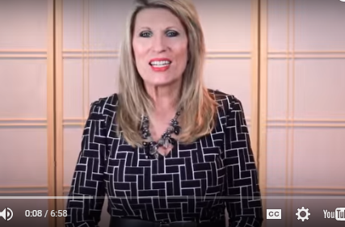
Watch the Training Video
“The Three Components for Success!”
It can be found on Club Reduce 3.0 under Training > Basic Training > Lesson #1

Slide 4
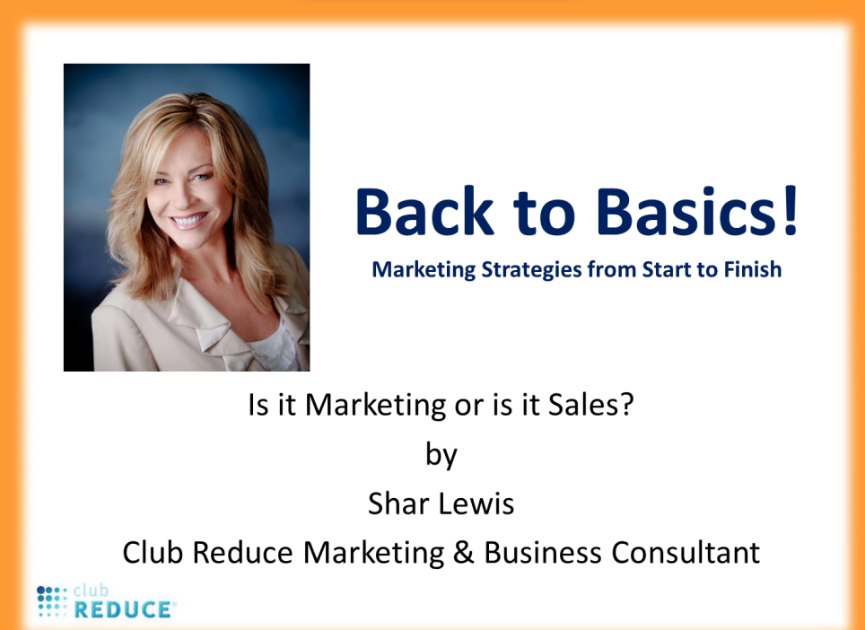
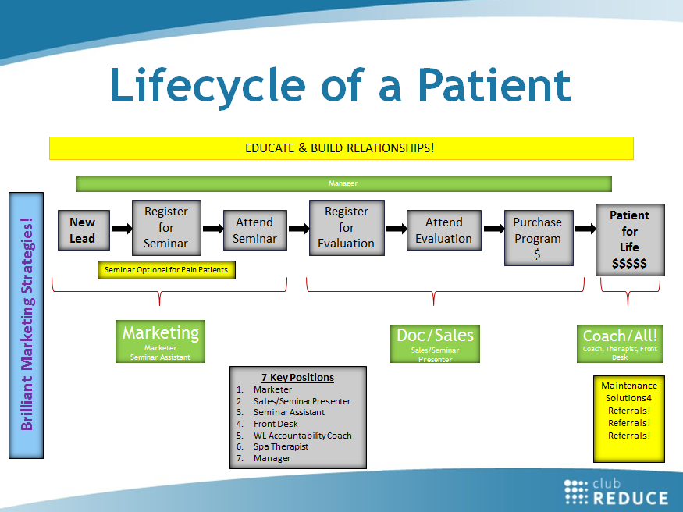
Watch the Webinar titled
“Back to Basics”
Review the Lifecycle of a Potential Patient and
7 Key Positions so they understand their role in the bigger picture.

Slide 5
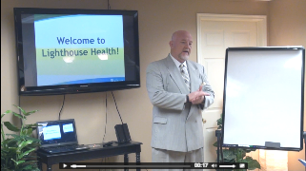
Have Your Telemarketer Watch You Giving the Seminar
Or one of the sample seminar presentations on Club Reduce
These can be found on Club Reduce 3.0
Marketing > Internal Marketing > In-Office Weight Loss Seminar > Weight Loss Presentation
There are 4 samples with different presenters…Dr. Singleton, Shar, Dr. Goodman and Jenna.
Same presentation and slides different ways to present.

Slide 6

Build your
Marketing Tickler System
You will need one 3-inch binder, 1 set of alphabet tabs (A-Z), 1 set of monthly tabs (Jan-Dec), and 3 sets of daily tabs (1-31)
Print out the 2 Tickler Forms that can be found on Club Reduce 3.0 > Marketing > Tickler System for Tracking Marketing > Lead Follow Up Sheet & Tickler Follow Up Sheet
Build your Marketing Tickler System
Gather all your leads to be put in this book. This may include current patient list, tradeshow leads, banner leads, referrals, online, etc.
Every lead should be in this book, have a PPL Lead Sheet, and live on a day on the Tickler Follow Up sheet somewhere in that book

Slide 7
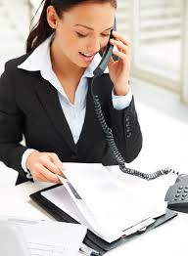
Watch the Webinar titled
“Boost Your Business with the Must Have Tickler System”
Remember… A lead never dies until they literally die or become your patient!

Slide 8
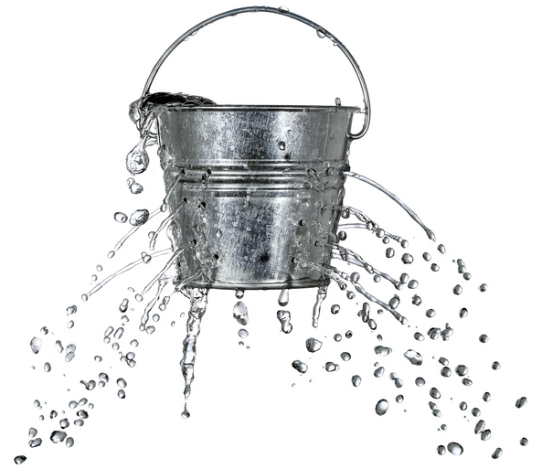
No More Leaky Bucket!
The Marketing Tickler System ensures that you don’t loose leads!
You’ll find more leads, convert more leads into patients, and convince more patients to remain patients for life!

Slide 9
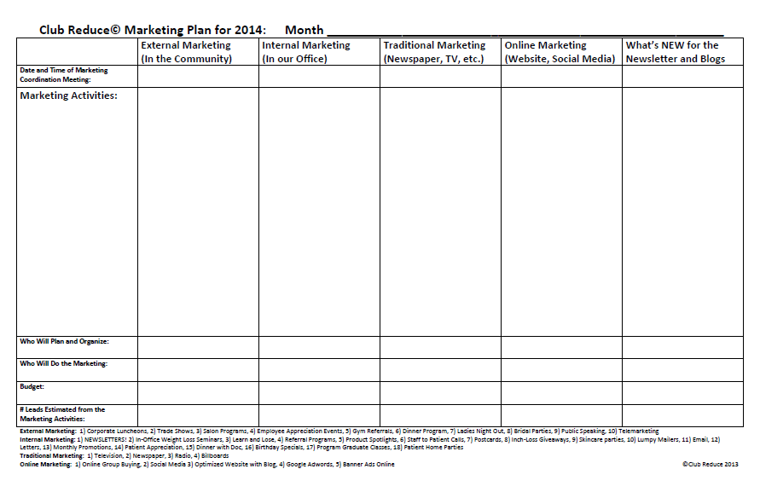
Create a Marketing Plan

Slide 10
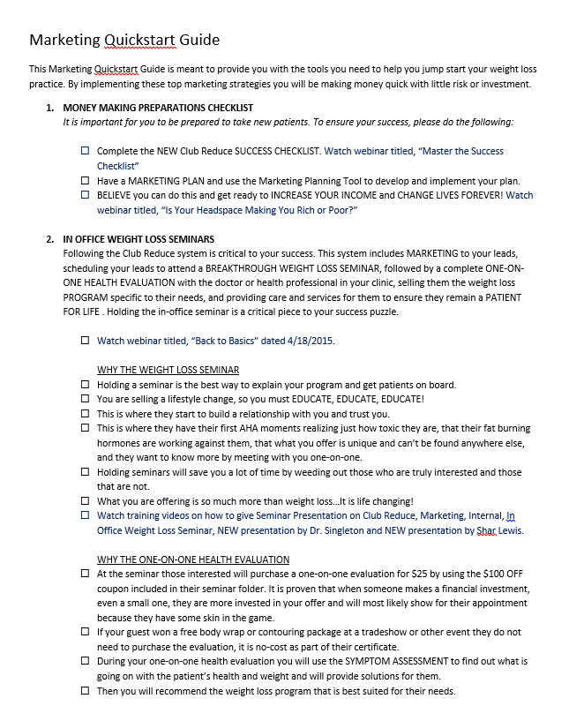
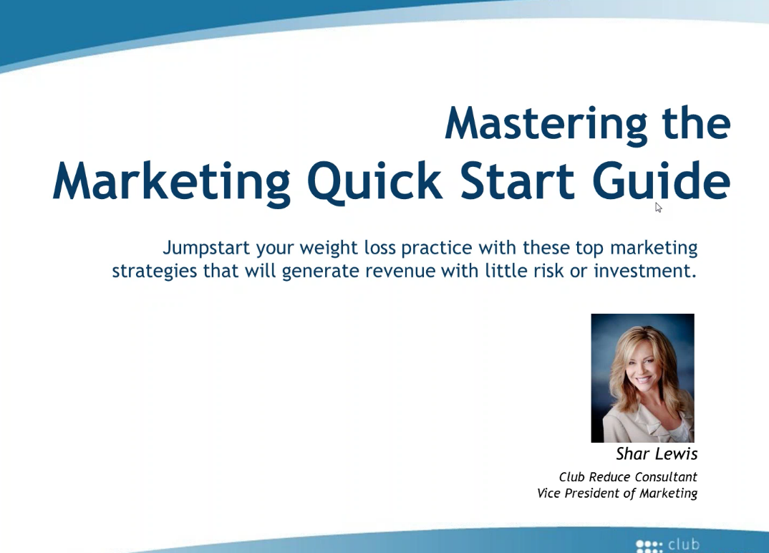
Print and Follow the Marketing QuickStart Guide

Slide 11

Top 5 Marketing Campaigns
to Get You Started
Marketing to Current Chiropractic Patients
Banners and Bandit Signs
Trade Shows and Community Events
Corporate Lunches
Referrals

Slide 12


1. Marketing to Current Patients

Slide 13
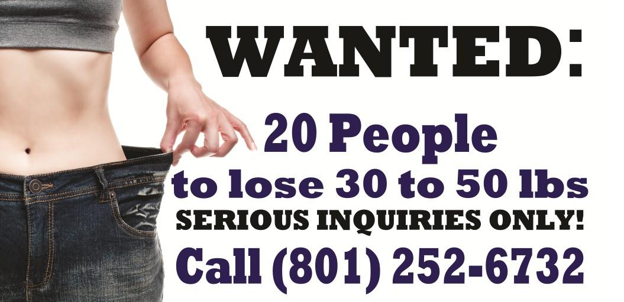
2. Banners and Bandit Signs

Slide 14
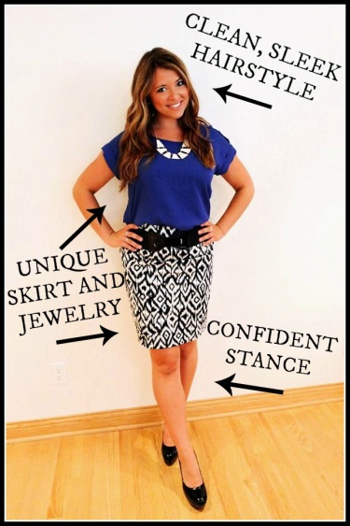
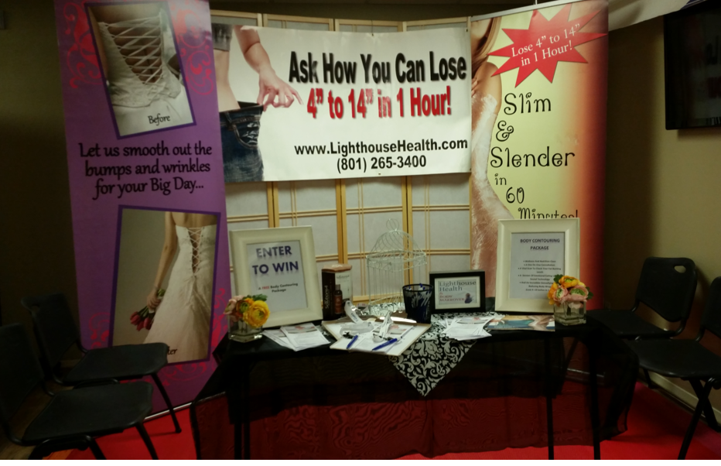
3. Trade Shows & Community Events

Slide 15



4. Corporate Lunches

Slide 16


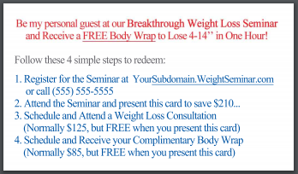
5. Referrals
Be my personal guest at our Breakthrough Weight Loss Seminar and Receive a FREE Body Contouring Package to Lose 4-14” in One Hour!

Slide 17
Watch the Marketing Webinars
to Learn HOW to IMPLEMENT the Campaigns CORRECTLY
“Master the Marketing QuickStart Guide”
“Marketing to Current Chiropractic Patients”
“Learn How to Run a Successful Tradeshow, Health Fair or Community Event
“Learn How to Schedule and Host Successful Corporate Lunches”
For Referrals use the Business Card offer and Monthly Promotions and ask everyone “Who do you know?”

Slide 18

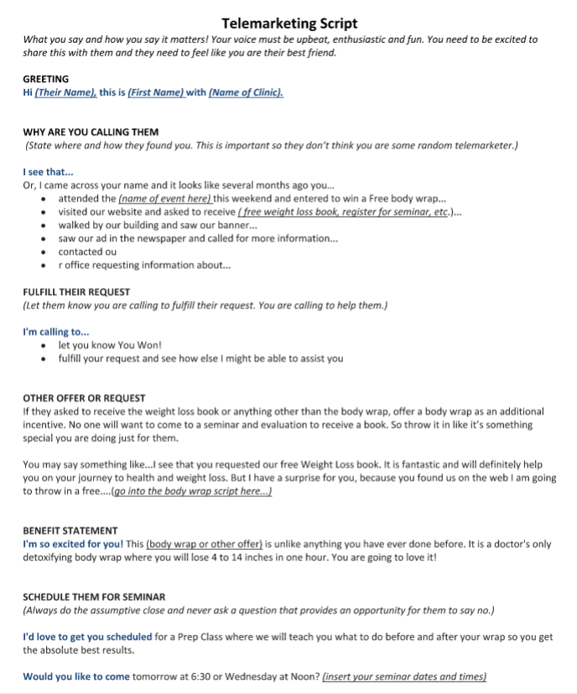
Review the Telemarketing Script and Role Play Call Scenarios

Slide 19

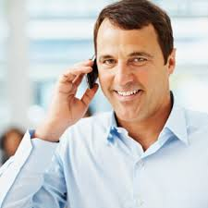
Watch the Webinar
“7 Steps to Improve Your Conversion Rate with Telemarketing”

Slide 20
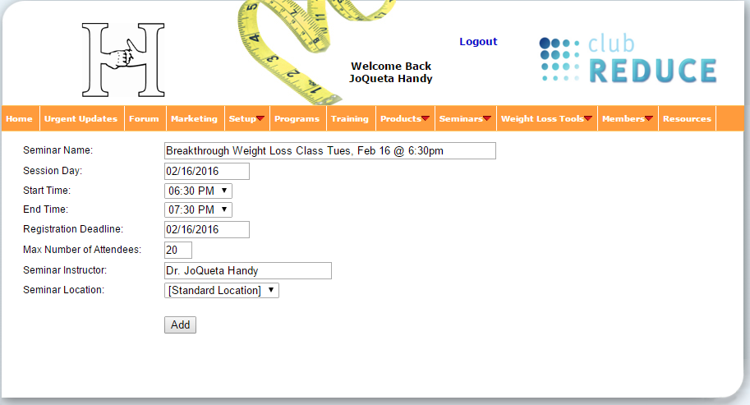
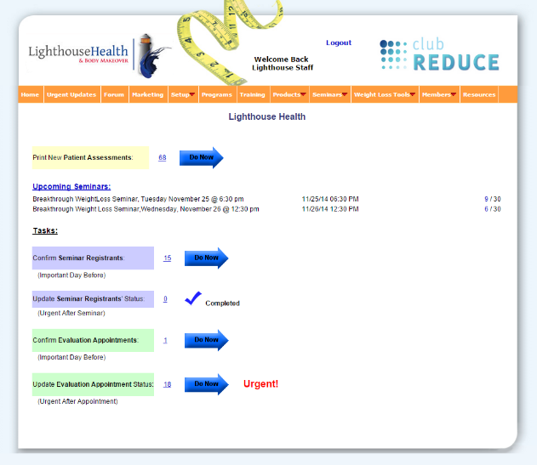
Know When Your Next Seminars Are and How to Add Them in Club Reduce
Your staff will need to update statuses in Club Reduce
with Urgent Updates every step of the way.

Slide 21
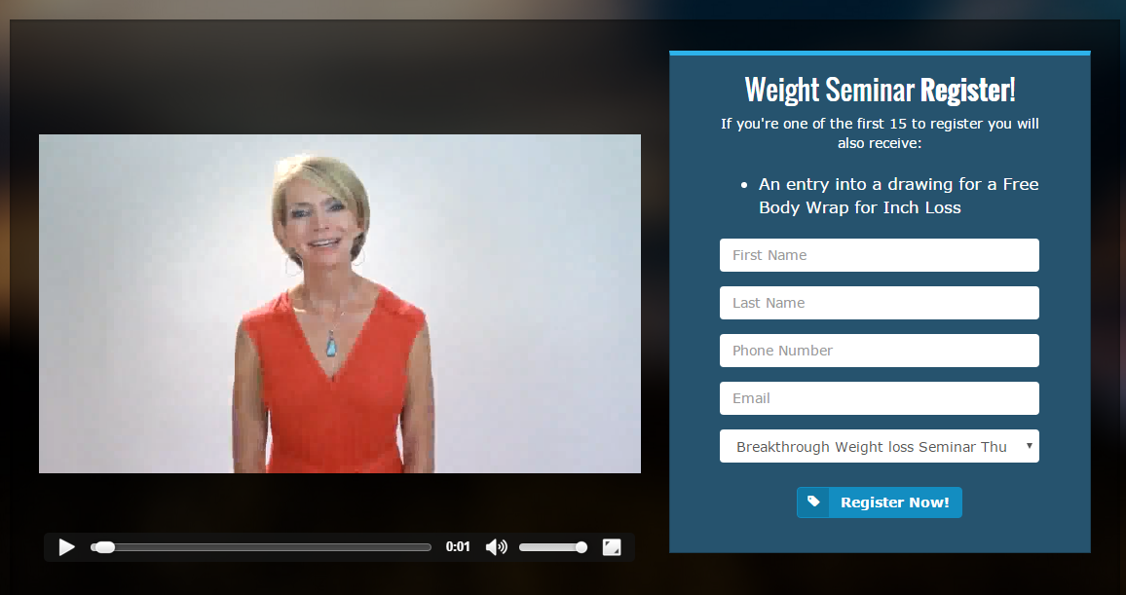
See How your Seminars
Automatically Populate your Landing Page DrJones.WeightSeminar.com
Always use your Landing Page on marketing materials never your regular website

Slide 22
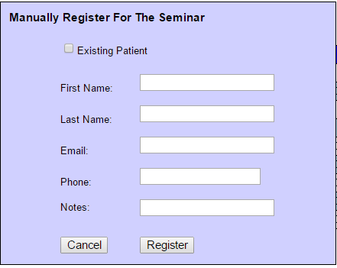
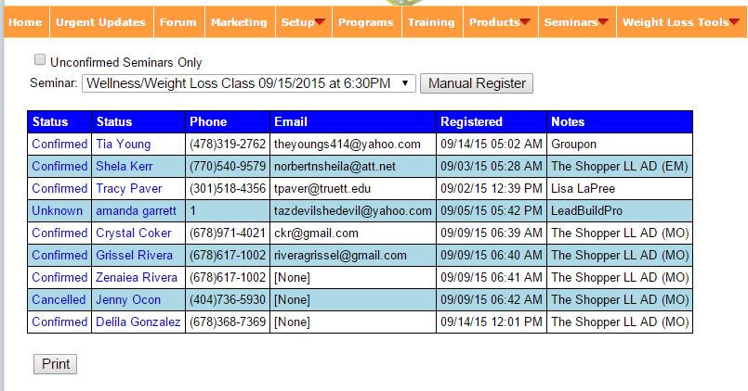
Schedule your Leads for Seminar in Club Reduce
Be sure to put your name and the lead source in the NOTES section
so you get the bonus when that person shows

Slide 23
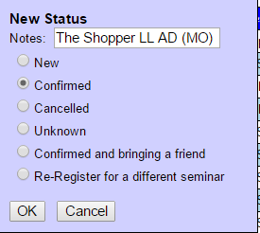

Call and Confirm Every Scheduled Lead for Seminar
the Night Before and Update them in Club Reduce
Text them the day of if you were unable to confirm

Slide 24
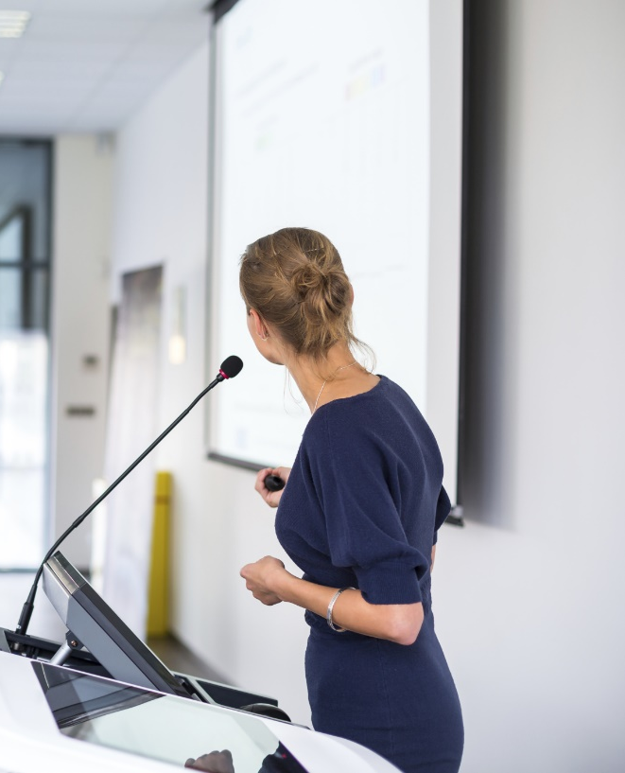
Prepare for the Seminar
Print Scheduled for Seminar lead attendee list
Set up seminar room with screen, powerpoint and chairs
Have Seminar Folders prepared
Have poster with available 1-1 Evaluation times with doctor or health specialist prepared to schedule appointments with doctor

Slide 25

Steps to Take after the Seminar
Enter no shows and scheduled 1-1 evaluations in Club Reduce Urgent Updates and add to Appointment Scheduler
Confirmation email of date and time will automatically be sent
Email with directions to take Symptom Assessment before arrive for 1-1 evaluation will be sent

Slide 26
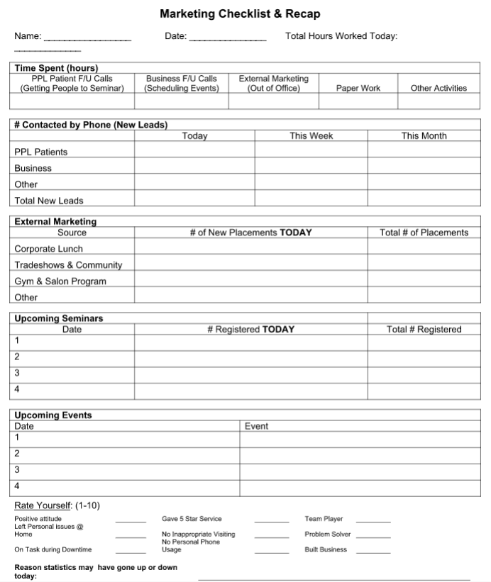
Review the REQUIRED Daily Tracking Forms with your Telemarketer
The REQUIRED marketing forms are:
Daily Call Log
Daily Checklist and Recap
Marketing Metrics
Be sure to account for every minute of every day on the daily call log
Summarize that information on the Daily Checklist and Recap
Carry the information over onto the Marketing Metrics form every day so it calculates for the day, the week, and month

Slide 27
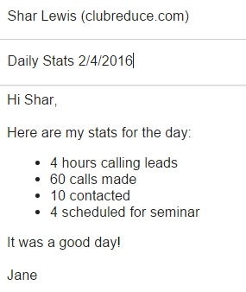
Have them Send you a Daily Summary Email with their Stats
Have them send you a DAILY SUMMARY EMAIL with a summary of their stats for the day
It should include the following:
# hours on phone
# calls made
# people contacted
# scheduled for seminar
You need a telemarketer on the phones a minimum of 15-20 hours per week calling leads and filling your seminar

Slide 28

What to Look for in their Stats
If they are leaving messages the average call time is 3 minutes (including Tickler) so they would average 20 calls per hour
If they are contacting people and having conversations each call may be 5-7 minutes so they would average 10-12 calls per hour – calls are longer so they are making fewer calls
If you see they are contacting people and talking to them but not scheduling for seminar then you know you have a training issue and need to work with them on their scripting
On average when calling in the late afternoon or evening they should be scheduling approximately one lead for seminar per hour

Slide 29
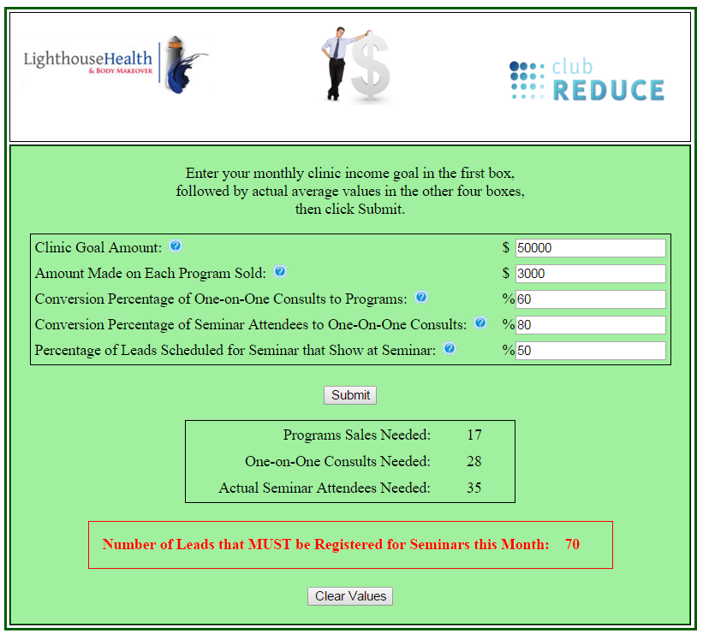
Use the Marketing Calculator to Set Your Goals
Watch the webinar titled “Use the Monthly Marketing Planner to Set Ambitious yet Achievable Goals”

Slide 30

Have your Telemarketer and Every Member of your Team
Do a Program!
I would recommend the 20-Day or the 5-Week.
Your employees will only be successful if they are passionate about the program and can speak from personal experience.
If someone doesn’t have weight to lose, that’s okay -- just increase their calorie intake.
Something life changing will happen when your staff does this!
They will love it!

Slide 31

Fill your Head with Positive Thoughts
Listen to one Self-Mastery Technology session per day
Share a positive quote or thought with a friend daily and post it in your office where you can see it or on your bathroom mirror at home – my kids and I send a daily group text with a thought for the day
Read or listen to motivational books daily

Slide 32


Have Fun and Practice What You Preach!

Slide 33

Do you Need Help Growing Your
Club Reduce Business
to Increase your CASH Income and Help your Patients HEAL?
www.ClubReduceConsulting.com
801.917.0900

Slide 34

Client Testimonials
www.ClubReduceConsulting.com

Slide 35

Thank You!

