Slide 1
Attract New Patients Using Youtube
Dayo Adiatu, LeadGen180

Slide 2


LeadGen180.com
Dayo

Slide 3
What Is Youtube?
A video sharing service where users can watch, like, share, comment and upload their own videos

Slide 4
Why Should You Consider Joining Youtube?
Over 1 billion users (⅓ of all people online)
Makes up 33% of all online activity
Third largest website in the WORLD
Second largest search engine (right after google) It’s bigger than Bing, Yahoo, and Ask COMBINED
It’s FREE!

Slide 5
Your Patients Are Using Youtube!
In case it’s not obvious yet...

Slide 6
Why Your Practice Needs A Youtube Channel
Your patients are on Youtube
Consumers research. They use video when researching providers, conditions, and treatments
Reach potential patients in a personal way
Answer FAQs
Create a home for your testimonials videos, intro, and office tour videos
Establish yourself as an authority/expert
Allow potential patients to find you!

Slide 7
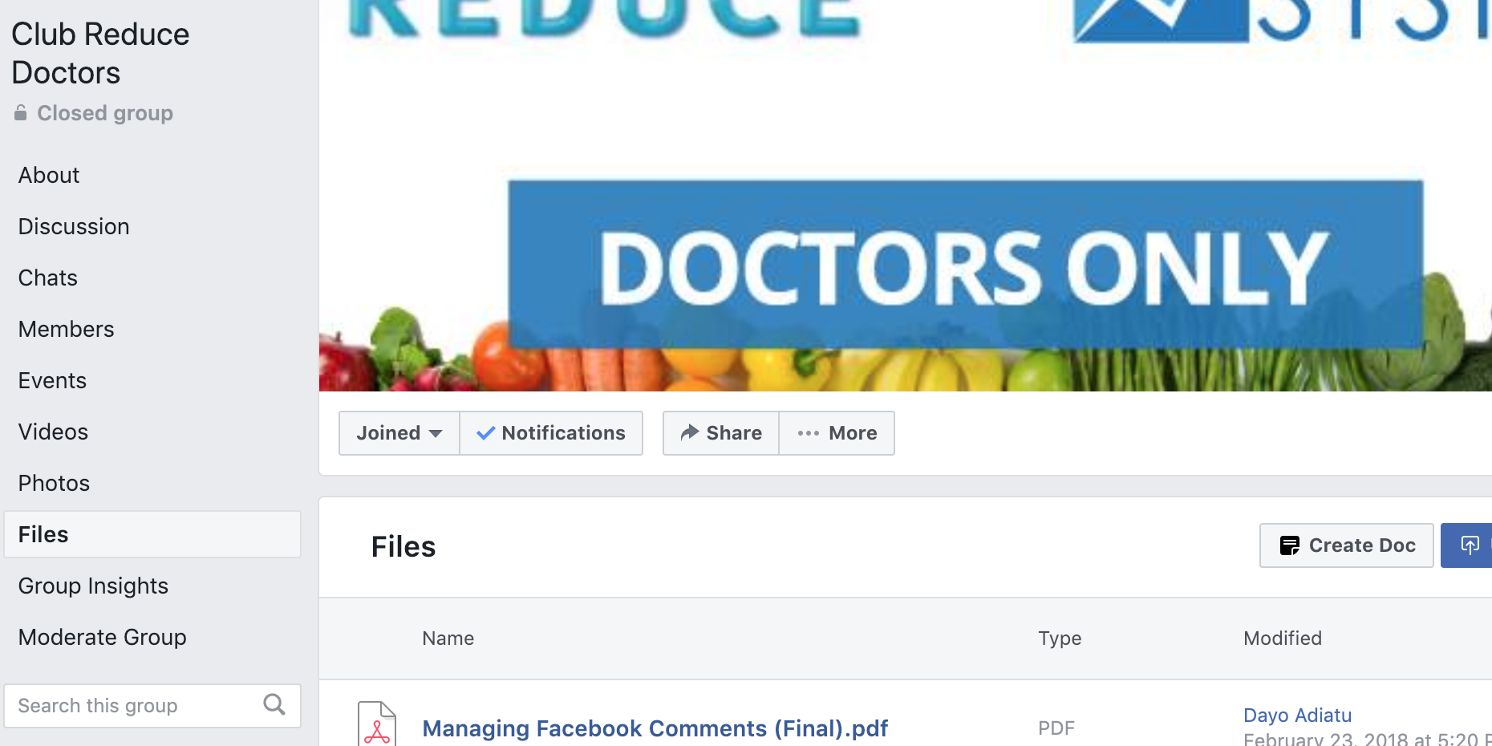
How To Create A Youtube Channel

Slide 8
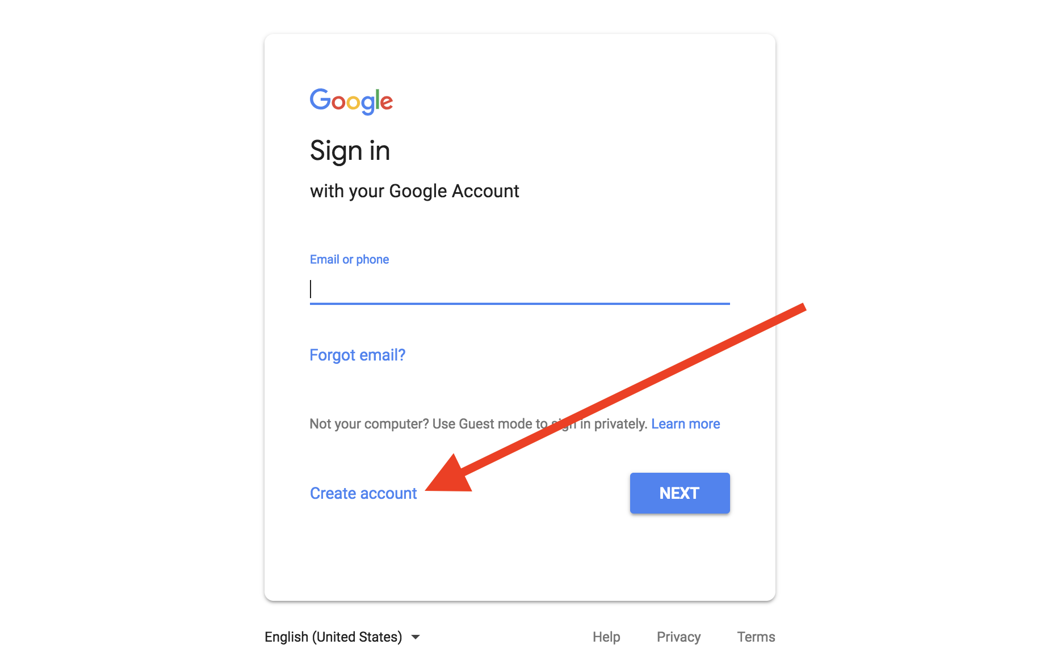
How To Create A Youtube Channel: Create A Google Account

Slide 9
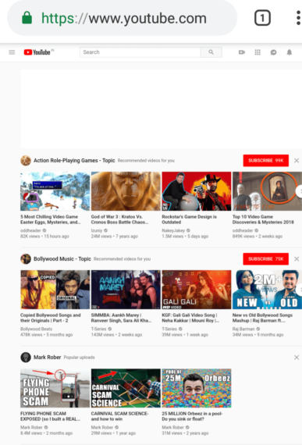
How To Create A Youtube Channel: Visit Youtube.com

Slide 10
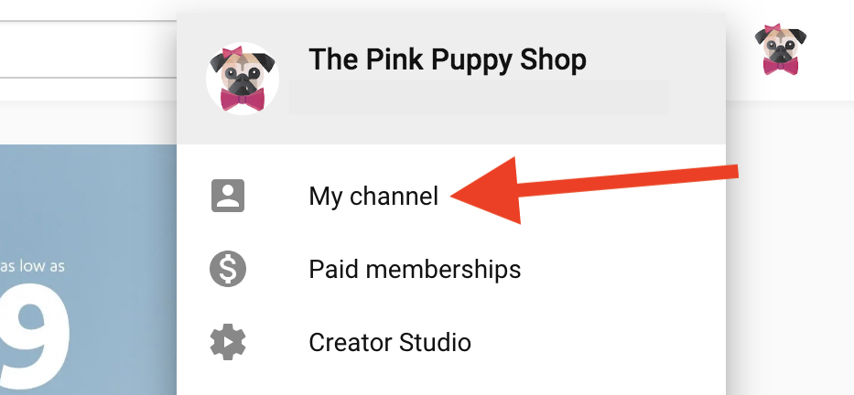
How To Create A Youtube Channel: Find Your Channel
Click on your personalized icon in the upper-right corner. If you do not yet have an icon set, it will show as the first letter of your username. Once you click on your channel icon, a drop-down menu will appear. Choose the option that says “my channel.”

Slide 11
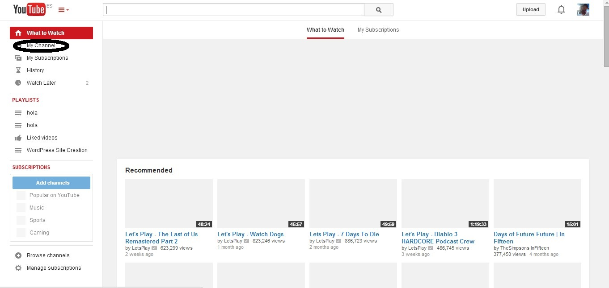
How To Create A Youtube Channel: Find Your Channel

Slide 12
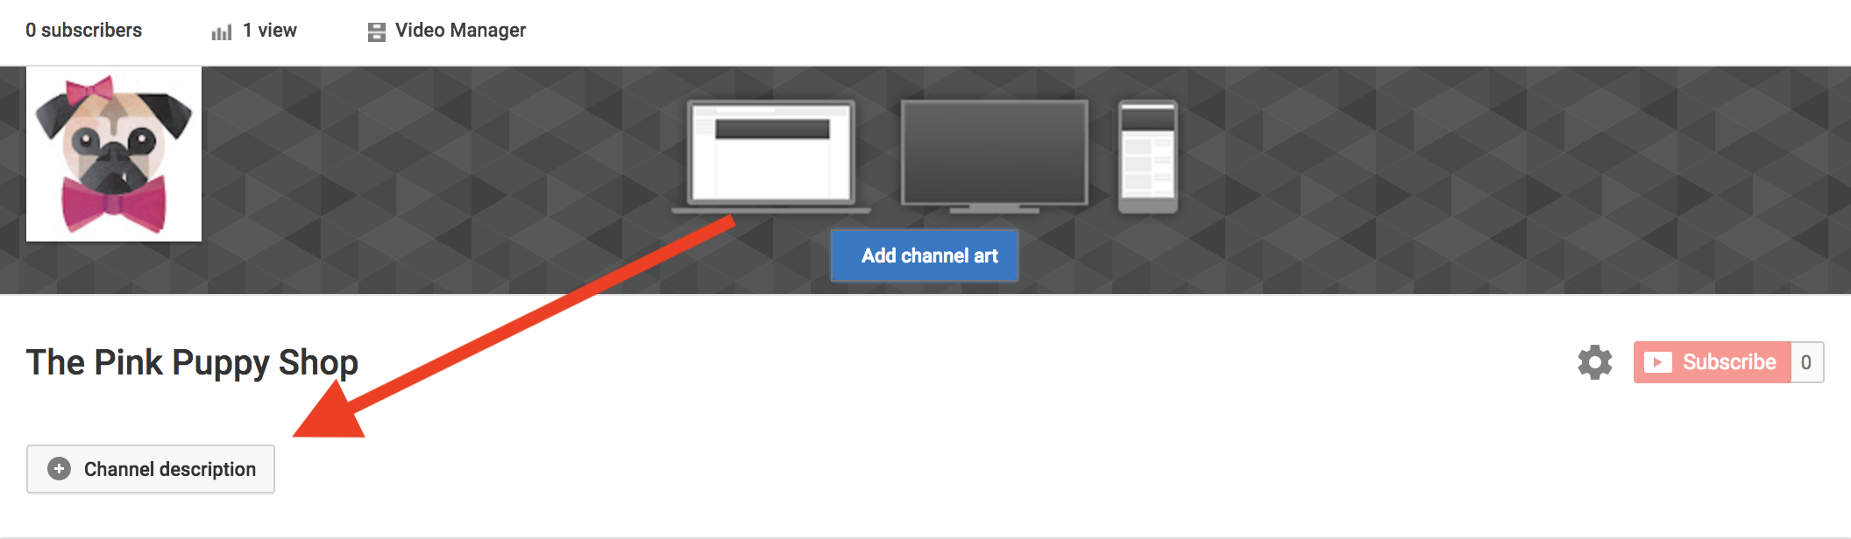
Customizing Your Youtube Channel: How To Create A Youtube Channel: Description

Slide 13
How To Create A Youtube Channel: Description
Similar to “About” page on your website
100-150 Words
Include Services
Include “Call To Action” (Phone Number, Website Link, etc)
Include Address

Slide 14

Customizing Your Youtube Channel: Add Channel Art

Slide 15
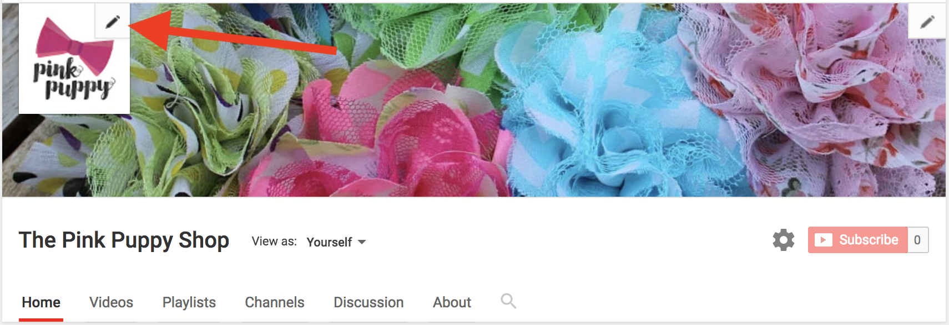
Customizing Your Youtube Channel: Update Icon

Slide 16
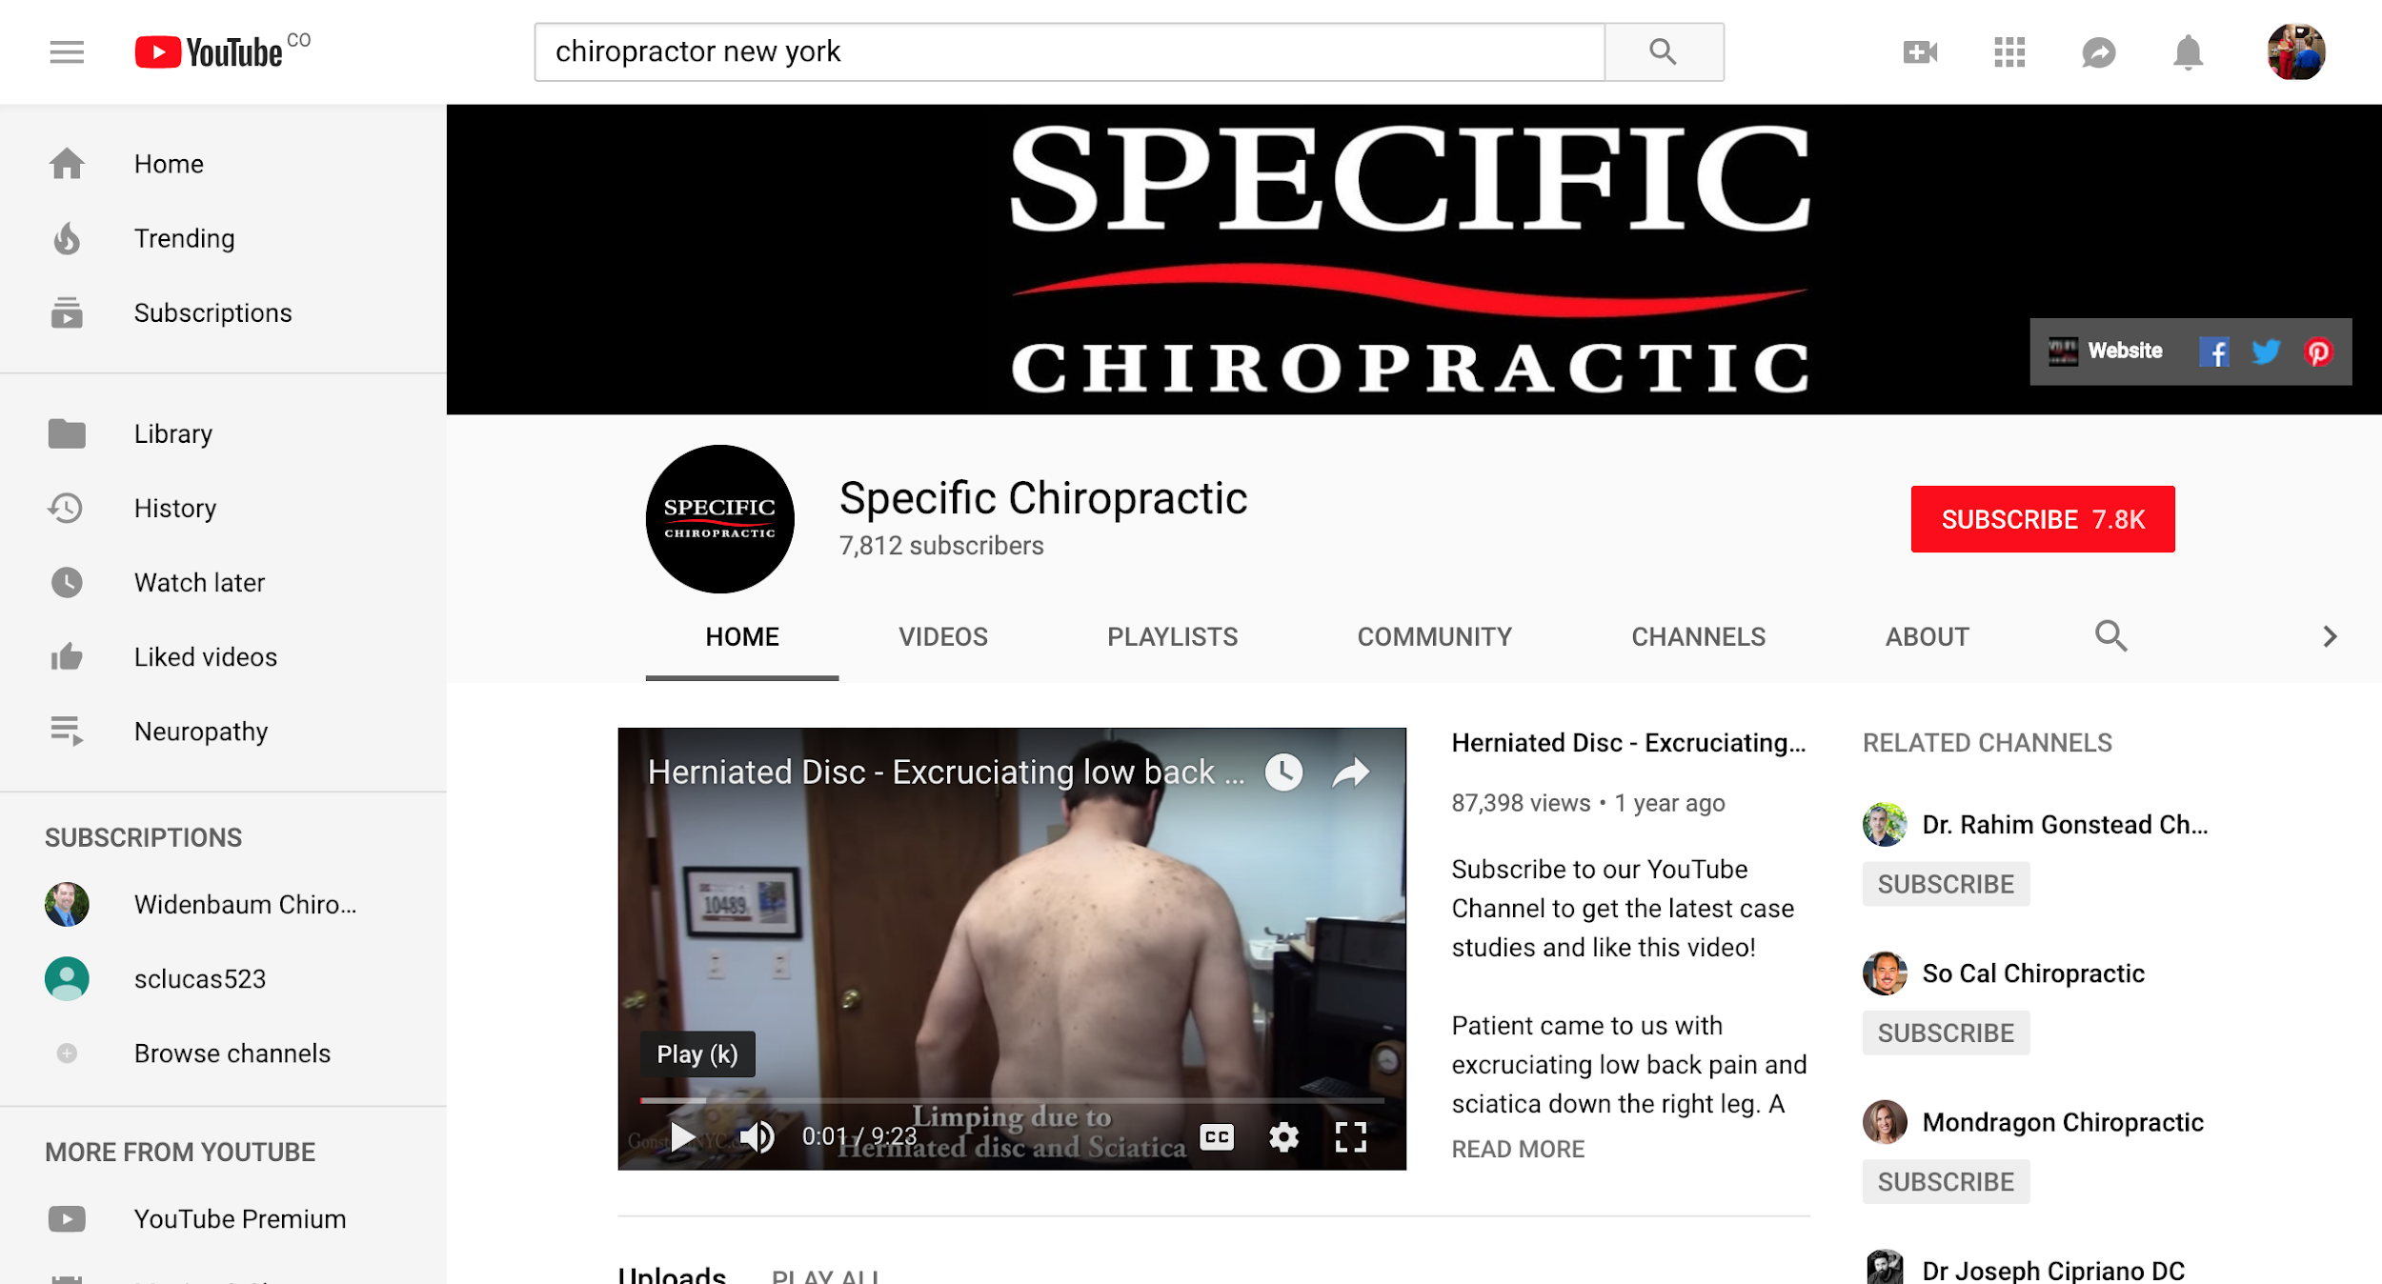

Slide 17
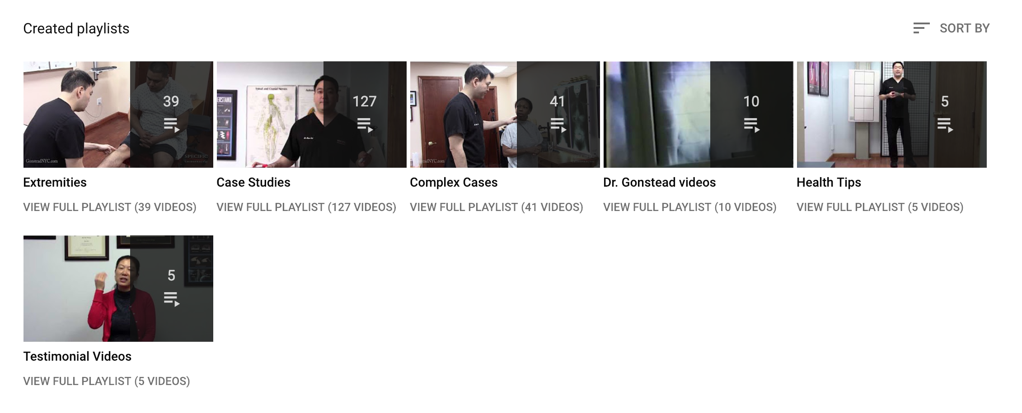

Slide 18
Choosing Content To Upload On Your Youtube Channel
Educational videos (Medical Conditions, Symptoms, Causes, Treatments, Preventative Tips)
Patient Testimonials
Demo Devices, Services, Techniques
Speaking Engagements
Clinic Tour
Product Explanation
Clinic FAQs

Slide 19
Recording Content To Upload On Your Youtube Channel
High Definition Camera or Smartphone
Sound Quality Is Most Important. Record in a quiet space, free from the hustle and bustle of the office (Consider investing in a lapel microphone)
Introduce Yourself
Include A Call To Action
Keep It Short (Less than 5 minutes)
Include Logo (to prevent theft)
Editing Software or Editing Partner (Intro, logo, video text)
(Fiverr, Upwork.com, IMovie, etc)

Slide 20
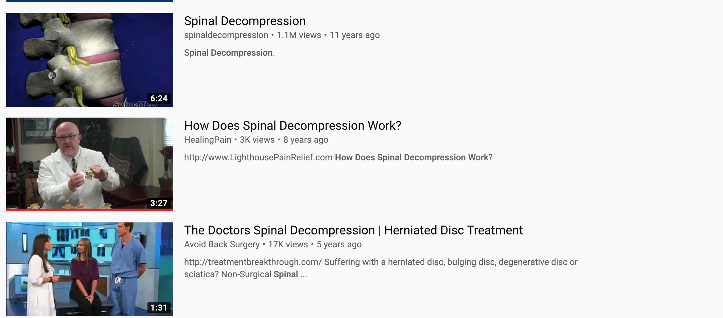
Optimize Your Video

Slide 21
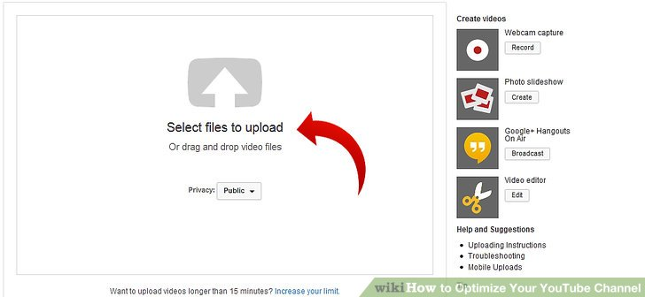
Customizing Your Video Upload So Patients Can Find You

Slide 22
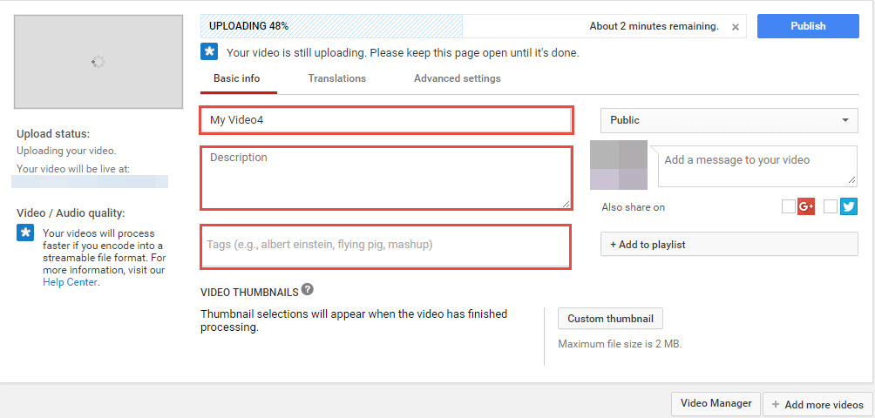
Customizing Your Youtube Channel
pload videos, edit video titles and descriptions, choose keywords

Slide 23
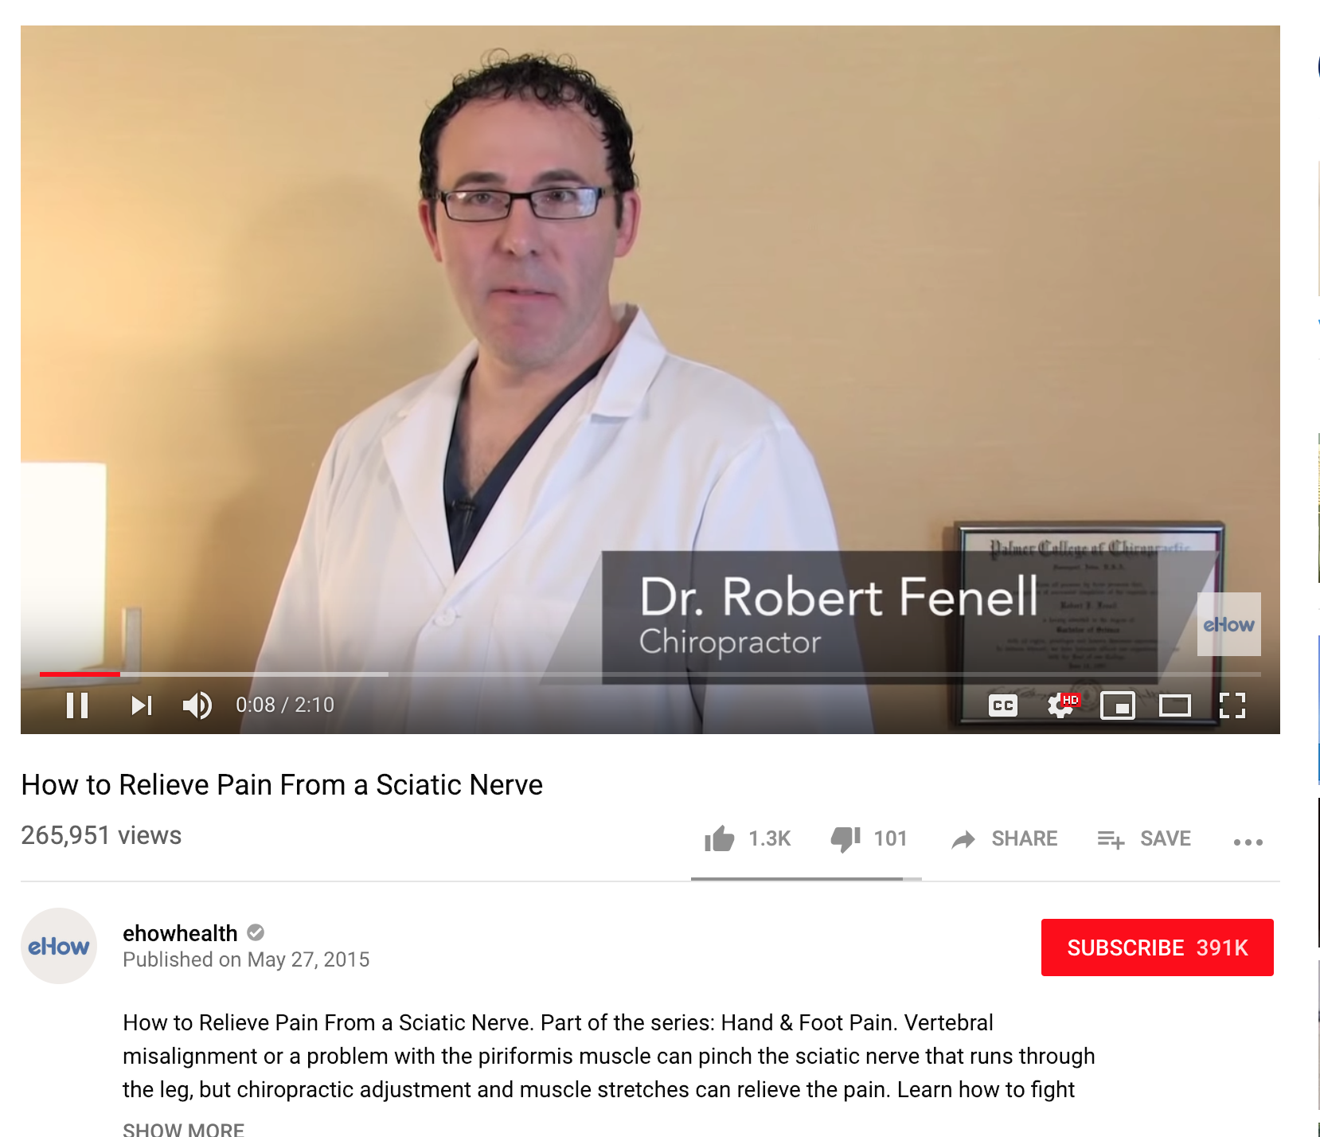
Customizing Your Video Upload So Patients Can Find You

Slide 24
Customizing Your Video: Title
Clear and concise
Consider “How To” or “How Do I” Answers
List
Testimonial Quote
Search Term

Slide 25
Customizing Your Video: Description
1,000 characters
Only first 2/3 lines of text show
Discuss what’s in the video
Include location and contact information
Include Links

Slide 26
Customizing Your Video: Tags
Use keywords & search terms
Terms can be long and short
Don’t use terms that are irrelevant

Slide 27
Customizing Your Video Upload
Consider Video Name
Include As Much Information In The Description As Possible
Add Keywords
Include Offer
Include Links
Bonus: Send to Landing Page

Slide 28
Getting The Most Out of Youtube
Comment w/ The Video Link on Ads
Share on other Platforms: Upload Youtube Videos Separately on Facebook, Instagram, Website
Upload Facebook Lives on Youtube
Link Youtube to Website & Include on Email Signatures
Utilize Playlists to Help Visitors Navigate Your Page
Create Featured Video
You can create as many channels as you like!

Slide 29
Video Tutorials & Links

Slide 30
Questions?
Go To Youtube!

Slide 31
Dayo LeadGen180.com
dayo@leadgen180.com

