Slide 1
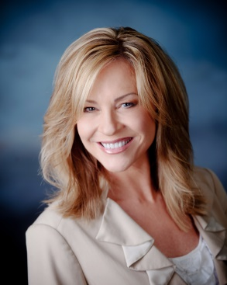
Learn How to Schedule and Host Successful Corporate Lunches
Shar Lewis Club Reduce Consultant Vice President of Marketing and Business Development

Slide 2


Hire or Identify the Right Staff Person
Just like your Telemarketer this person must have the following qualities to be successful:
Upbeat, fun, professional voice on phone
Passionate about your program and the corporate lunches
Ability to read script, make it their own, and be persuasive
Ability to follow directions and be self motivated
Professional in appearance and the way they represent your business in person
Motivated by money (bonus and incentives)
May be employee or Independent Contractor

Slide 3
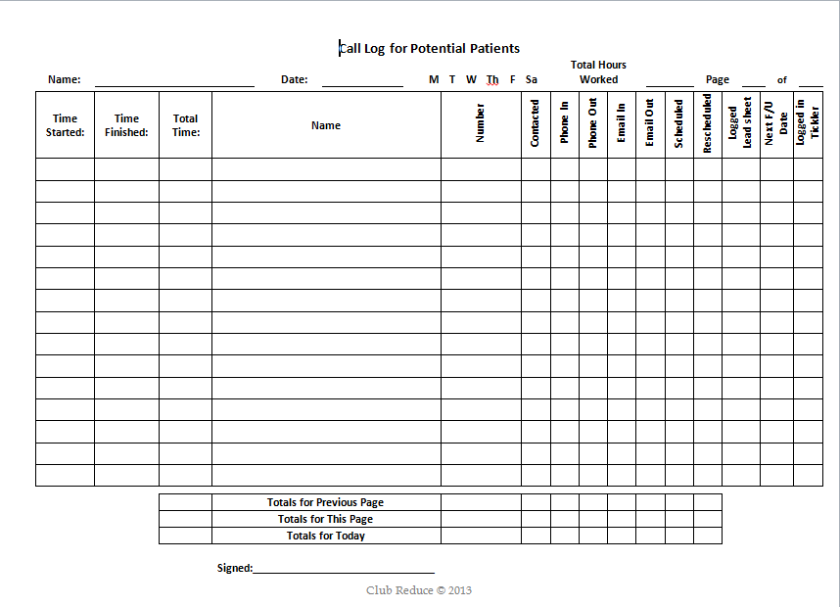
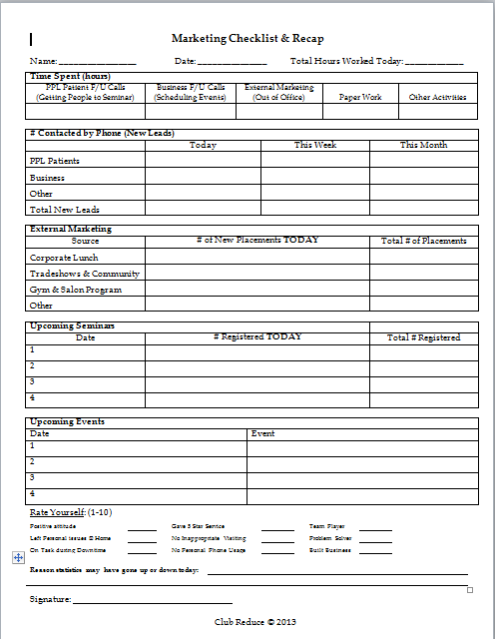
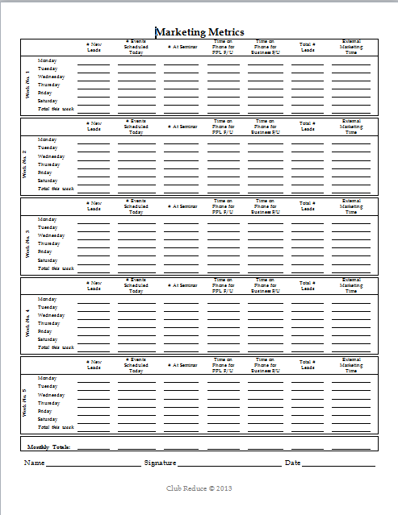
Manage Your Community Relations Coordinator & Track Leads
Manage your Community Relations Coordinator the same way you do your Telemarketer and track every lead.
Daily Call Log, Daily Checklist & Recap, Marketing Metrics REQUIRED to be completed daily (Found under Training, Staff Training, Marketing Director/Watch webinar titled “Skyrocket Your Business Through Setting Goals)
Daily email summary sent to Manager or Owner to include # Hours on phone, # Called, # Contacted, # Scheduled, # Performed, # Scheduled Evaluation
Must keep all leads in Marketing Tickler System and each lead must have its own PPL (Watch webinar titled “Boost Your Business with the Must Have Tickler System)

Slide 4

Set Goals!
It is important to set Goals and know how to achieve them to increase income.
Call 2-3 hours per day
Best time to call is between 8-11am
Should average 12-20 calls per hour depending on if they speak to someone
Schedule 1 Corporate Lunch per week
Register 15-25 people per luncheon
Schedule 10 from each luncheon for 1-1 evaluation
Have 5 show for 1-1 evaluation each week
Sell 3 who showed for evaluation a program with average price $3,500 = $10,500 revenue each week

Slide 5

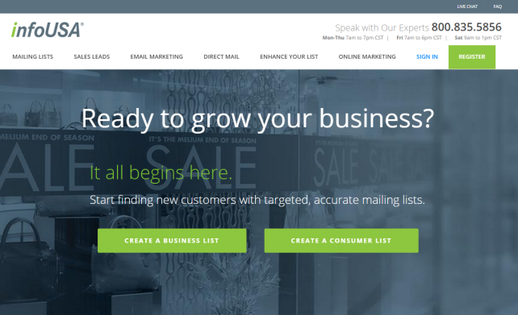
Get Started
Find or Purchase a list of businesses to call.
Purchase targeted list from InfoUsa.com
Chamber of Commerce
Local Library
Search by Demographic
Stay away from service industries and franchises
Businesses within 5-10 miles from clinic
Businesses with 10-100 employees (limit 25 per luncheon)
Majority of female employees

Slide 6

Choose Your Marketing Materials
There are two series for you to choose from depending on the capacity you have with staff to deliver.
Employee Appreciation (NEW! - With Landing Page)
Lunch and Learn (same as Corporate Lunch)
Employee Pampering Event
Employee Health Screening
Corporate Luncheons (NEW! Materials – Original Program)

Slide 7


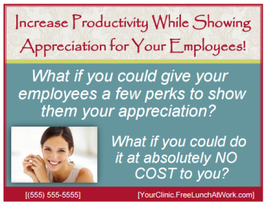
Employee Appreciation Series with Landing Page & 3 Options
Employee Appreciation LARGE POSTCARD to be mailed first followed by phone call
Employee Appreciation BROCHURE to be sent as attachment with email to provide additional information followed by phone call
Employee Appreciation SMALL POSTCARD to be sent after the brochure followed by a phone call

Slide 8

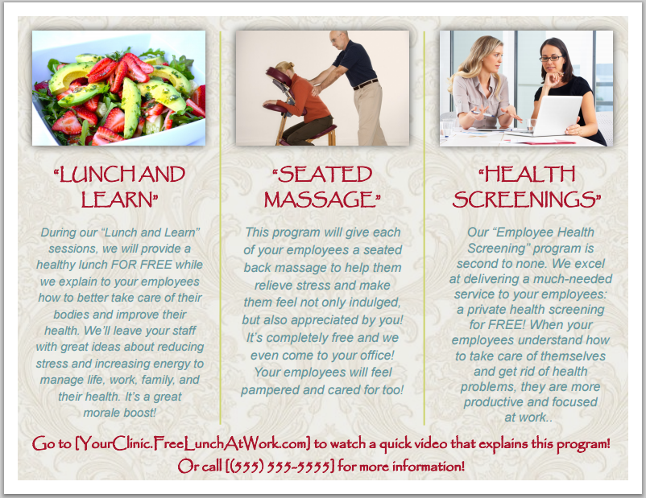
Employee Appreciation LARGE POSTCARD

Slide 9
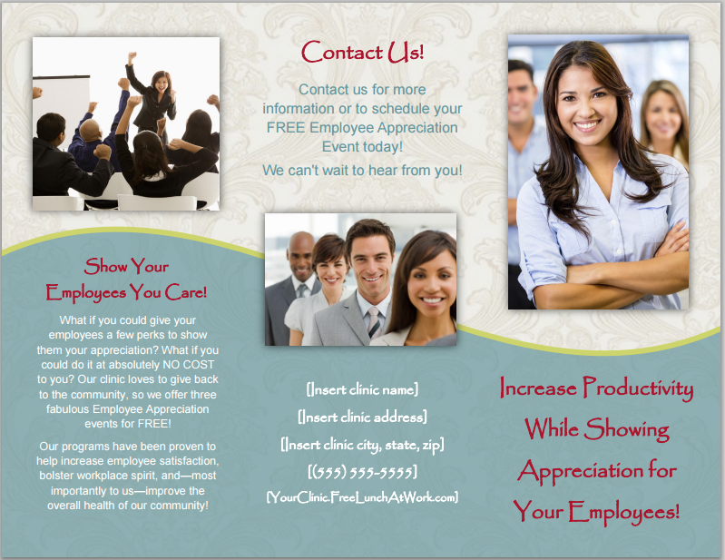
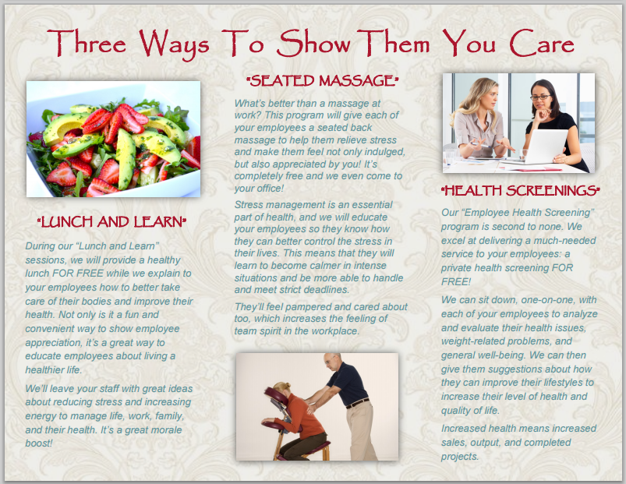
Employee Appreciation BROCHURE

Slide 10

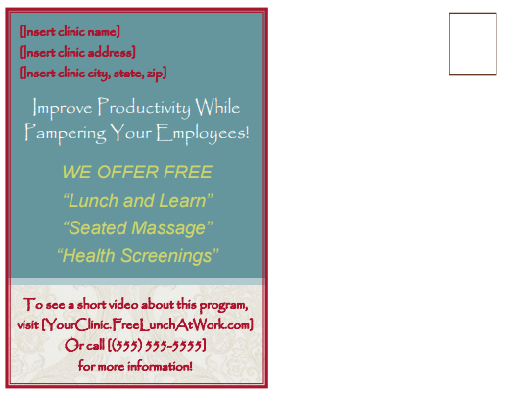
Employee Appreciation SMALL POSTCARD

Slide 11
Employee Appreciation LANDING PAGE
www.FreeLunchAtWork.com

Slide 12
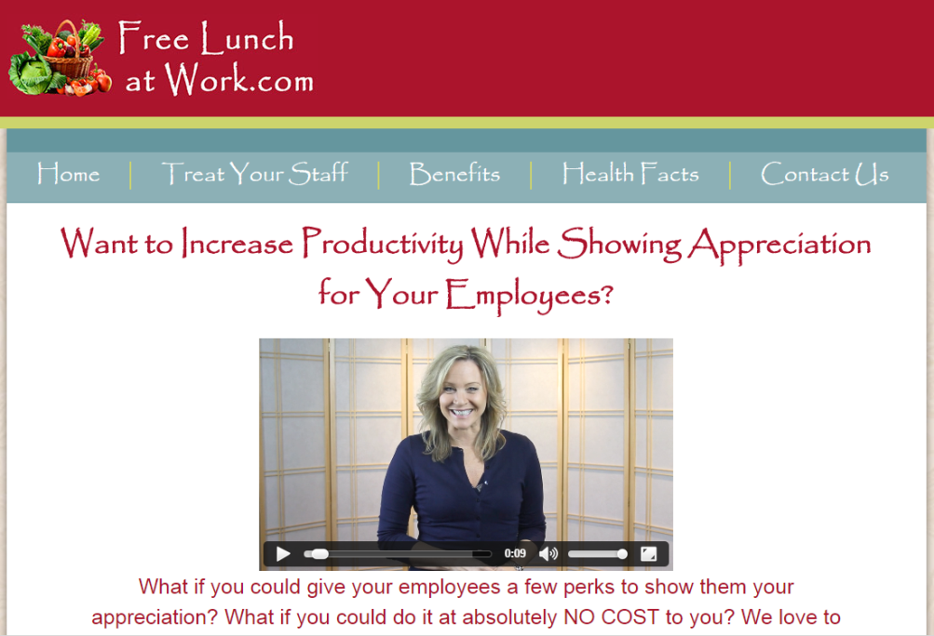
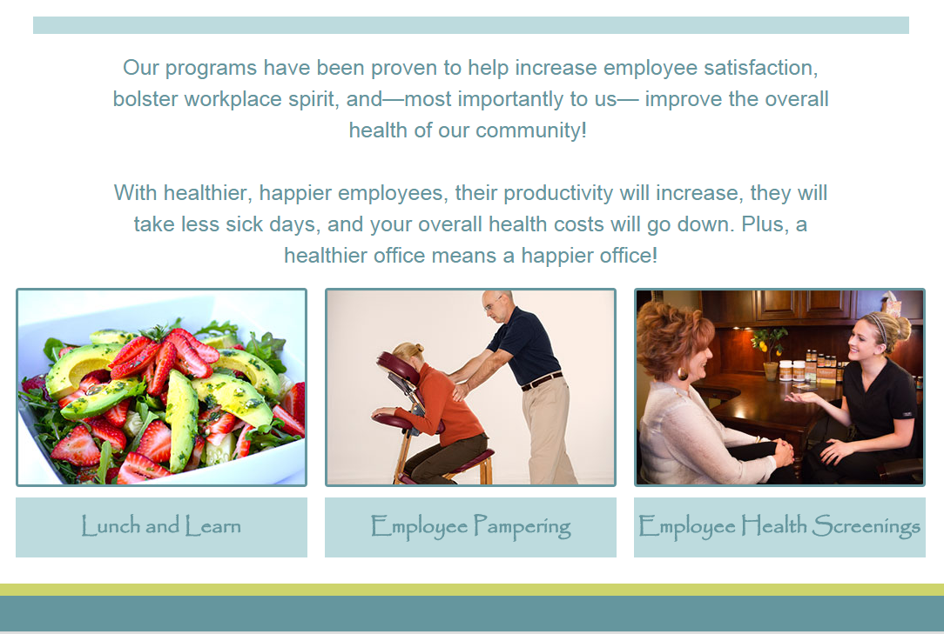
Employee Appreciation LANDING PAGE - Home

Slide 13
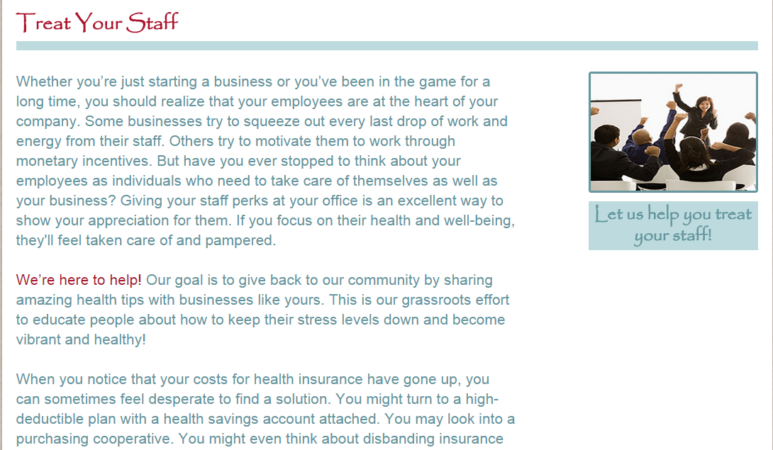
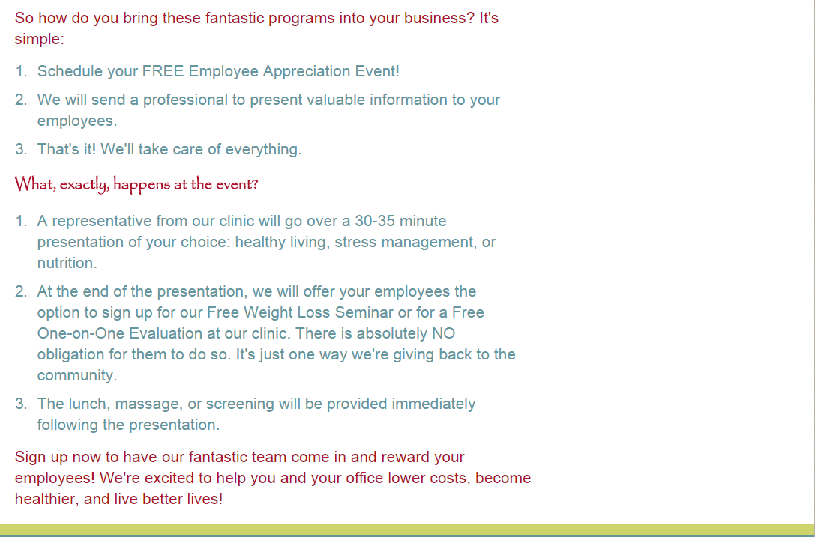
Employee Appreciation LANDING PAGE – Treat Yourself

Slide 14
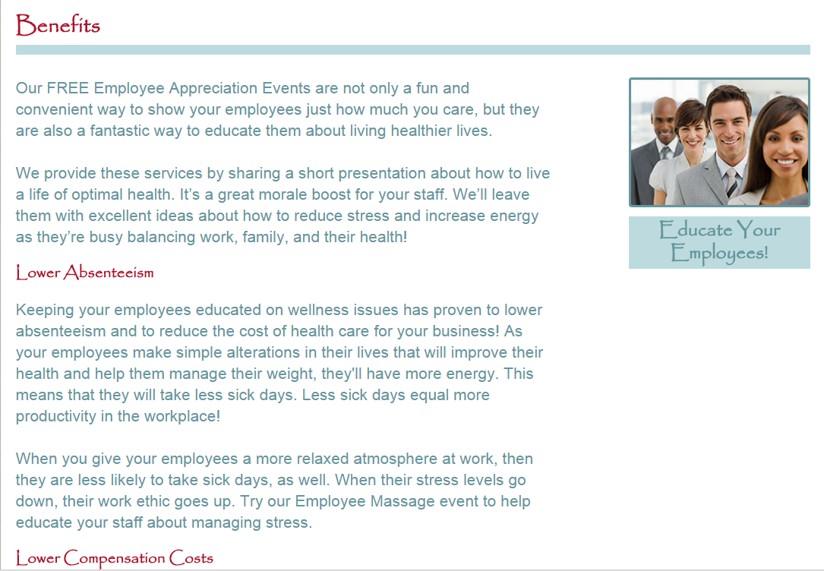
Employee Appreciation LANDING PAGE - Benefits

Slide 15
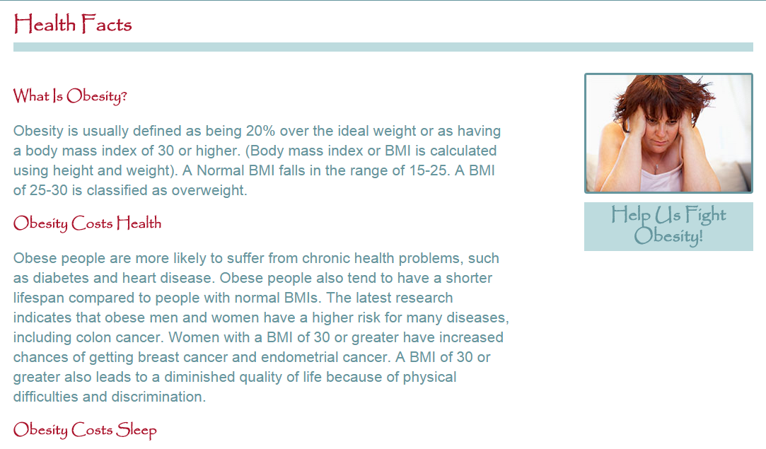
Employee Appreciation LANDING PAGE – Health Facts

Slide 16
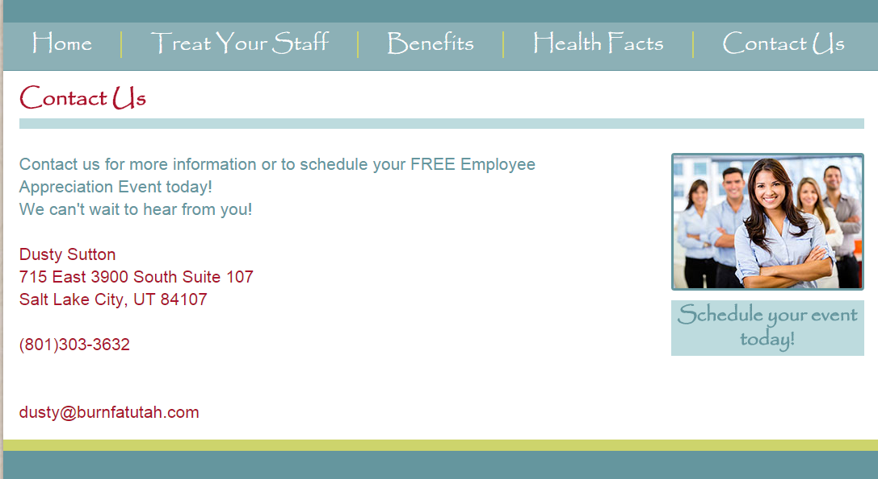
Employee Appreciation LANDING PAGE – Contact Us

Slide 17



Corporate Luncheon Series NEW! Materials – Original Program
Corporate Luncheon LARGE POSTCARD to be mailed first followed by phone call
Corporate Luncheon BROCHURE to be sent as attachment with email to provide additional information followed by phone call
Corporate Luncheon SMALL POSTCARD to be sent after the brochure followed by a phone call

Slide 18


Corporate Luncheon LARGE POSTCARD

Slide 19
Corporate Luncheon BROCHURE

Slide 20
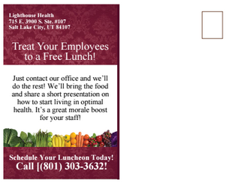
Corporate Luncheon SMALL POSTCARD

Slide 21
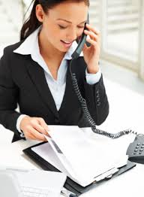
Make the Call Get past the Gatekeeper and Gather Contact Info on Decision Maker
Who do I need to speak with about bringing in a FREE LUNCH for your employees? (Get past the Gatekeeper & get the decision makers NAME)
Before you transfer me may I get their direct line in the event we get disconnected? (Get PHONE NUMBER)
In the event I need to leave a message, may I please get their email address so I may send them some information and they can decide if they would like to speak with me further? (Get EMAIL ADDRESS)

Slide 22
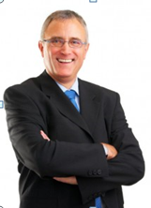
Make the Call Scripting when Speaking with Decision Maker
Hi, my name is __________, with __________________.
We are giving back to the community by providing employee appreciation events and free lunch to our neighbors.
If we could help you…Would you be interested?
Increase employee morale
Increase productivity
Decrease the number of sick days
Decrease workers compensation costs…
It’s a great way to show your employees how much you appreciate them and we bring the FREE LUNCH!

Slide 23
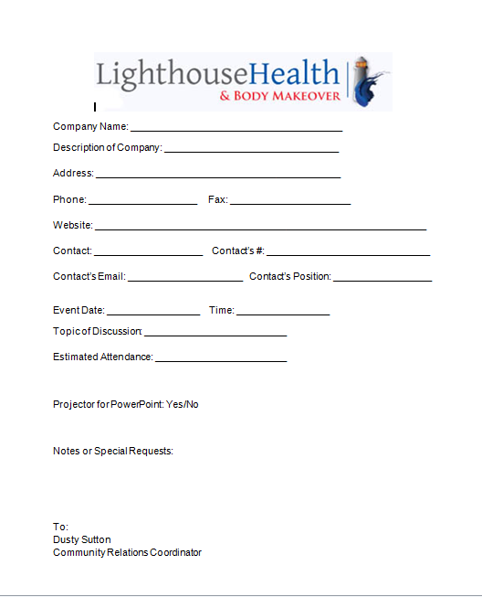
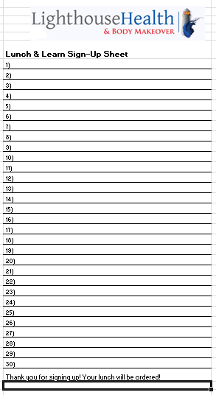
Schedule the Event & Register their Employees
Pick a day and time that is convenient for the employer when the majority of the staff will be available to come
If the staff work shifts, schedule several luncheons (or breakfasts) at different times on different days
Limit the number of people to 25 per event
Have the decision maker complete the CONFIRMATION FORM that holds their date
Have them complete the REGISTRATION FORM by having staff sign up to attend and place their order for lunch
The business may want to post flyers around the office and send emails to invite employees
Follow up 1 week before with reminder and to confirm technical needs
Follow up 2 days prior to confirm number of attendees and lunch orders
*Lunch should be boxed so is easy to order and hand out quickly.

Slide 24


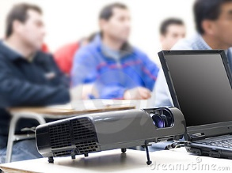
Prepare for the Event
Order boxed lunches the day before the luncheon event
Prepare the Seminar Folders to hand out at the luncheon event (Same as Seminar Folders at Clinic)
Registration Form – to be completed before they get folder
Welcome & Cover Sheet
10 Reasons You Are Not Losing Weight
Inch Loss & Body Wrap Flyer
Services Brochure
$100 Off Certificate
For purposes of time we do not use the Toxicity Quiz at luncheons
Prepare poster board with dates and times of available 1-1 evaluations with doctor or health specialist (2 stickers each appointment)
Seminar PowerPoint on computer and backup on thumb drive
Pack up computer, projector, cords, and remote

Slide 25

The Event
Arrive 30-45 minutes early to set up
Do not put food out where they can get it – They must wait until after the presentation
You must be respectful of their 1 hour time limit so they are in and out in one hour
5 minutes to arrive and check in
30-35 minute presentation
20 minutes to schedule 1-1 evaluation, answer questions, get their lunch and eat it or take it back to desk with them
Clean up and leave the room cleaner than when you arrived
Say Thank You to organizer and give him/her a small gift with Thank You Card

Slide 26

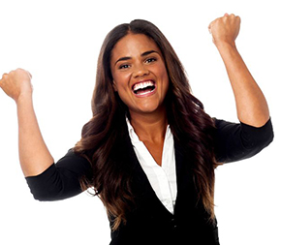
Make the Close
Be sure to CLOSE after the presentation the same way you do at your seminar/class held in your clinic
Open your folder and pull out the $100 certificate (of FREE if that is your offer)
Have each attendee fill out the certificate
Tell them to go see (name of marketing person) and pick the day and time they want to meet with you (doctor or health specialist)
Marketing person will take one sticker and place it on their Seminar Folder as a reminder and will put the other one on the certificate to take back to the clinic to use to schedule in Club Reduce and on scheduler
Offer FREE BODY CONTOURING PACKAGE to the first 5 people to the back of the room to schedule 1-1 evaluation

Slide 27


Input into Club Reduce and Work every lead until they Show
Be sure to put every scheduled appointment on your scheduler
Be sure to put every scheduled appointment into Club Reduce with contact information from both the REGISTRATION FORM and the $100 off certificate
Call all appointments the night before to confirm and send a follow up reminder text the morning of
Continue to work the lead in the SALES TICKLER BOOK until they show for 1-1 evaluation and purchase program
Remember…A lead never dies until they literally die or become your patient!

Slide 28

They Will LOVE You!
Have fun and build relationships and rapport
Be sure to send a thank you card the next day to the decision maker and/or luncheon organizer
Be sure to schedule another luncheon 6 months out and be a recurring presenter for their staff 1-2 times a year

Slide 29

Three additional Success Strategies to Grow your Business
NEW SUCCESS CHECKLIST
NEW MARKETING QUICKSTART GUIDE
HIRE ME to come to your clinic to provide personal, one-on-one COACHING and CONSULTING

Slide 30



I Can Help You!
Personal
training and coaching
at your clinic
for you and your staff
specific to your needs
and goals

Slide 31

Sign Up Today!
Train your staff NOW to take advantage of the Spring and Summer weight loss frenzy and have help with implementing the latest and greatest Club Reduce 4.0!
www.ClubReduceConsulting.com
801.917.0900

Slide 32

Thank You!

