Slide 1
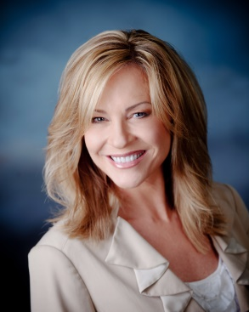
Nurture Patient Relationships
Using Club Reduce Newsletters
Shar Lewis
Club Reduce Consultant
Vice President of Business Development

Slide 2

What We’ll Cover in Today’s Webinar
Top 10 reasons WHY you should be sending a monthly patient newsletter.
20 shocking direct mail STATS proving its value as an effective marketing strategy.
COST-EFFECTIVE and DONE-FOR-YOU: You can’t afford to NOT do it.
Full size, color newsletter or NEW POSTCARD OPTION.
Your JULY Newsletter Rundown.

Slide 3
People don’t buy from you because you sell. They buy because they trust you, are loyal to you, and are fans of your business!

Slide 4
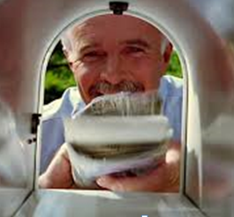
Top 10 Reasons WHY you Should Send Monthly Newsletters
POSITIONS YOU as somebody who doesn’t just fix things but can make a positive impact in their lives.
INFORMS your clients of happenings at your clinic.
INSPIRES your clients to stay motivated and succeed with their health and weight loss goals.
EDUCATES your clients on good health and nutrition to simplify their new lifestyle change.
INCREASES SALES of additional products and services bringing you ongoing monthly income.
ENCOURAGES REFERRALS of friends, family and business associates as new patients and new income.
ENHANCES REPUTATION of your clinic in the community making you the go-to authority.
PROMOTES INTERACTION and dialog with your clients keeping them patients for life.
COST-EFFECTIVE COMMUNICATION with your clients.
IT’S EASY! - WE DO ALL THE WORK FOR YOU!

Slide 5
There is a perception that online marketing has replaced offline marketing, yet direct mail continues to effectively engage customers and plays a valuable role in the overall marketing mix creating the much needed one-to-one interaction customers desire!

Slide 6
20 Shocking Direct Mail Stats
50%
of people say they pay more attention to direct mail than any other media.
70%
of Americans have declared their preference for paper-based media in a digital world stating they prefer to read print and paper over reading off a screen.
65%
of people who receive direct mail have made a purchase.

Slide 7
20 Shocking Direct Mail Stats
73%
of US Consumers said that they prefer direct mail because they can read the information at their convenience.
61%
of Americans said that they prefer direct mail because they can refer back to the information when needed.
40%
of Americans prefer direct mail because they can take the information easily to other places.

Slide 8
20 Shocking Direct Mail Stats
72%
of US respondents said they look forward to what’s in the mailbox.
79%
of consumers will act on direct mail IMMEDIATELY compared to only 45% who say they deal with email straightway.
56%
of consumers think printed marketing is the most trustworthy of all communication channels.

Slide 9
20 Shocking Direct Mail Stats
75%
of consumers say they are examining their mail more closely in recent months to search for coupons and discounts.
70%
of consumers have renewed relationships with businesses that they had previously used.
34%
Direct mail has the highest rate of success in new customer acquisition at 34% compared with other marketing channels.

Slide 10
20 Shocking Direct Mail Stats
68%
of consumers read their mail as soon as they receive it
87%
of consumers read mail that is personally addressed to them.
68%
of consumers that receive direct mail offers would recommend to a friend.

Slide 11
20 Shocking Direct Mail Stats
!
Direct mail is the preferred channel for receiving marketing from local businesses.
!
Direct mail – yes, snail mail – still reigns supreme.
!
Greater emotional processing is facilitated by the physical material rather than the virtual.
!
Women prefer direct mail over men.

Slide 12
A newsletter is a cost-effective medium for building relationships and maintaining regular contact with customers
and prospects.
Research firm Nielsen Norman Group asked respondents how they preferred to receive company updates, and 90 percent cited newsletters.

Slide 13
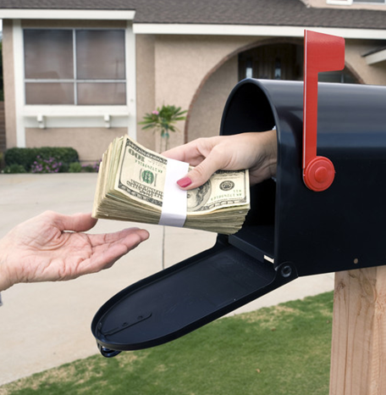
Cost Effective and Done-for-You
You Can’t Afford to NOT do it!
To do a monthly newsletter yourself would cost on average $750 to $2500 per issue/month.
$75 hour for content writer (some charge per word, some charge per hour)
$75 hour for graphic designer (conservative, most are much higher)
Approximately 10-30 hours per issue (depends on size, scale and template)
This is INCLUDED in your monthly Club Reduce membership and is completely customizable.
We have one template for weight loss and one for pain patients.
Written to promote your clinic services, supplements, success stories and recipes.
Must be consistent and sent out monthly to be successful.
It is absolutely worth the cost of postage and will come back to you in increased sales, repeat business and referrals keeping your patients for life.

Slide 14
Put a fence around your herd by communicating monthly with your current patients and potential leads.
Our newsletters are strategic and thoughtfully planned.

Slide 15

Full Size Newsletter Features
Educational Articles
Inspirational Success Stories
Featured Product of the Month
Ask the Doctor Feature
Did you Know Segment
Healthy Tip
Skinny Contest
Monthly Promotion
Recipes
Featured Services and Promotions
Clinic Events and Calendar
Find the Lemon and Win a Prize
Sodoku Fun

Slide 16
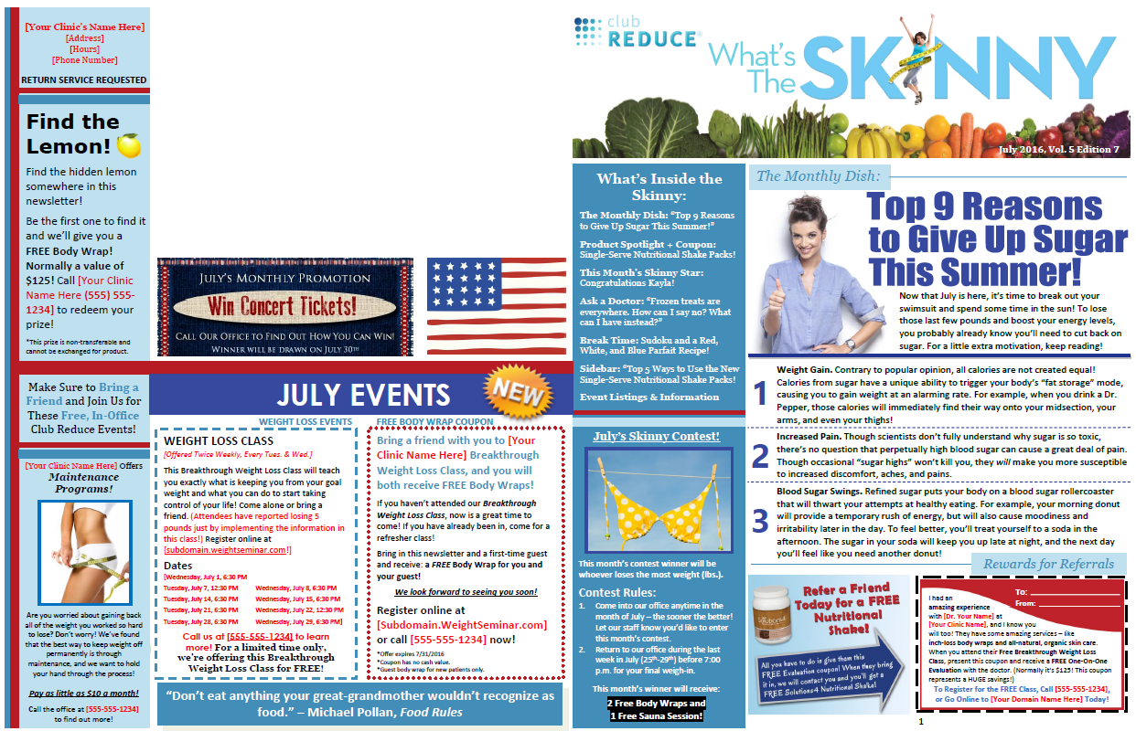
What’s the Skinny - Front

Slide 17
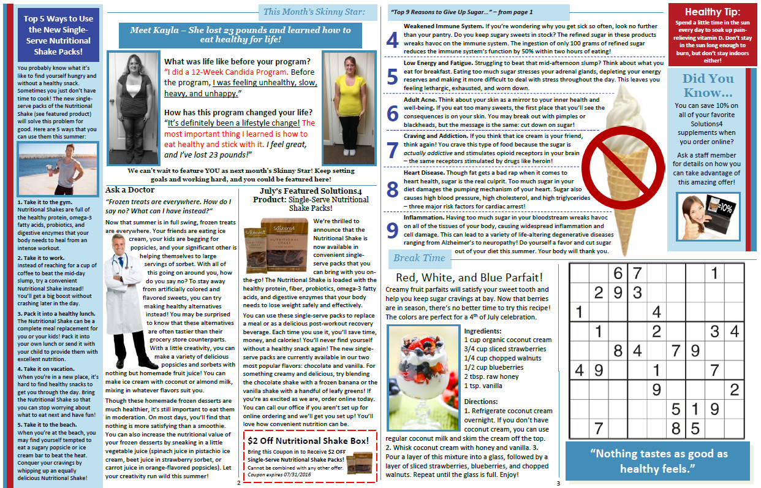
What’s the Skinny - Back

Slide 18
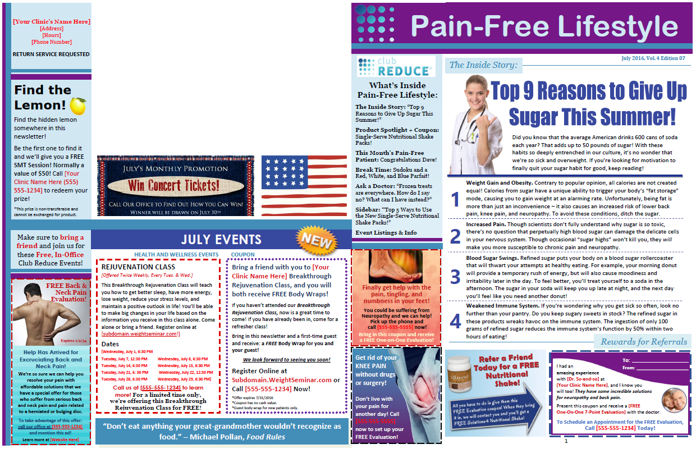
Pain Free Lifestyle - Front

Slide 19
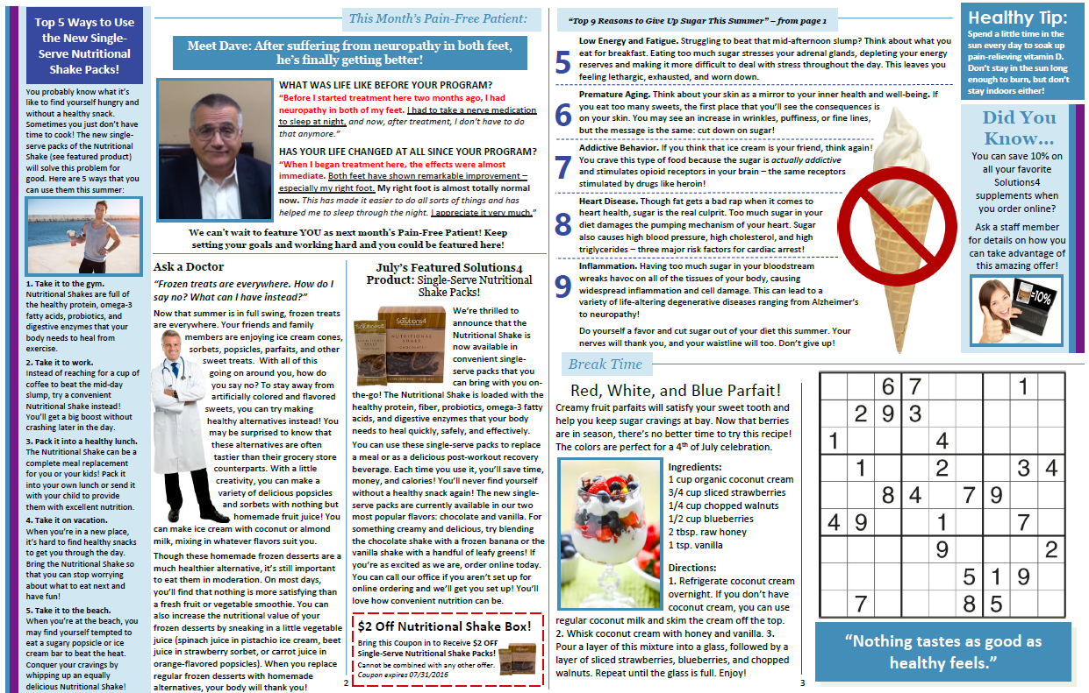
Pain Free Lifestyle - Back

Slide 20
Drum Roll Please….
Introducing the
NEW NEWSLETTER POSTCARD
Making your mailings even more cost effective!
No more excuses!

Slide 21
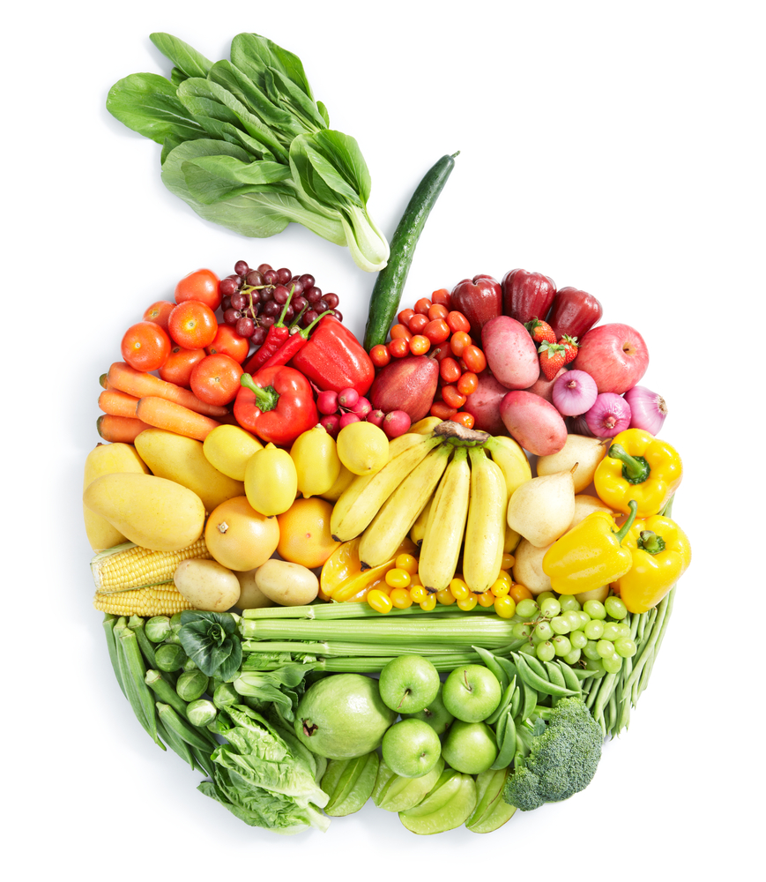
Postcard Newsletter Features
Inspirational Patient Spotlight
Featured Product of the Month
Nutrition Corner with food education and recipes
Promotional Offer or discount

Slide 22
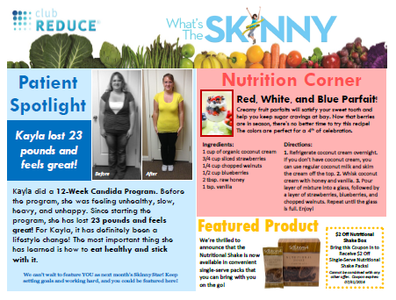
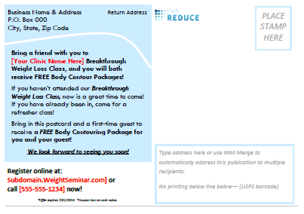
What’s the Skinny POSTCARD
This layout is specific for BULK MAILINGS. Please check with the post office for specifics on placement of address label BEFORE printing and mailing. They have DETAILED GUIDELINES.

Slide 23
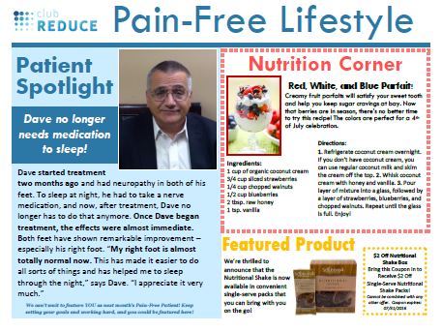
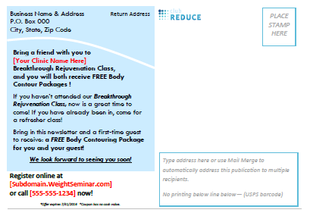
Pain Free Lifestyle POSTCARD

Slide 24

Your NEWSLETTER Take-A-Ways
A patient newsletter can be your strongest marketing and business building tool.
It is one of the best tools to keep your customers coming back to you over and over again.
It creates top of mind awareness so when they think of weight loss, diet, health and nutrition…they think of you!
People purchase from businesses they know, trust and are top of mind.
When they or someone they know need your services they will call you!

Slide 25
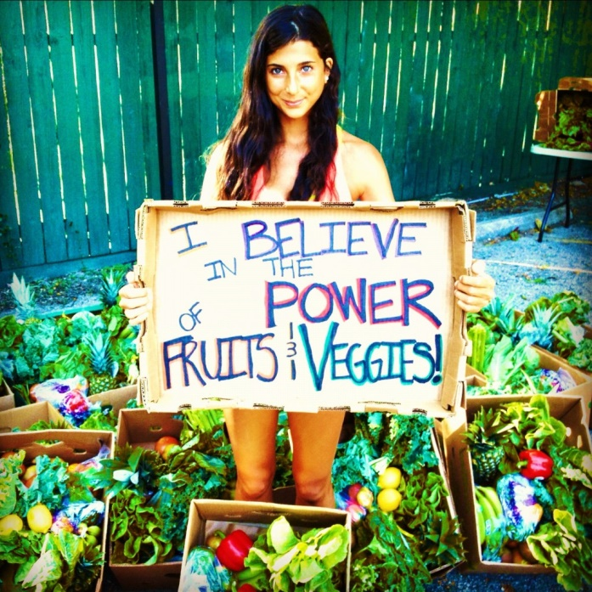
Remember to… Practice What You Preach

Slide 26

Love your Patients to Health and Make them Patients for Life!

Slide 27
Your JULY Newsletter
Rundown

Slide 32

Thank You!

