Slide 1
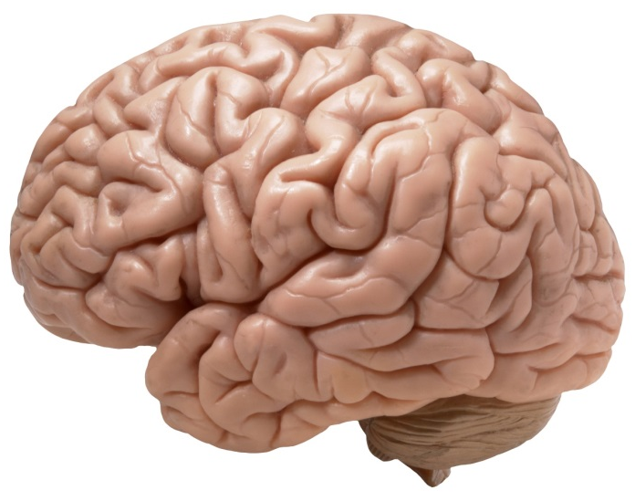
Hacked, Hooked, and Hijacked -The Importance of the Gut Brain Connection-
With Dr. Todd Singleton

Slide 2

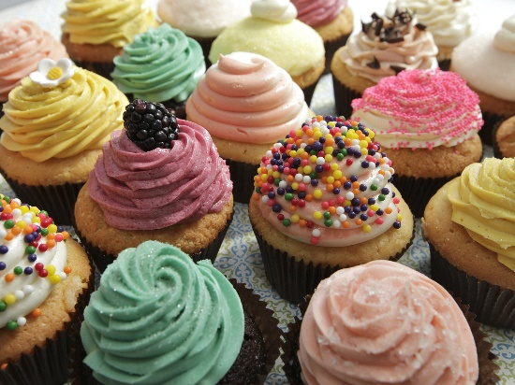

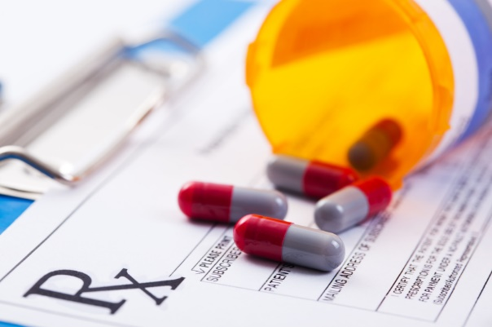
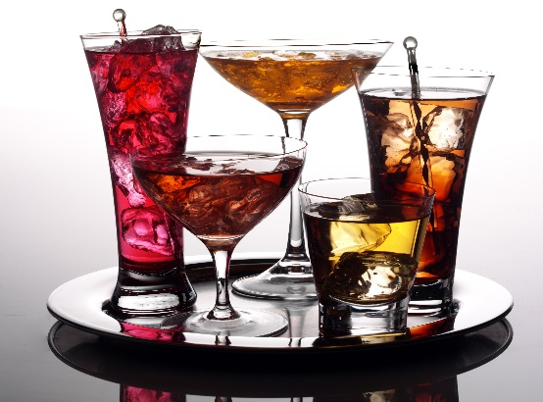

We Live an Addictive Lifestyle, and We Don’t Even Know It

Slide 3

Addictive Behaviors That Happen Throughout the Day…
Any questions about this?
Just give up one of these behaviors and see how it feels.
False fixes like eating help for a short period of time, then boomerang back in our face.

Slide 4
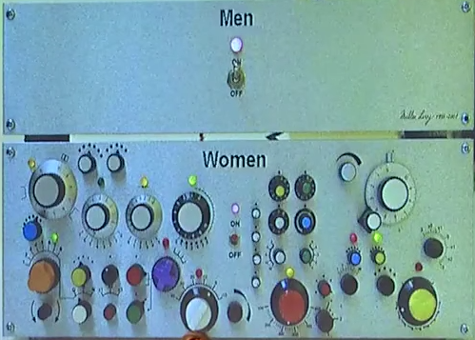
Let’s go on a journey from the brain, mouth, and gut…
This is highly scientific.

Slide 5
Differences in the Brain
Men: You’re either “on” or “off.”
Women have many knobs because they work out of two hemispheres and have more
connections
between both sides.
This makes them
better multitaskers.

Slide 6
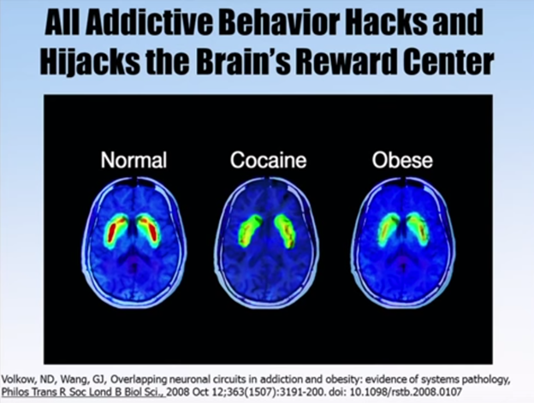
Addictive Behaviors
You Aren’t Even Aware of…
Red/orange is the reward center of the brain. It lights up when dopamine neurotransmitters link up with dopamine receptors.
The same centers in the brain light up with substance abuse (whether with food or with drugs).
This is reversible. We have all the answers.

Slide 7
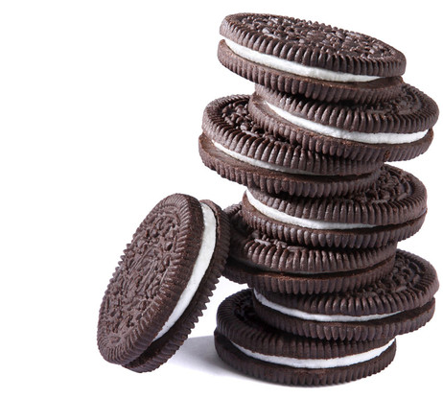
Sugar Is More Addictive Than Cocaine
Study on Oreos in rats:
One group injected with morphine.
One group injected with cocaine.
One group offered an Oreo.
Researchers then measured the pleasure center of the brain. The rats that had eaten Oreos had more activity in this region than those injected with cocaine or morphine. Also, rats given Oreos went straight for the cream filling!

Slide 8
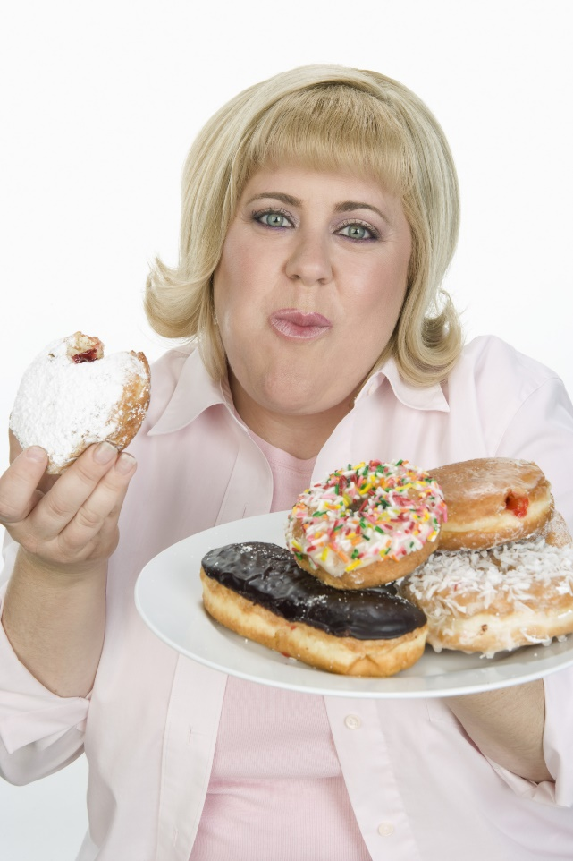
The Gut and the Mind are Intertwined
Problem: When our brain is addicted, we want to put something in our mouth that will give us pleasure. We chew quickly, swallow, and go straight for another bite.
The gut is the catch-all for what we mentally desire. It changes our physiological state. If we can’t control it, we may become someone that we (and other people) hate.

Slide 9
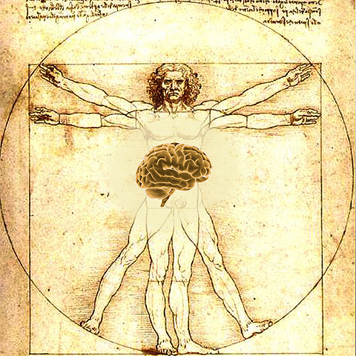
The Thoughtful Bowel
We now know that there is a brain in the bowel.
The gut is more intellectual than the heart and may have a greater capacity for “feeling.”
It is the only organ that contains an intrinsic nervous system that is able to mediate reflexes in the complete absence of input from the brain or spinal cord.

Slide 10
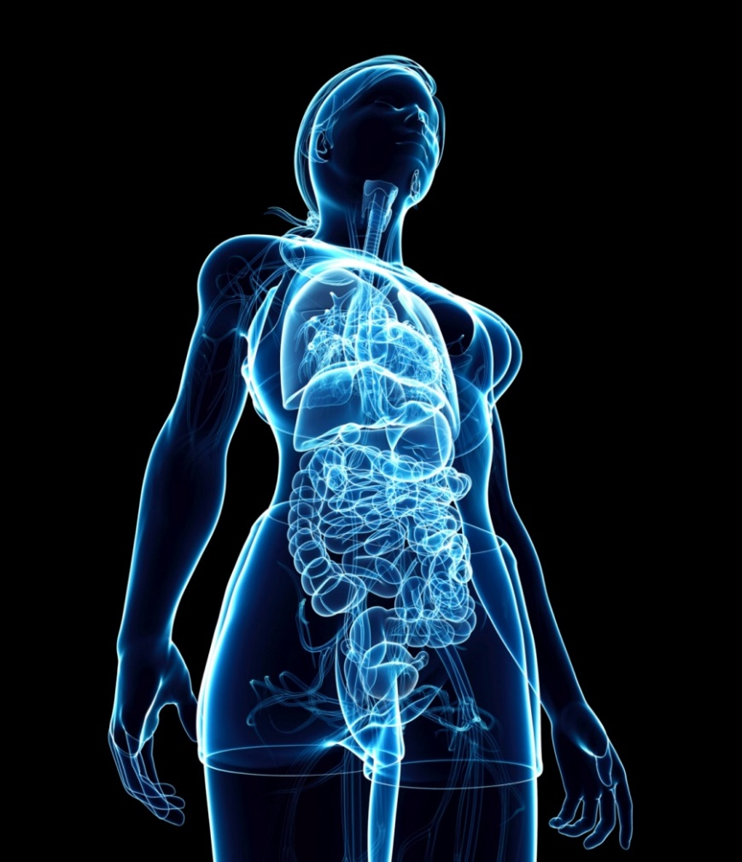
Enteric Nervous System (ENS)
ENS is one of the main divisions of the nervous system of neurons that governs the function of the gastrointestinal system. It is now referred to as separate from the autonomic nervous system since it has its own independent reflex activity.

Slide 11
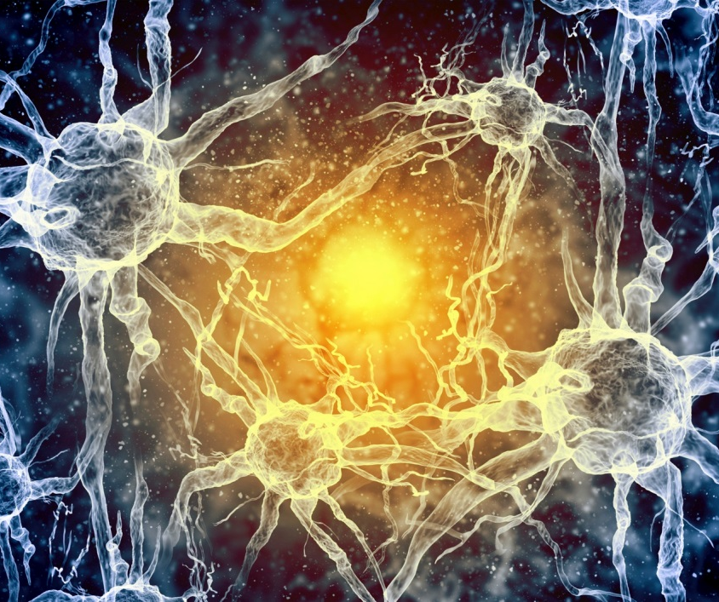
Enteric Nervous System (ENS)
ENS consists of 500 million neurons.
1/200th of the neurons in the brain
5x as many as the 100 million neurons in the spinal cord
More neurons in the gut than the entire peripheral (NS)

Slide 12

It is reasonable to ask why anyone should care that we all have a second brain. The answer, of course, is that we should care about our second brain for the same reasons we care about our first.

Slide 13

Gut Health Effects
The brain can affect the behavior of the bowel.
The gut can also manage to get along without hearing from the brain.
The brain in the bowel has got to work right or no one will have the luxury to think at all.
No one thinks straight when his mind is focused on the toilet and having pains that no one can solve.

Slide 14
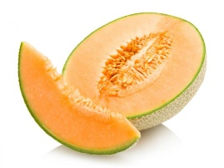
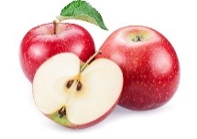
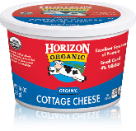
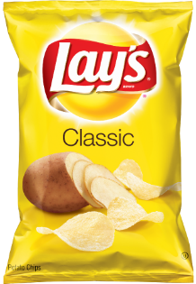
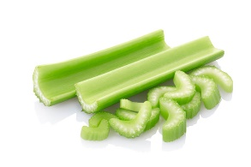
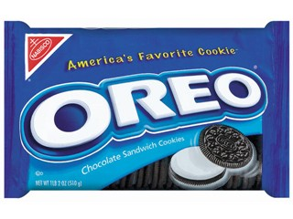
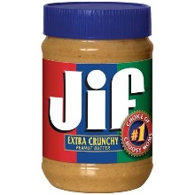
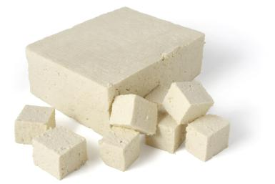
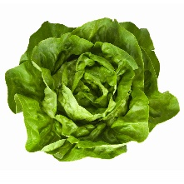
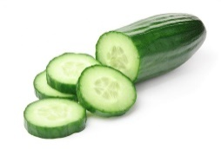
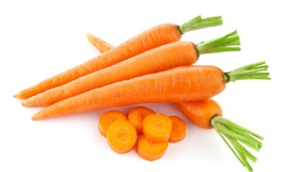
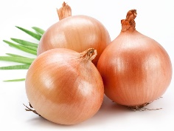
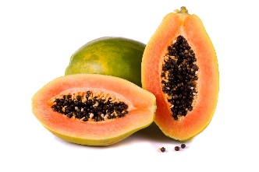
What’s Working Against You Calorie Consumption
1 lb. Lay’s
Potato Chips
1 lb.
Peanut
Butter
2 lbs. Cantaloupe
1 lb. Apples
1 lb. Oreos
1 lb. Cottage Cheese
2 lbs. Celery
1 lb. Tofu
1 lb. Lettuce
2 lbs. Cucumbers
1 lb. Carrots
1 lb. Onions
2650 calories
1 lb. Papaya
2200 calories
2400 calories
2225 calories

Slide 15
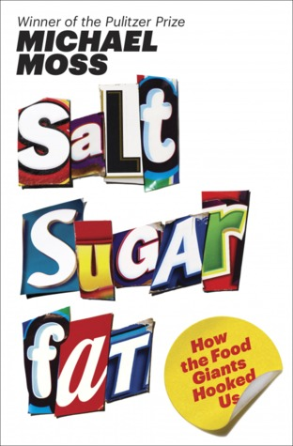
The Wisdom of Michael Moss
Food scientists calculate the “bliss point” (feel of fat in the mouth).
They also figure out the pressure it takes for a potato chip to break.
Not to mention the neurotoxins that make you crave just one more bite.
Advertising redirects health concerns by touting food as “fat-free” or “low-salt.”
Coke Life Green is a great example. Fewer calories and 35% less sugar!

Slide 16
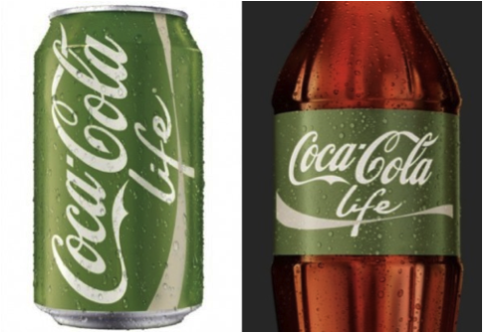
The Wisdom of Michael Moss
Coke Life Green is a great example.
Fewer calories and 35% less sugar!
Still all about “Open Happiness.”
Bottom line: The junk food industry would cease to exist without salt, sugar, and fat.

Slide 17
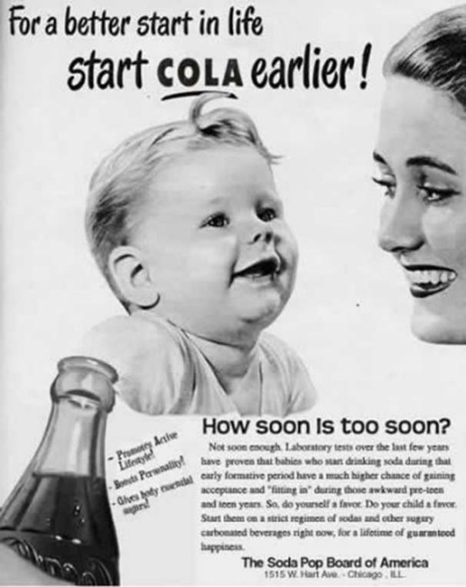
False Advertisements
They’ve been around for many, many years.
The ad on the right says,
“Laboratory tests over the last few years have proven that babies who start drinking soda during that early formative period have a much higher chance of gaining acceptance and ‘fitting in’ during those awkward pre-teen and teen years. So, do yourself a favor. Do your child a favor. Start them on a strict regimen of sodas and other sugary carbonated beverages right now, for a lifetime of guaranteed happiness.”
“Promotes Active Lifestyle! Boosts Personality! Gives Body Essential Sugars!”

Slide 18
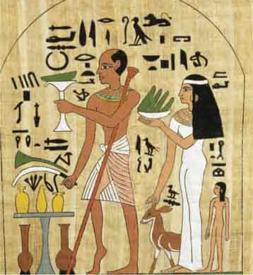
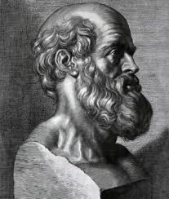
Ancient Wisdom
“One-quarter of what you eat keeps you alive. The other three-quarters keeps your doctor alive.”
- Ancient Egyptian Proverb
“Let food be thy medicine and thy medicine be thy food.”
- Hippocrates, Father of Medicine

Slide 19
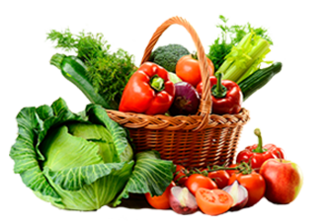
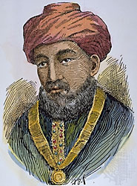
Ancient Wisdom
“When diet is wrong, medicine is of no use. When diet is correct, medicine is of no need.”
- Ancient Ayurvedic Proverb
“No disease that can be treated by diet should be treated with any other means.”
- Maimonides, 1135-1204

Slide 20

Basic Healthy Diet
Eat as nature intended—real food, not food-like, processed food.
Remember these 4 rules:
Eat food that will rot (before it rots).
Eat foods that were available more than 2000 years ago.
Eat low on the food chain.
Don’t eat what you can’t pronounce.

Slide 21
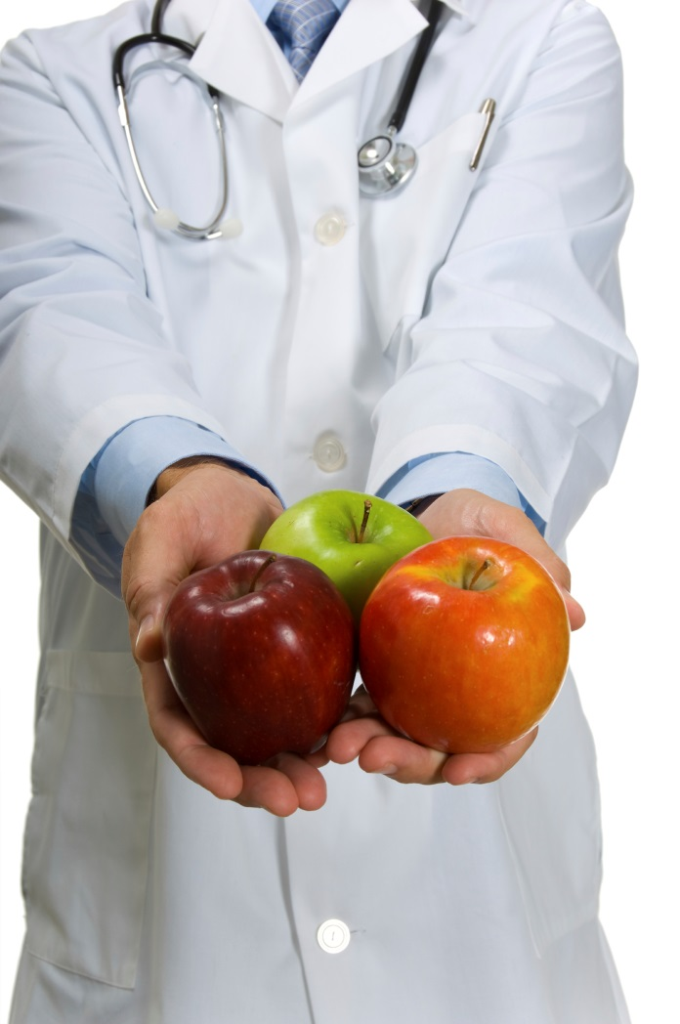
Basic Healthy Diet
Other important factors:
Choose organic whenever possible. Remember the benefits of juicing.
Consider strict elimination of gluten, casein, etc.
Avoid processed and fast foods.
Avoid added sugars, flavor and color-enhancing additives.
Use healthy fats: olive, grapeseed, coconut, etc.

Slide 22
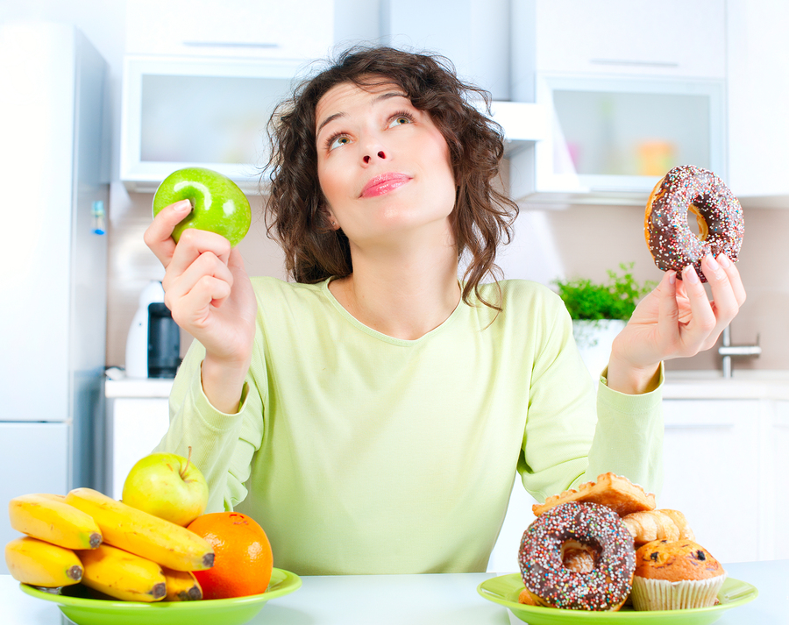
Dealing with Cravings and Impulse Control: Appetite-Satiating Amino Acids
L-phenylalanine
N-acetylcystenine
5-hydroxytryptophan (5-HTP)

Slide 23

Dealing with Cravings and Impulse Control
In clinical studies, L-phenylalanine has been shown to help overweight women consume fewer calories throughout the day.
N-acetylcysteine has been shown to reduce cravings by regulating glutamate levels. (toxic to nerve cells) (gluten and casein diet).

Slide 24

Dealing with Cravings and Impulse Control
5-HTP helps to make serotonin levels increase in the brain. Since serotonin helps regulate mood and behavior, 5 HTP has a positive effect on adherence to a dietary prescription. (90% is made in the GI tract)

Slide 25
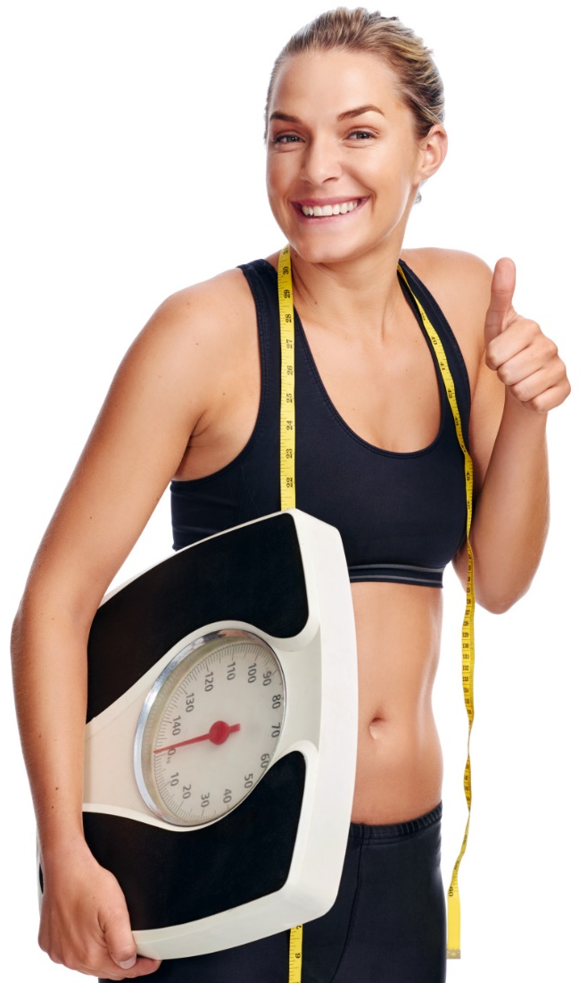
Dealing with Cravings and Impulse Control
So, combining all 3 amino acids can provide you with the resources you need to lose weight safely and effectively!

Slide 26
Dealing with Cravings and Impulse Control
Herbal formula:
Green tea leaf extract provides a healthy boost of natural energy.
Huperzia seratta and Coleus forskohlii work together with others to boost energy, reduce cravings, aiding in weight management.
This formula provides seed extract that gives L-DOPA, which supports the body’s production of dopamine, key neurotransmitters for the brain’s perception of reward and pleasure.

Slide 27
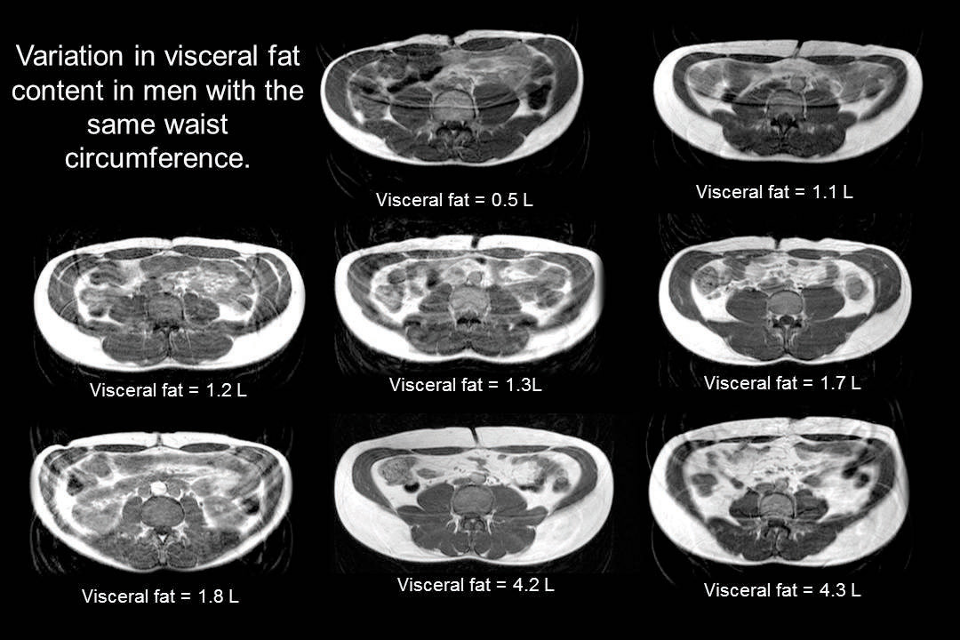
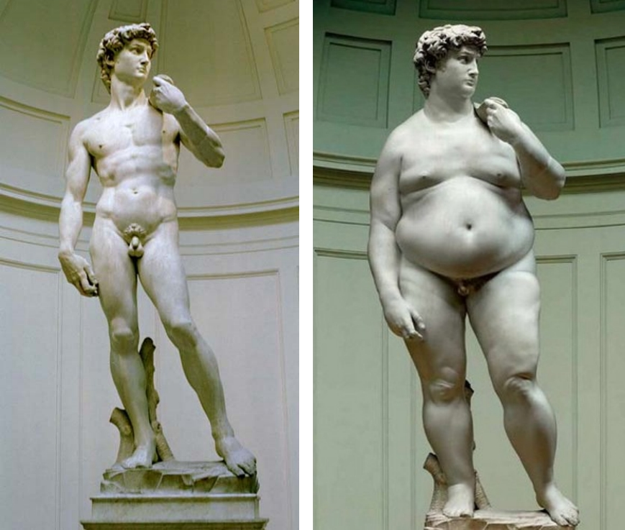
A New Disease
The white is fat
Fall asleep at the meal.

Slide 28

Supplementation for Adrenal Calming
Rhodiola Rosea: Has been used for centuries to increase stamina, reduce fatigue, treat depression, and resolve many neurological disorders.

Slide 29
Supplementation for Adrenal Calming
Phosphatidylserine(PS):
One of the most important components of your cell membrane.
It helps build brain cells.
Nutritional deficiencies are associated with mental impairment, brain fog, stress and degenerative neurological disease.
PS plays a role in helping to prevent dementia.
Supplementation with PS helps to restore neurotransmission, lowers cortisol, improves mood, motivation, decreases anxiety, improves memory and cognition, and increases cellular metabolism.

Slide 30
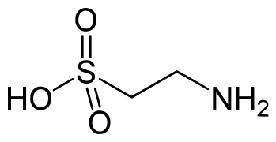
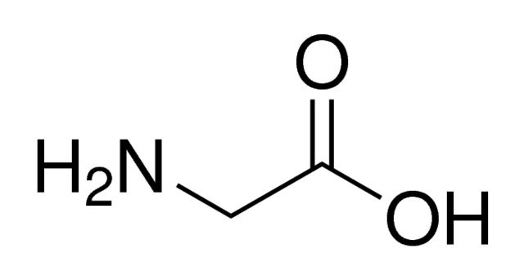
Supplementation for Adrenal Calming
Glycine and Taurine: Two amino acids that are used in the synthesis of protein for overall brain health and a restful state.

Slide 31

Back to Sleep for Better Health
7-8 hours needed for health and weight loss
12-2 increase GH
Darker room
Frequent potty
breaks deprive
sleep

Slide 32
Back to Sleep
Melatonin: Hormone that’s produced in response to a darkening environment in the pineal gland. Sun goes down, melatonin goes up.
Phenibut: Helps to relieve anxiety and promote restful, rejuvenating sleep. Phenibut is a GABA derivative that can cross the blood-brain barrier and relieve tension, anxiety, and fear.
5-HTTP: Amino acid that helps to increase REM sleep by supporting levels of serotonin. Serotonin provides the body with the precursors needed to manufacture melatonin.

Slide 33
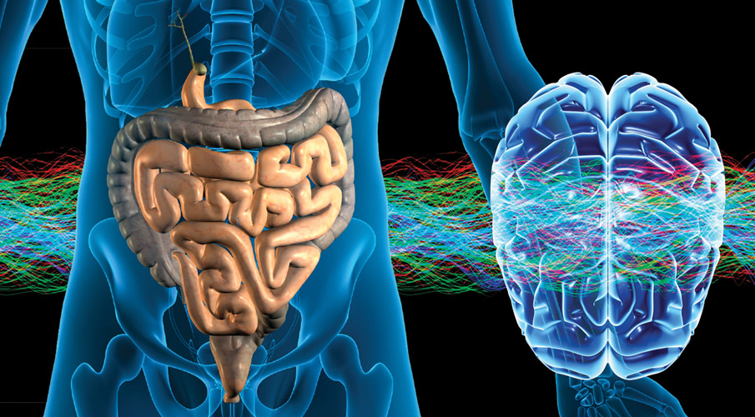
Serotonin Support
Supplement until your gut is back online and producing its own serotonin.

Slide 34

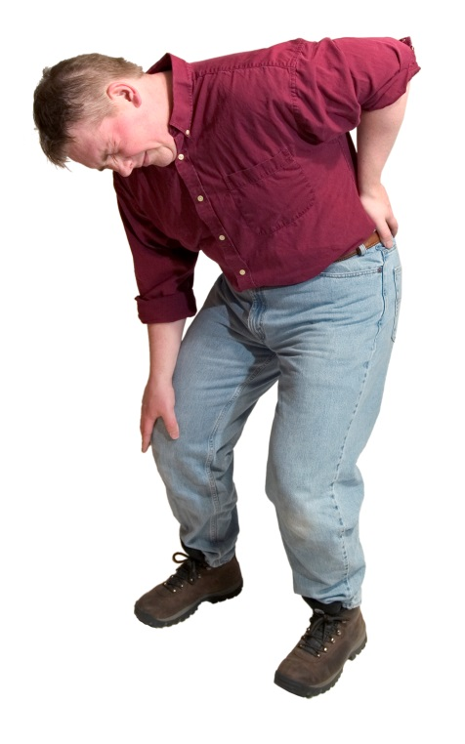
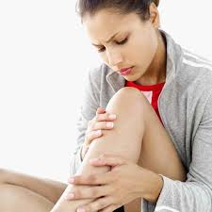

Let’s Start with a Question:
How Can You Help Your Chiropractic Patients Decrease Their Pain without Doing a Full Program?

Slide 35
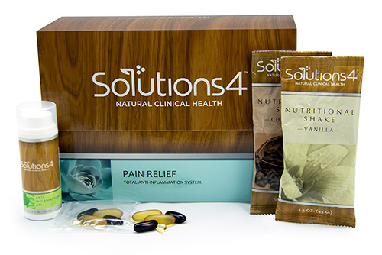
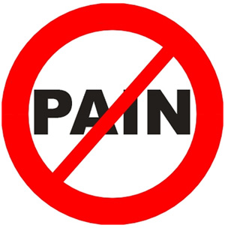
Try Reducing Inflammation
Through Supplementation!

Slide 36
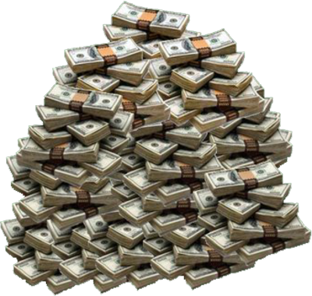
Transform Your Practice and Make More Money
The Solutions4 Pain Relief System won’t just change your patients’ lives ­– though that’s a pretty big deal. It will also boost your business by tens of thousands of dollars each year! That’s a big payoff for such an easy thing.

Slide 37
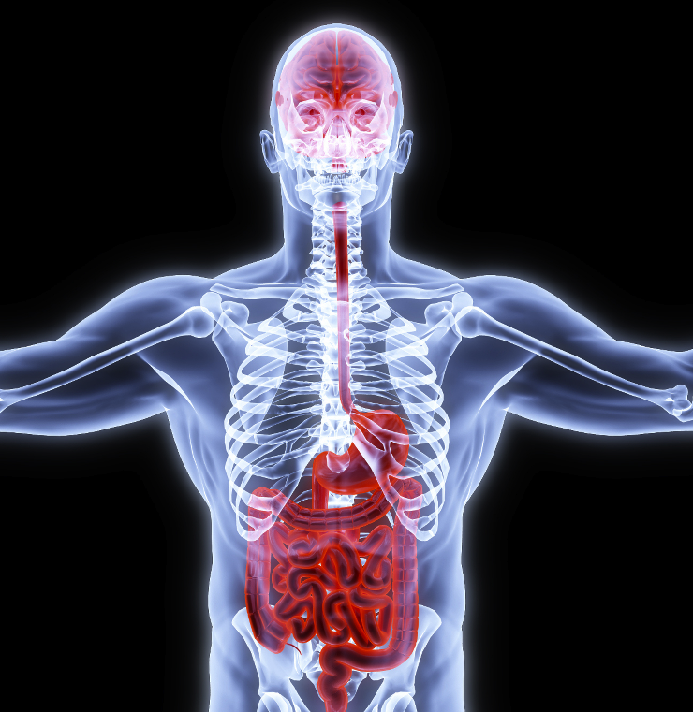
Gut Health and Full-Body Health (Including Mental Health) Go
Hand-In-Hand
By optimizing your patients’ nutrition, you can improve their gut health, boost their brainpower, and even reduce their pain! Nutrition is absolutely foundational for every aspect of health.

Slide 38
Thank you!
Call or Text me with any questions
#801-903-7141

