Slide 1

Quick Start Kits:
7, 14 & 21 Day Options
Product Education and Sales Training
Shar Lewis
Club Reduce Consultant
Vice President of Business Development

Slide 2

Quick Start Kits

Slide 3

Quick Start Kits
7-Day Quick Start Cleanse Kit
14-Day Quick Start Weight Loss Kit
21-Day Ultimate Weight Loss Kit (7 & 14 Day Kits Combined)

Slide 4

7-Day Quick Start Cleanse
This 7-Day body cleansing system allows you to achieve the same results as our traditional detox kit but with simplified, easy-to-use, herbal supplement packs and stick-pack beverages.
This new and improved system is formulated to help rid your body of toxins that contribute to weight gain and poor health.
After completing this 7-Day Cleanse you’ll have increased fat-burning hormones, more energy, a clearer mind, fewer cravings , and a slimmer figure.

Slide 5
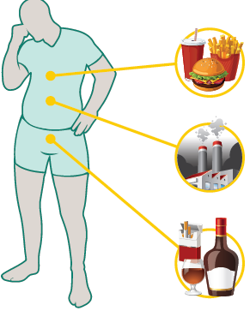
7-Day Quick Start Cleanse
Detoxification: Your Personal Journey to a Cleaner, Healthier You
WHY CLEANSE?
ENVIRONMENTAL POLLUTION: Modern day industrial life fills the air you breathe with poisons, contaminates the water you drink, and further degrades the food that you eat.
UNHEALTHY FOODS: Processed and commercial foods saturate your body with artificial colors, sweeteners, preservatives, pesticides, and more.
DRUGS & ALCOHOL: Substances that are used and abused (alcohol, tobacco, drugs, illicit, prescription and otherwise) increase the toxic load on your body. These substances require your liver and other organs to work overtime to try to clear their residue from your body.
HELPS TO: Detoxify the body, reduce cravings for junk food, improve digestive health, boost energy and vitality, smooth and clarify skin, enhance mental clarity, improve sleep, boost fat-burning hormones.

Slide 6
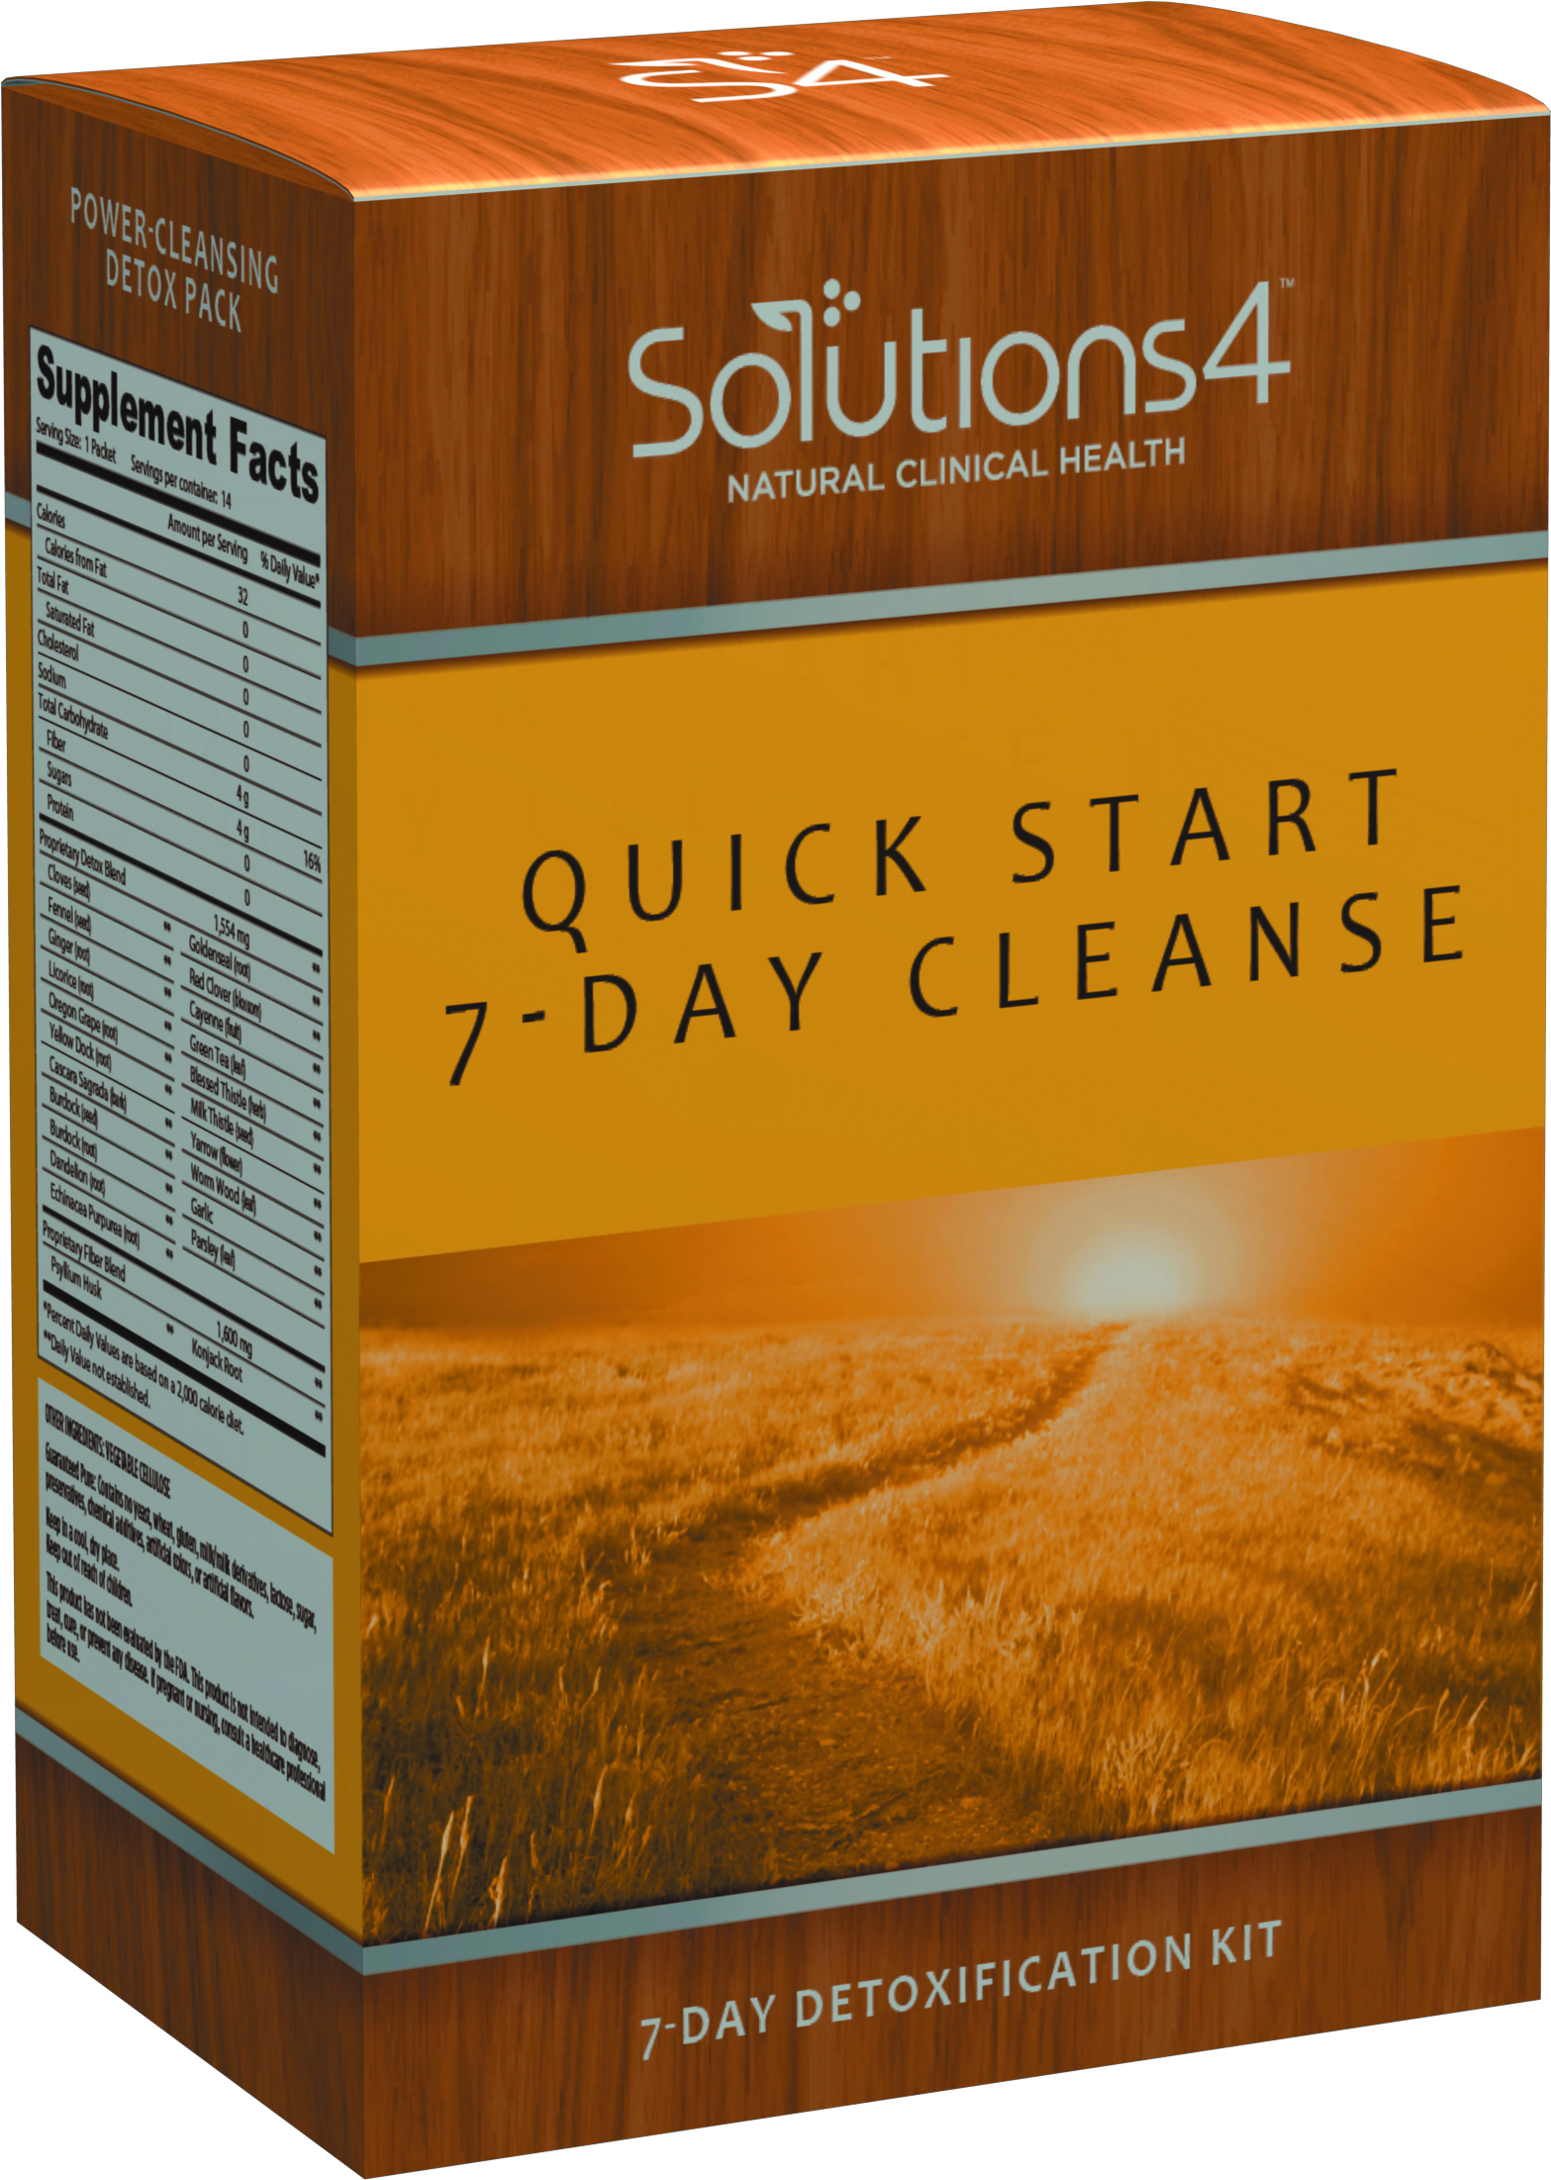
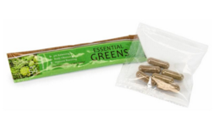
7-Day Quick Start Cleanse
Kit Includes:
Dietary Guidelines & How to Guide
14 Power Cleansing Detox Packs (take 2 per day)
14 Essential Green Beverage Packets (take 2 per day)

Slide 7
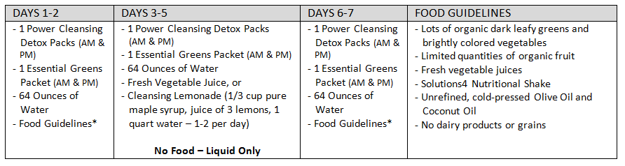
7-Day Quick Start Cleanse
Dietary Guidelines & How To Guide
*Blending your fresh vegetable juice is fine. However, on Days 3-5, liquid only days, it is preferable to juice your fresh vegetable juice rather than blending it.

Slide 8

7-Day Quick Start Cleanse
Dietary Guidelines & How To Guide
TIPS FOR THE BEST CLEANSE
SET YOUR SIGHTS: Everyone cleanses for different reasons. You have chosen a customized path to help you achieve your health and weight loss goals. Write down what is motivating you and put in somewhere you can see it all day long.
LET YOUR BODY REST: Cleansing your body is hard work. Make sure you get 8 hours of sleep each night.
STICK TO IT: Some patients experience a healing crisis during detoxification that may include headaches and/or fatigue. Please know that this is a normal result of your body flushing out all the toxins and getting back to a better state of health.

Slide 9

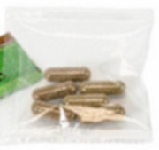
7-Day Quick Start Cleanse
Power Cleansing Detox Supplement Packs
  Easy to use supplement packs help detoxify the body naturally and deep cleans the digestive system
  Combines Body Purifier and Intestinal Cleanser supplements together in larger more powerful capsules (see Short Sheet for complete list of ingredients)
  Fiber is Konjac Root and Psyllium Hulls/Husks that has the ability to delay it’s exit from the stomach causing you to feel fuller longer

Slide 10
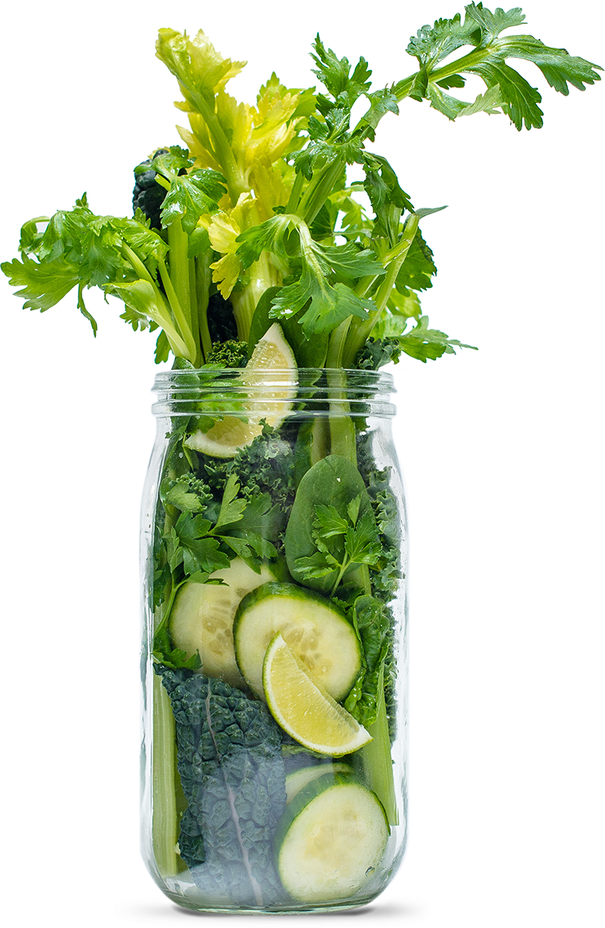
7-Day Quick Start Cleanse
Essential Greens Beverage Packets
  Convenient, on-the-go Essential Greens beverage packets provide your body with the nutrients it needs to nourish the body and energize your mind.
  (see Short Sheet for ingredient listing)

Slide 11
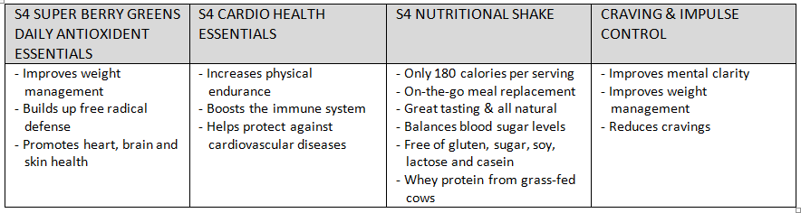
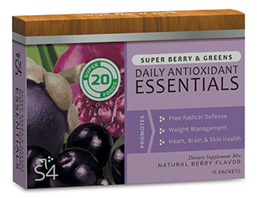
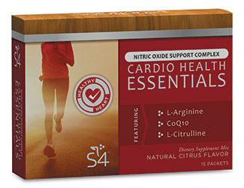
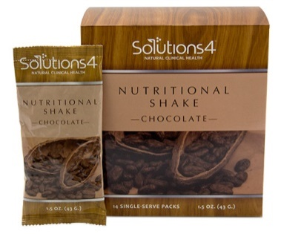
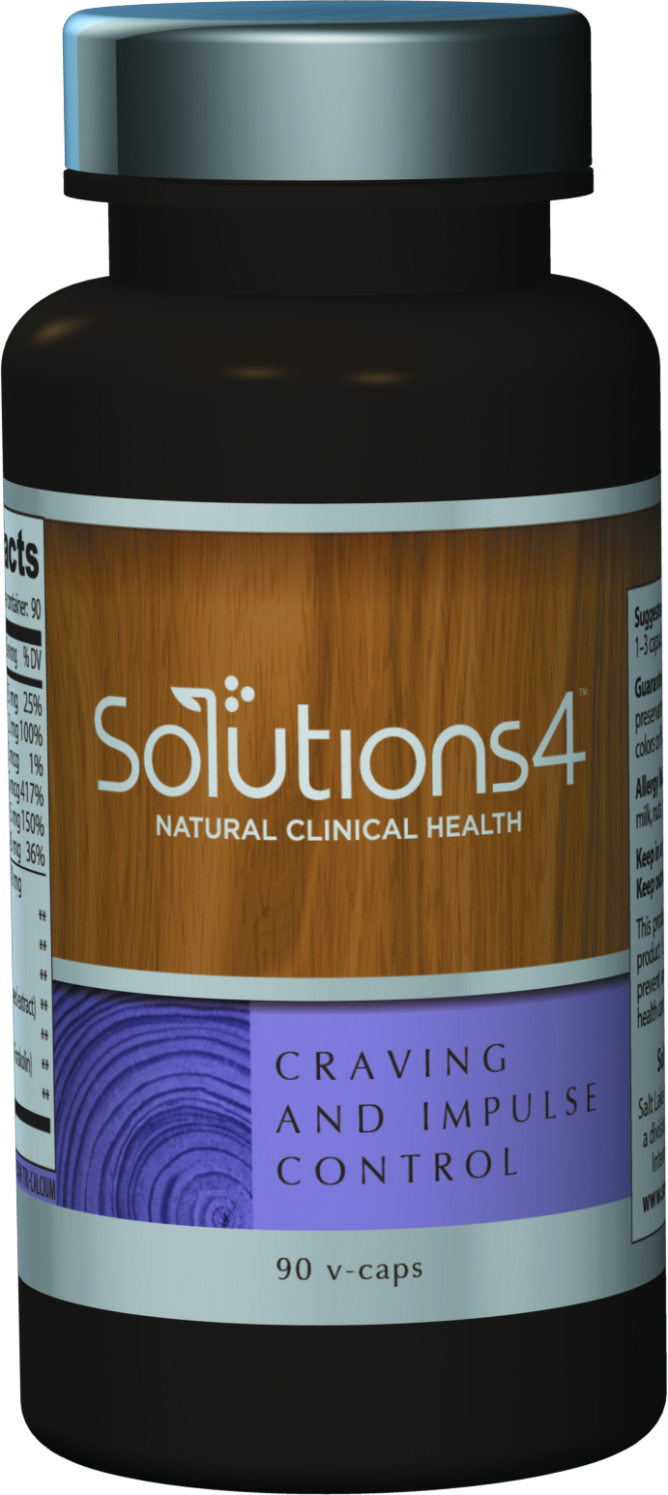
Helpful Hints to Maximize Your Results
Add these benefit-boosting
products to your program for optimal results

Slide 12

14-Day Quick Start Weight Loss
This 14-Day weight loss kit was formulated to help you achieve your health and wellness goals while losing weight at the same time. Each individual supplement packet contains everything you need to naturally and effectively shed excess pounds and transition into better health.
As an added benefit, these supplements will also suppress your appetite and increase your energy levels without affecting your metabolism or stressing the adrenal glands.
For best results, this kit should be used in conjunction with a dietary nutritional program and exercise routine.

Slide 13
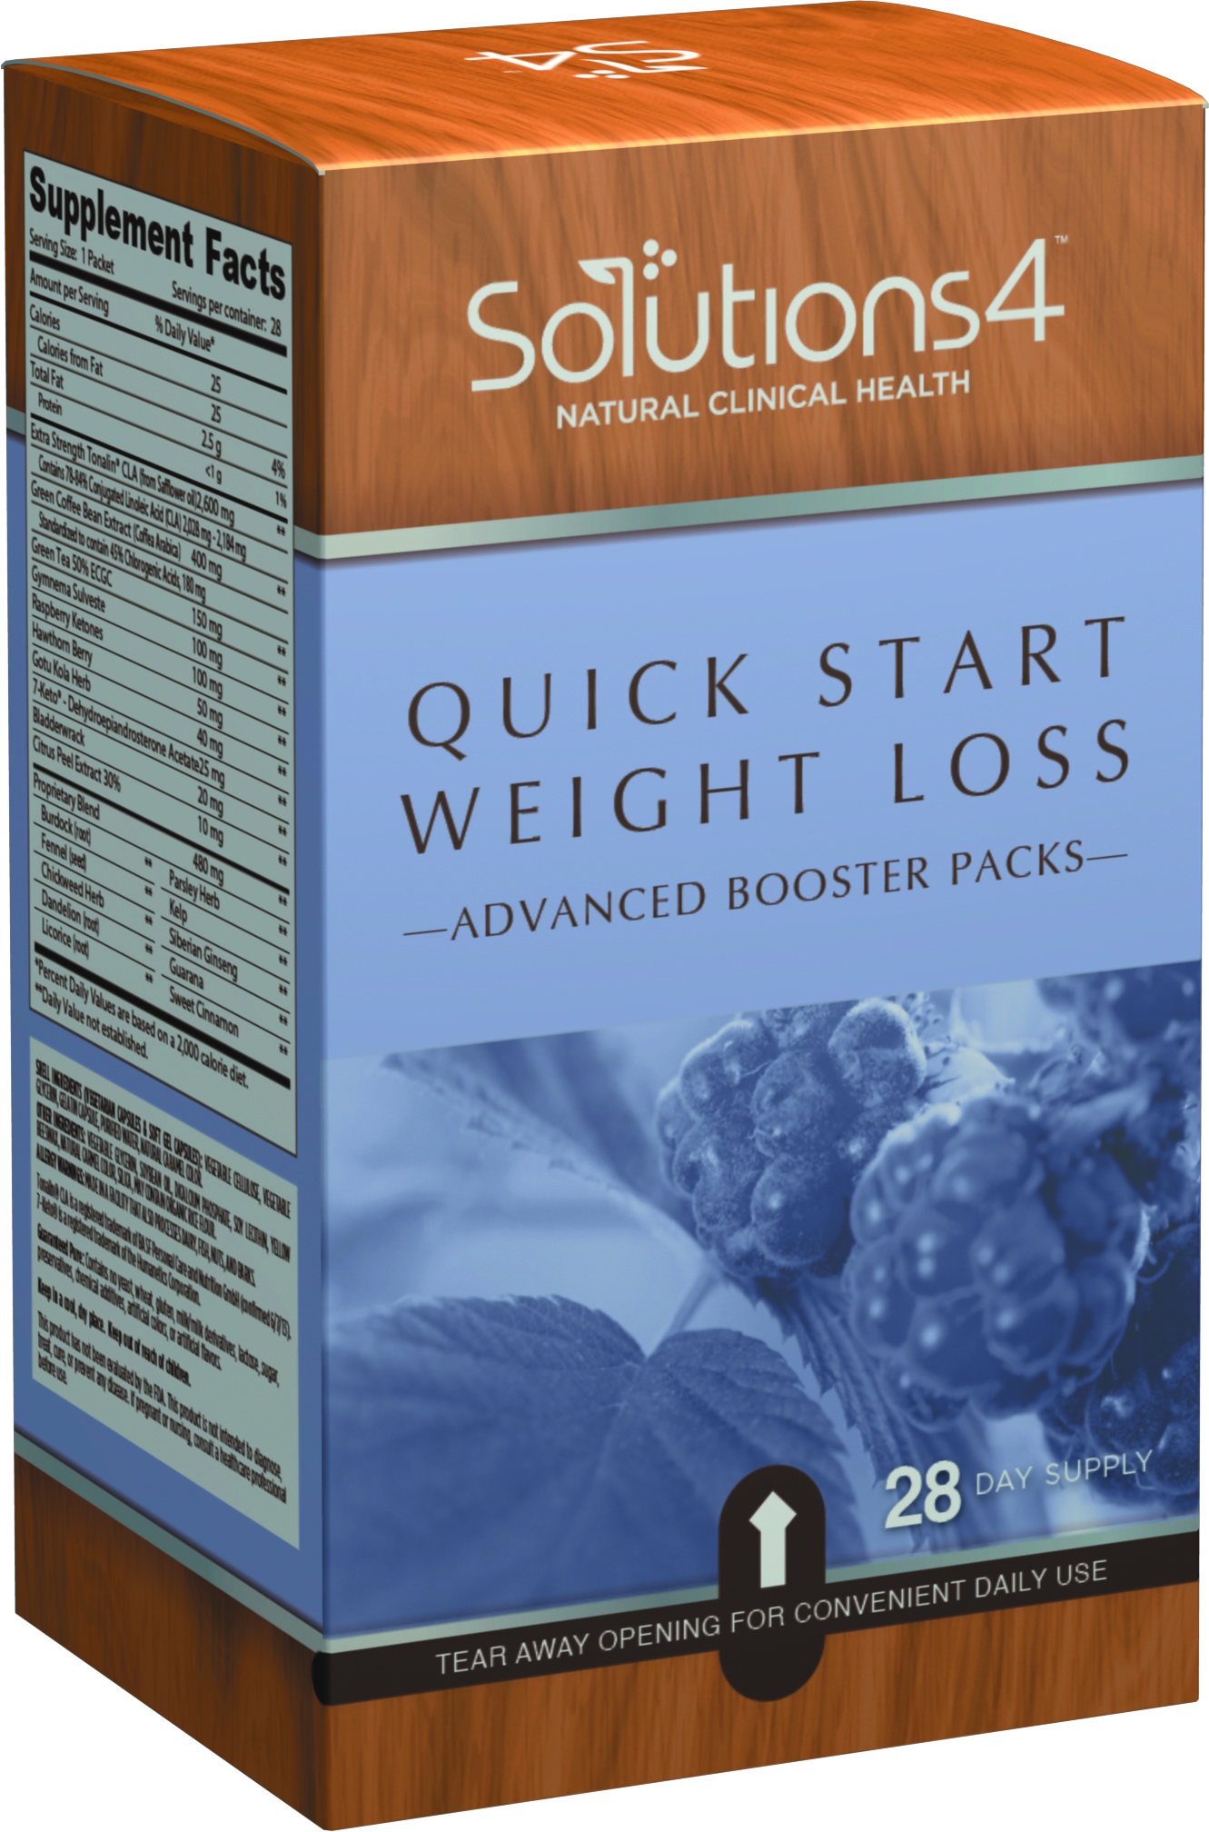

14-Day Quick Start Weight Loss
Kit Includes:
Dietary Guidelines & How to Guide
28 Advanced Supplement Booster Packs (take 2 per day)
  Extra Strength Tonalin CLA
  Appetite Appeaser & Suppressant
  Green Coffee Bean Extract
  Raspberry Ketones
  7 Keto DHEA
*Best if used in conjunction with S4 Nutritional Shake Packets

Slide 14
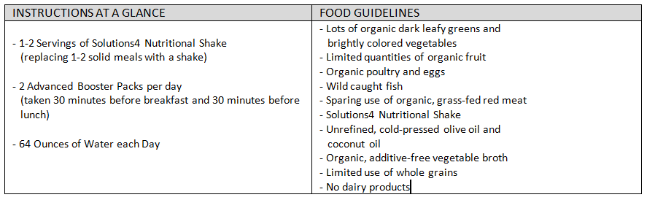
14-Day Quick Start Weight Loss
Dietary Guidelines & How To Guide

Slide 15

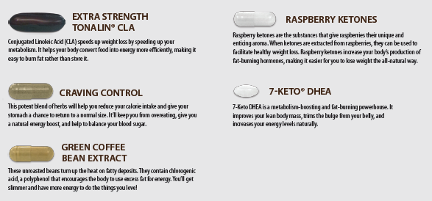
14-Day Quick Start Weight Loss
Advanced Booster Supplement Packs

Slide 16

14-Day Quick Start Weight Loss
Advanced Booster Supplement Packs
BENEFITS:
Boosts metabolism & increases energy
Converts food into energy
Appetite suppressant & balances blood sugar levels
Burns fat & turns fat into energy
Increases fat-burning hormones
Improves lean muscle
Helps eliminate belly fat

Slide 17
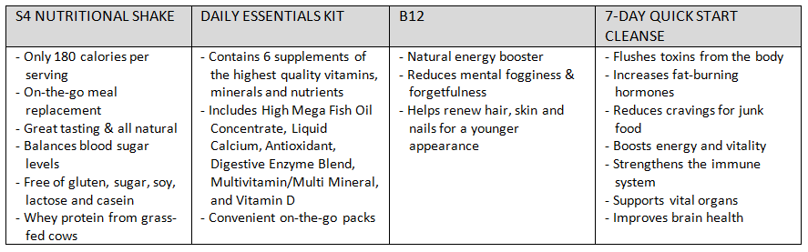
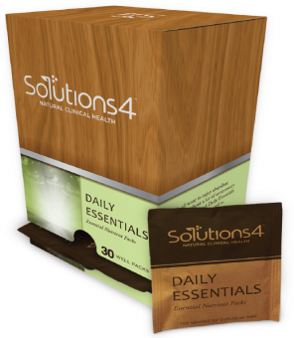
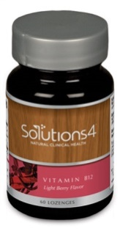
Helpful Hints to Maximize Your Results
Add these benefit-boosting
products to your program for optimal results

Slide 18

21-Day Ultimate
Quick Start Weight Loss
This 21-Day Ultimate Quick Start Weight Loss Kit combines the 7-Day Quick Start Cleanse with the 14-Day Quick Start Weight Loss Kit and the S4 Nutritional Shake Packets for the perfect 21-Day take home kit for those who do not purchase your full weight loss programs with services such as the 20-Day Rejuvenation, 5-Week Candida and 12-Week Candida weight loss programs.

Slide 19
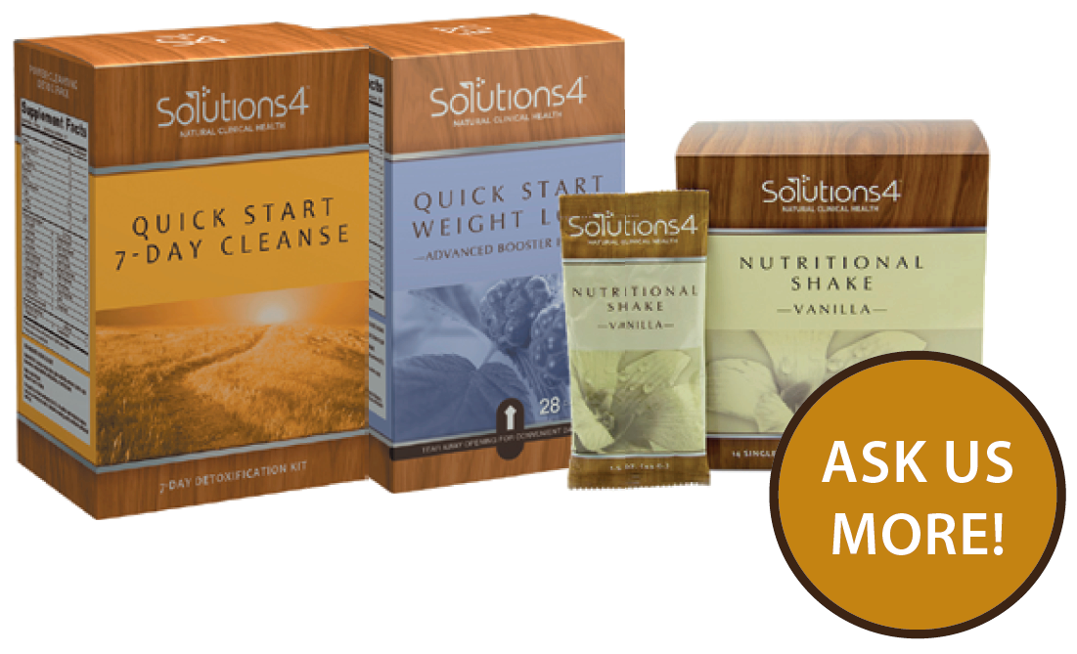
21-Day Ultimate
Quick Start Weight Loss
Kits to Combine Include:
7-Day Quick Start Cleanse
14 Day Quick Start Weight Loss Kit
Nutritional Shake Packets
Other benefit boosting products for optimal results

Slide 20

21-Day Ultimate
Quick Start Weight Loss
Quick weight loss results and total body health support for everybody, every lifestyle, and every budget.
Rids body of toxins and increases fat burning hormones
Suppresses appetite and increases metabolism naturally
Improves lean muscle and helps eliminate belly fat
Simple, easy, convenient to use

Slide 21
Solutions4
What Supplements you Take Matters!
Supplements the Stand Apart - To truly heal, you’ve got to give your body all the nutrients it needs to fight off pain.
Pure and Potent Ingredients - The nutrients in S4 products are never manufactured. They are derived from organically grown, freeze-dried plant materials – the most potent form your body recognizes. Unlike synthetic nutrients which are isolates, all-natural supplements include phytochemicals which complement the way your body uses required nutrients.
Selective Sourcing – S4 ingredients are selected for exceptional quality as well as freshness. S4 partners with organic growers and purchase harvests at their nutritional peak. S4 products also have a prescribed shelf life (never preservatives) to assure the highest potency.
Nutrition Where you Need it – Most multivitamins and grocery store supplements come in solid tablets and generic capsules. Studies show these can be slow to dissolve (if at all) and often pass through your digestive system before nutrients are ever released. S4 products are clinically developed for maximum absorption – and maximum results.
Complete Trust in a Complete Solution – S4 has been developing natural clinical products for more than 30 years and this Pain Relief System is one of a kind! It will target the source of your patients pain from inside a out.

Slide 22
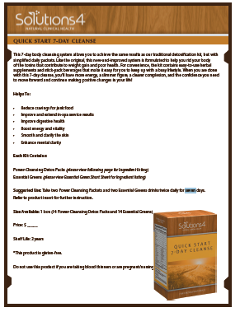
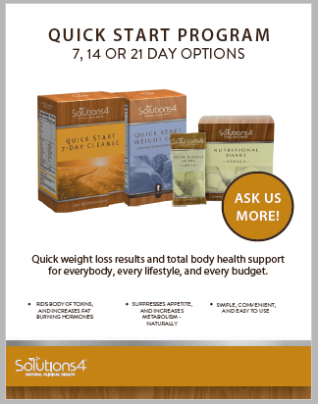
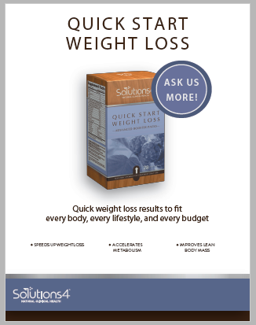
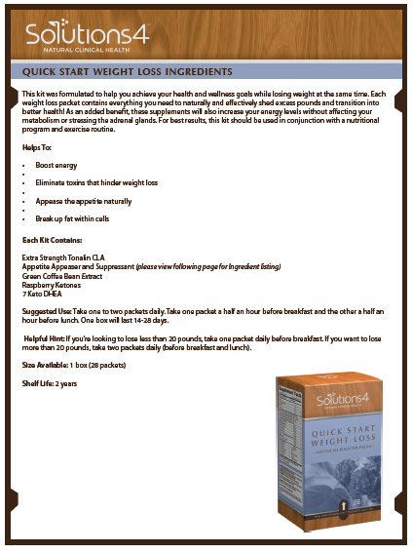
Solutions4
Short Sheets and Point of Purchase (POP)

Slide 23

The 7, 14 and 21 Day Quick Start Kits
are Good for your PATIENTS and Good for YOU!

Slide 24

It’s So Cost Effective
it Practically Sells Itself!
Perfect as a down sell option or an easy take home option if not providing weight loss services
Cost of 7-Day Quick Start Cleanse Kit:
  $35 Doctor Price/$70.00 Patient Price
  Includes: Dietary Guidelines & How to Guide, 14 Power Cleansing Detox Packs and 14 Essential Greens Beverage Packets
Cost of 14-Day Quick Start Weight Loss Kit:
  $29.00 Doctor Price/$58 Patient Price
  Includes: Dietary Guidelines & How to Guide and 28 Advanced Booster Supplement Packs
Cost of 21-Day Ultimate Weight Loss Package:
  Add Nutritional Shake Packets to the Kits above…
  $25 Doctors Price/ $50 Patient Price
  Total Price $89 Doctor Price/$178 Patient Price

Slide 25
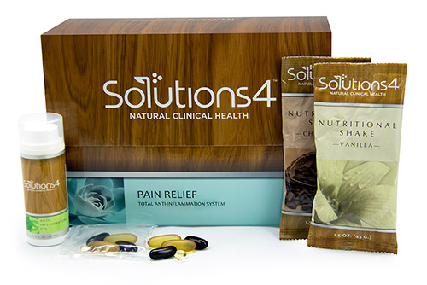
Recommend the S4 Pain Relief System to Each and Every Current Chiropractic and Pain Patient that Comes into your Clinic

Slide 26

Call Solutions4 Today to Place your Order for the Quick Start Kits Today!
(877) 817-6074

Slide 27

Do you Need Help Growing Your
Club Reduce Business
to Increase your CASH Income and Help your Patients HEAL?
www.ClubReduceConsulting.com
801.917.0900

Slide 28

Client Testimonials
www.ClubReduceConsulting.com

Slide 29

Thank You!

