Slide 1
Benefits of Whole Body Vibration
Dr. Todd Singleton

Slide 2
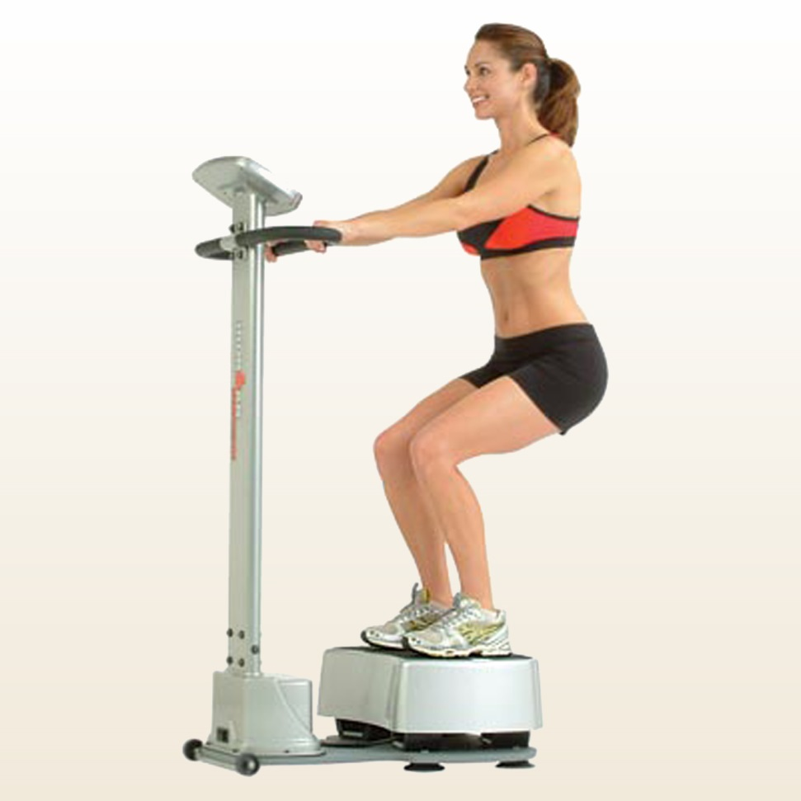
What Does WBV Do?
Whole Body Vibration (WBV) offers a low-impact way to increase strength and flexibility, in addition to combating osteoporosis and increasing the metabolism. WBV causes the muscles to experience an involuntary contraction at the same rate that the platform is vibrating. The mechanical stimulus produces a stretch reflex in 100% of the muscles. This means that the muscles react to the vibration by contracting and relaxing automatically.

Slide 3
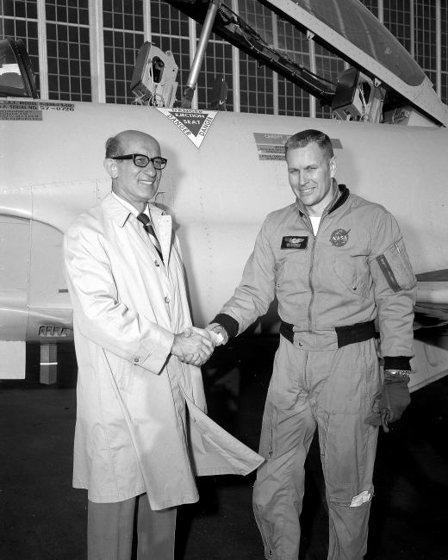
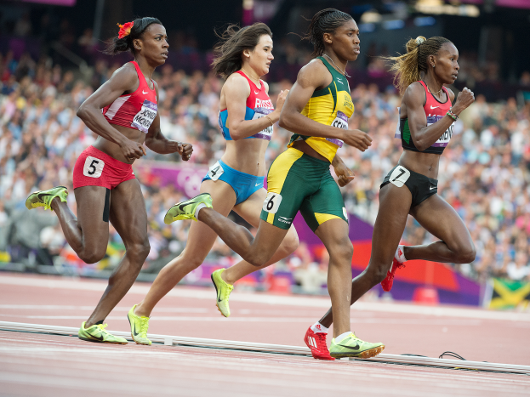
How Did It Come About?
Vibration training was used in the 1960s by the Russian space program to help cosmonauts recover more quickly from muscle atrophy. Since then, Olympic athletes have adapted WBV into their workouts. Trainers and doctors have been using WBV for over 40 years.

Slide 4
Benefits of WBV
Improves Muscle Strength: WBV improves muscle strength the same way that regular exercise does. Vibrations lengthen and shorten the fibers depending upon the frequency.
Enhances Wellness: WBV increases blood flow, lymph drainage, oxygenation of cells, the release of endorphins, and detoxification of the body.
Enhances Detoxification: WBV works from the inside out. Waste products are expelled at a cellular and lymphatic level.
Improves Circulation: WBV improves circulation by stimulating the exercise heart rate.
Improves Relaxation: WBV increases circulation, blood flow and oxygen intake. WBV also reduces cortisol (the stress hormone) and creates and releases endorphins. It also detoxifies the system, enhancing relaxation.
Accelerates Weight Loss: WBV stimulates all cells in the body to function at a higher rate, which in turn increases the metabolism, which helps to accelerate weight loss.
Reduces Cellulite: WBV causes increased local circulation to targeted areas, in turn giving areas with cellulite a “smoother” look.
Reduces Varicose Veins: WBV causes increased lymph drainage, which lowers the pressure in varicose veins so the valves of the veins can close off.
Increases Energy: WBV stimulates all cells in the body, increases blood flow and oxygen intake, and stimulates metabolism to help flush out toxins.
Increases Bone Density: There are two types of bone cells: ostioblasts (bone makers) and ostioclasts (bone shapers). Bones loss happens when there are more ostioclast than ostioblast cells. WBV stimulates weight bearing exercise, which stimulates the production of ostioblast cells.

Slide 5
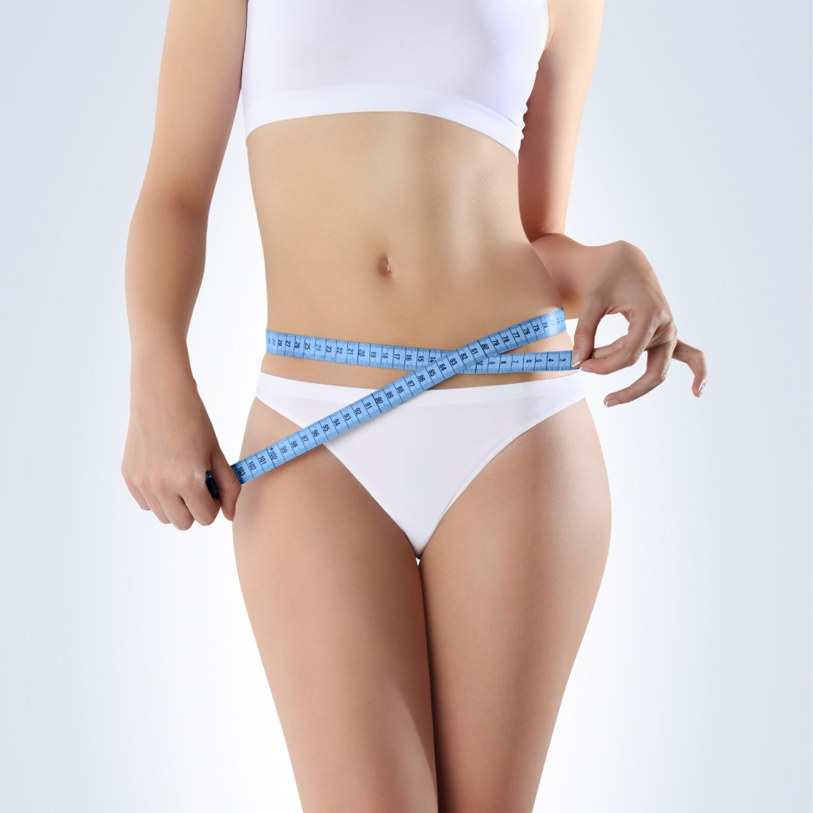
Benefits of WBV with Weight Loss
Whole Body Vibration helps with weight loss by increasing HGH
This type of exercise is very similar HIIT training
WBV can help patients who have plateaued with their weight loss
WBV is unattended therapy
WBV is great to use in conjunction with EWOT – (Exercise with oxygen therapy)
WBV helps increase lymphatic drainage and improves circulation which helps decrease cellulite via toxins

Slide 6
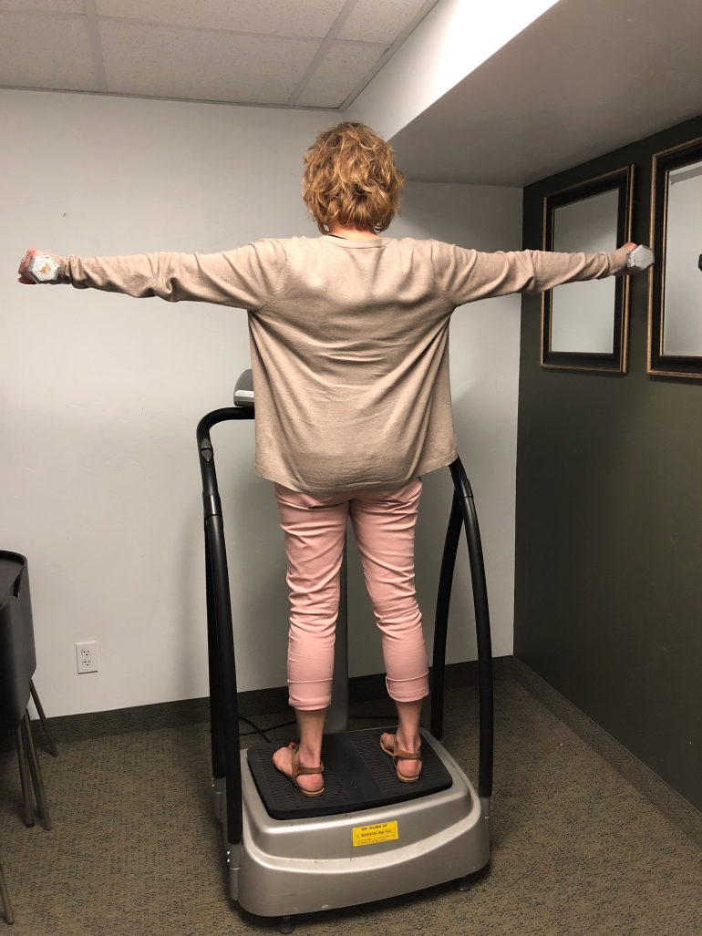
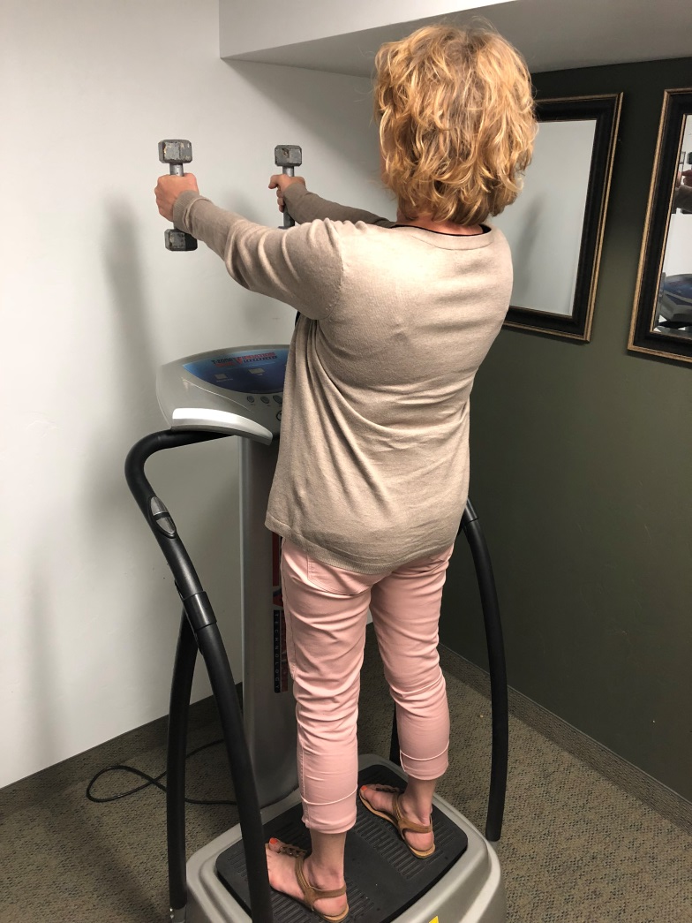
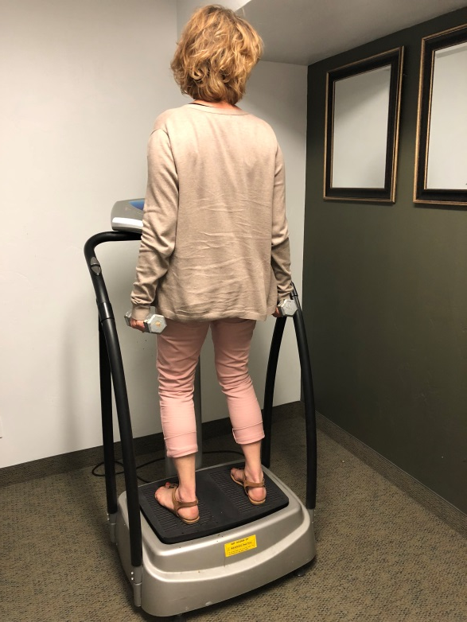
How to Use the WBV for Weight Loss

Slide 7
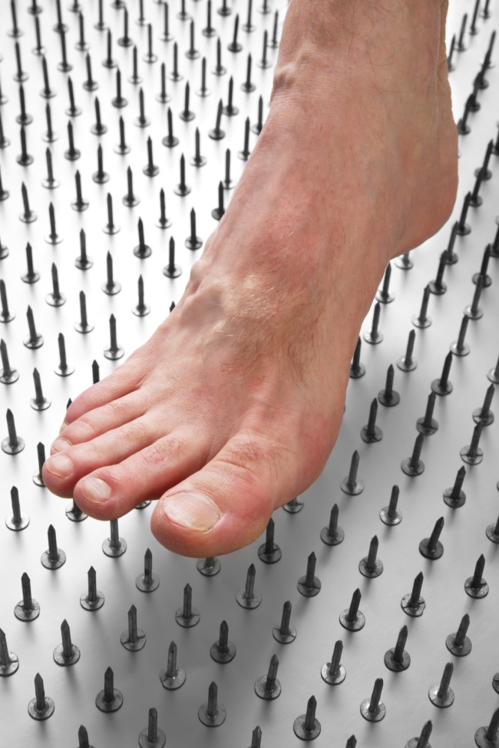
Benefits of WBV with Neuropathy
WBV helps increase blood flow and circulation which is lacking in the lower extremity
WBV helps decrease swelling to accelerate tissue healing during treatment
Using the Solutions4 Cardio Health Essentials while having neuropathy treatments will help to increase vasodilation
WBV helps with balance and coordination by increasing neurological feedback – proprioception training

Slide 8
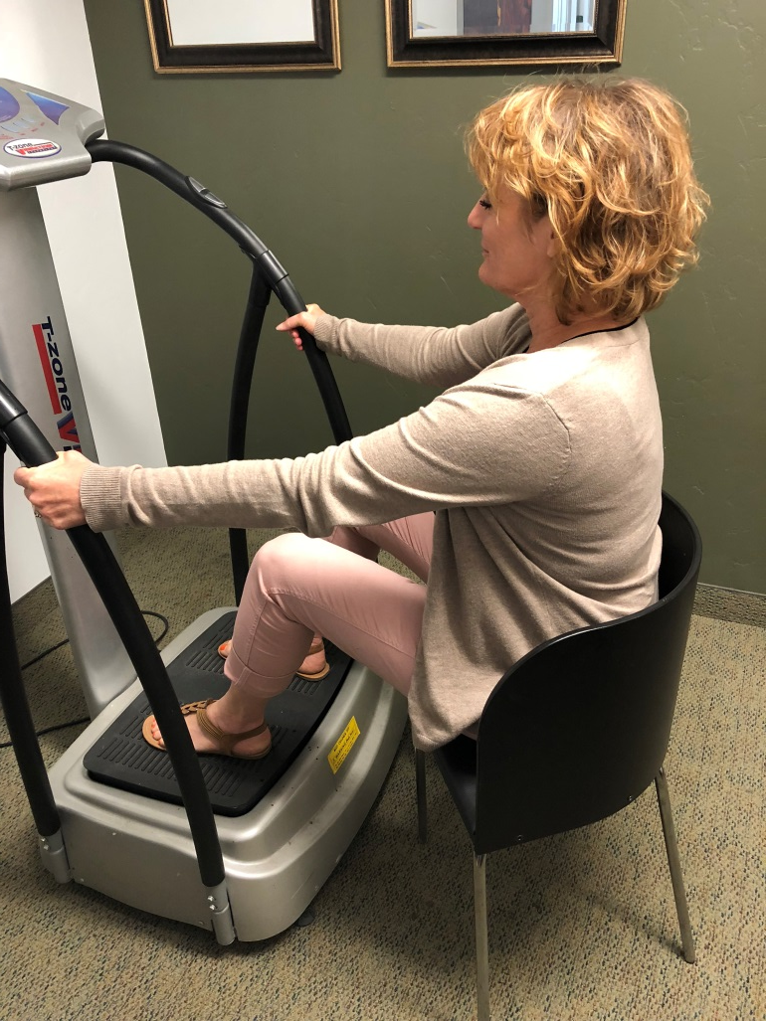
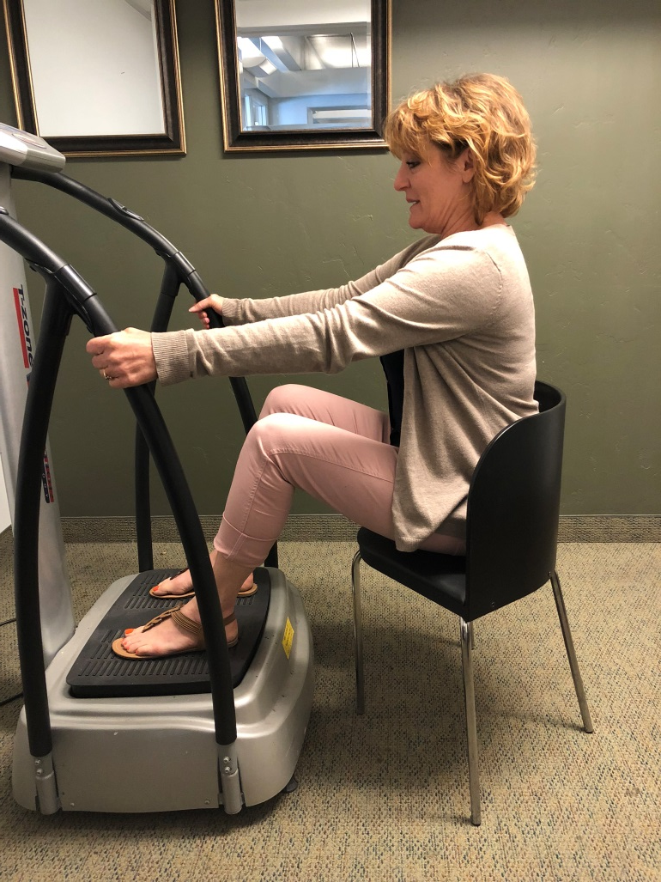
How to Use the WBV for Neuropathy

Slide 9
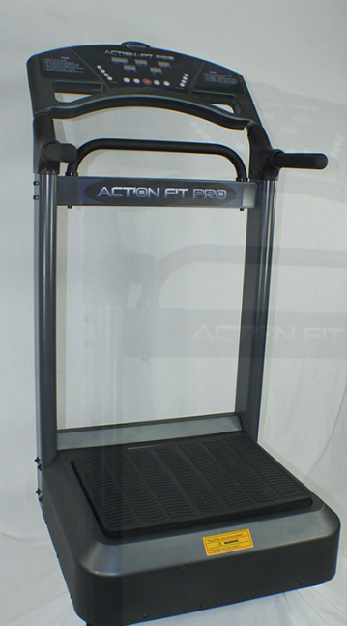
Resource
Contact GERRY to receive your Whole Body Vibration machine
#801-358-4777
www.vibratebacktohealth.com
On Club Reduce under the Resources page you will find the information to order your Whole Body Vibration

Slide 10

Closing Tips

Slide 11
Thank you!
Call or text me at 801-903-7141

