Slide 1
Upsell with the Doctors Script Pad (Product Recommendation Sheet)
Dr. Todd Singleton

Slide 2
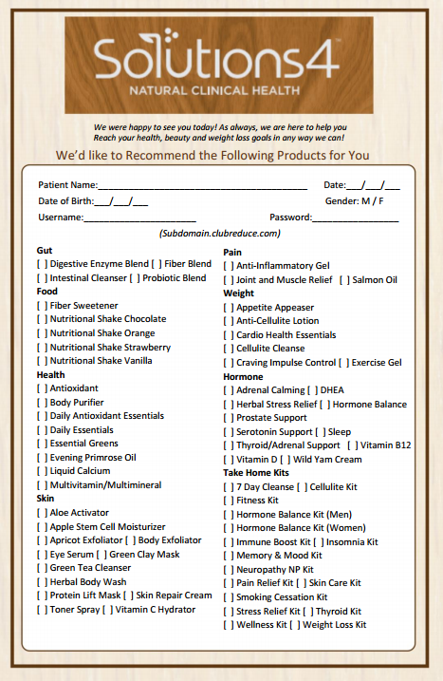
Location on Club Reduce
Marketing > All > Supplementation > Product Recommendation Sheet

Slide 3

Talk To ALL Your Patients Using the Script Pad (Recommendation Sheet)
Train your entire staff to upsell products
Print out Product sheets and have them in every room and at the front desk
Incentivize your employees when upselling products or Take-Home Kits

Slide 4

16 Take Home Kits
Patient can order any of the 16 Take-Home Kits on Club Reduce

Slide 5

How Can My Patients Order Online?

