Slide 1
Top 15 Most Frequently Asked Questions by Club Reduce Doctors
With Dr. Todd Singleton

Slide 2

Inside Scoop with Dr. Singleton about Patient Care 15 Frequently Asked Questions from Club Reduce Doctors

Slide 3


#1 – “When Should I Place Patients on the Solutions4 Hormone Balance Supplement?”

Slide 4


#2 – “My Patient Started Experiencing Candida-Like Symptoms after They Started Their Program. What Should I Tell Them?”

Slide 5
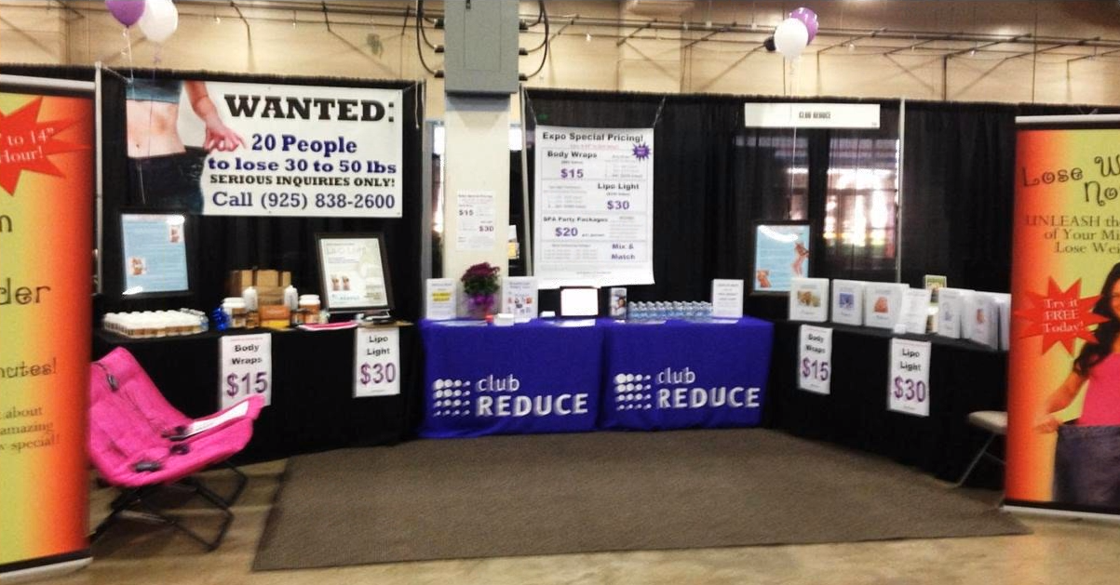
#3 – “What’s the Best Way to Market for Weight Loss?”

Slide 6


#4 – “What’s the Best Way to Market for Neuropathy?”

Slide 7

#5 – “My Patient has had Gastric Bypass Surgery. Is it Safe for Them to Do a Program?”

Slide 8

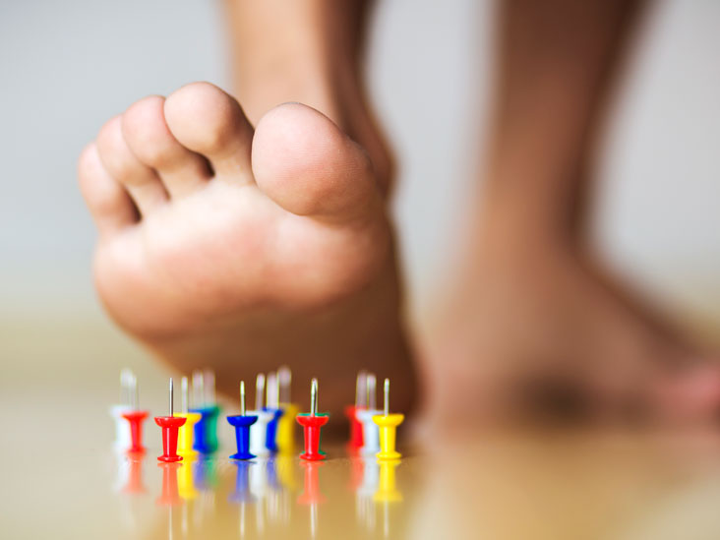
#6 – “My Neuropathy Patient isn’t Experiencing as Much Relief as My Other Patients. What’s Wrong?”

Slide 9
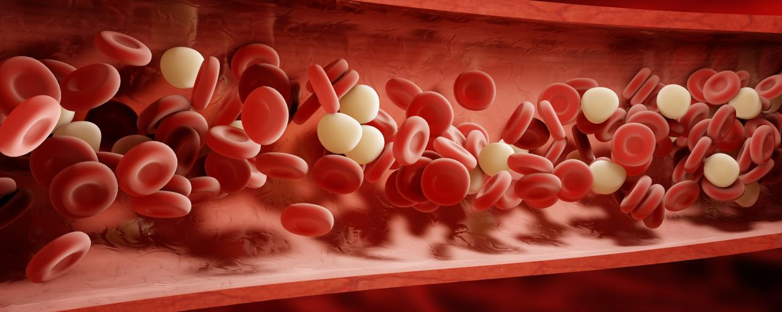
#7 – “Can My Patient Do a Program while Taking a Blood Thinner like Coumadin?”

Slide 10

#8 – “My Patients are Complaining about the Supplements. Why Do They Need to Take So Many? What Should I Tell Them?”

Slide 11
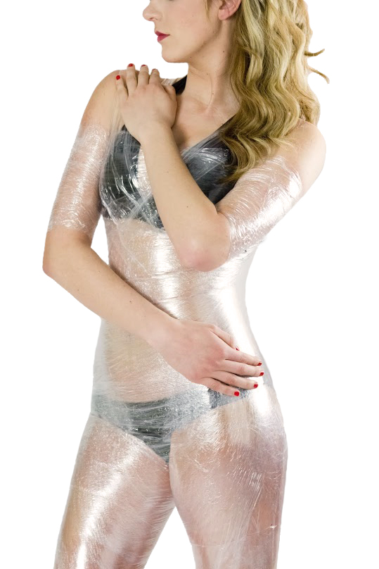
#9 – “What if My Patient Gets a Rash after Their Body Wrap?

Slide 12


#10 – “What if My Patient Doesn’t Lose Weight after 2-4 Weeks on a Program?”

Slide 13

#11 – “My Patient has a Pacemaker. Is it Safe for Them to Do a Program?”

Slide 14
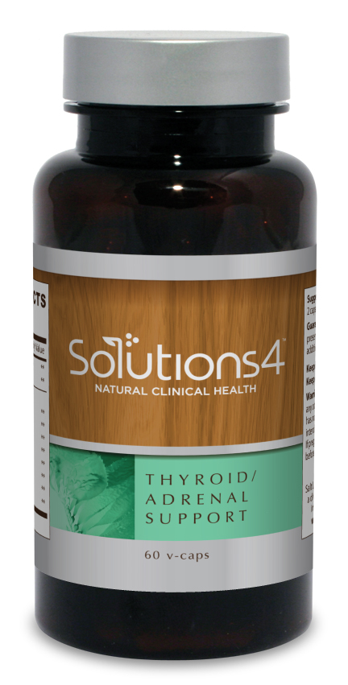
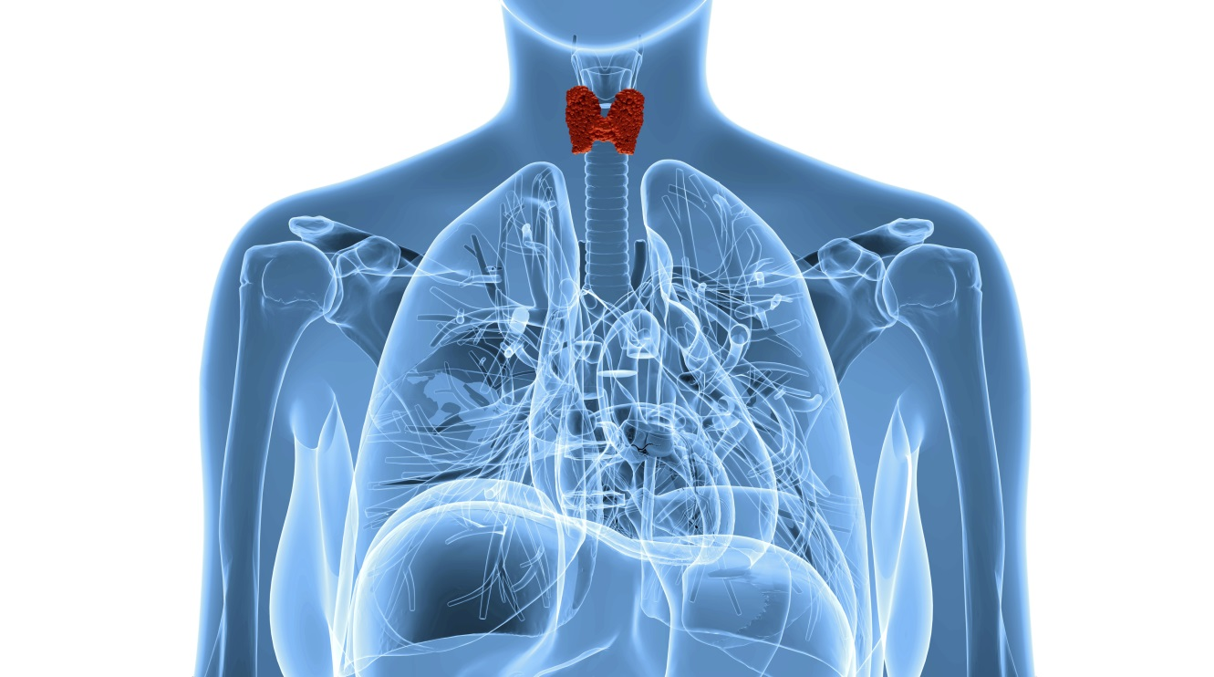
#12 – “My Patient has Thyroid Issues (or No Thyroid). How Should I Adjust their Treatment?”

Slide 15

#13 – “My Weight Loss Program Seems to Be Off to a Slow Start. We are Struggling to Fill Seminars. What Can I Do to Give it a Boost?”

Slide 16

#14 – “How Can I Best Help a Patient with Fibromyalgia”?

Slide 17
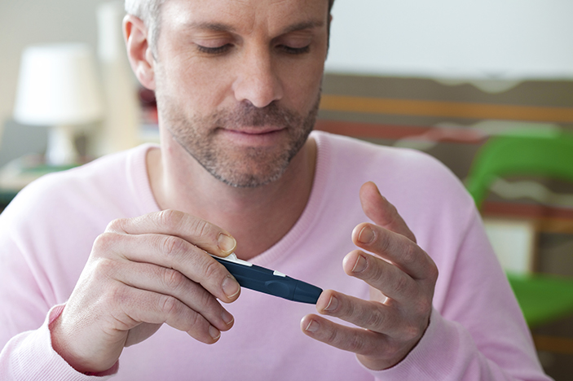
#15 – “How Can I Best Help a Patient with Diabetes?”

Slide 18

More Questions… “What Should I Do about No-Shows to the Breakthrough Weight Loss Seminar?”

Slide 19
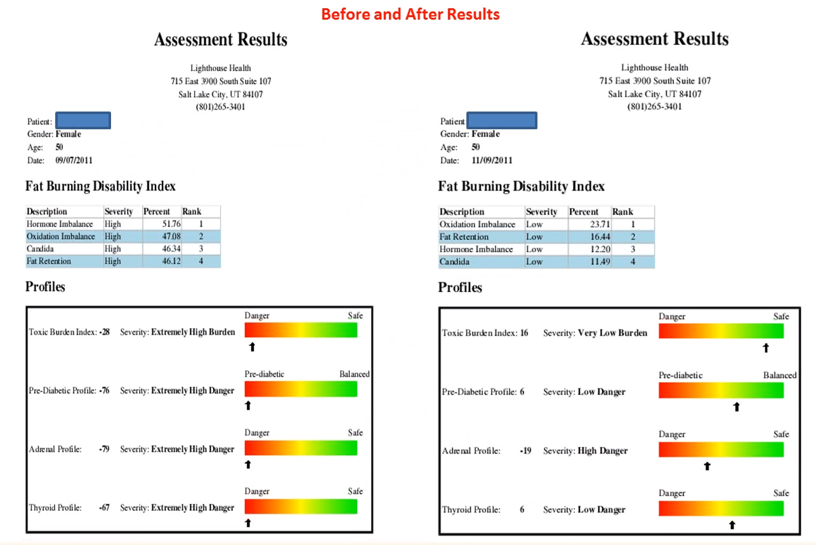
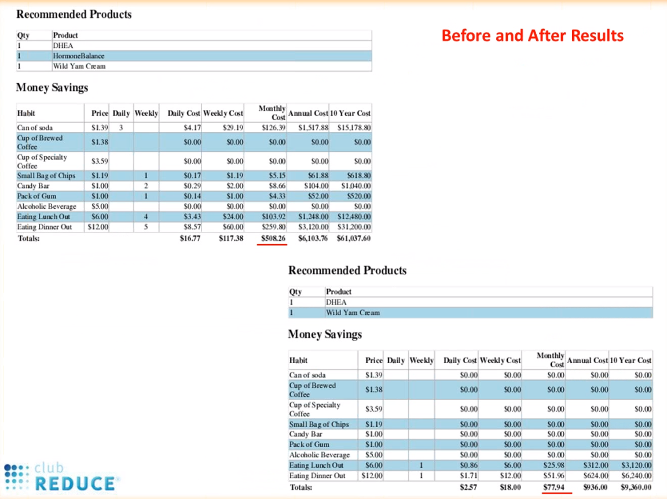
More Questions… “How Much Does a Program Cost?”

Slide 20
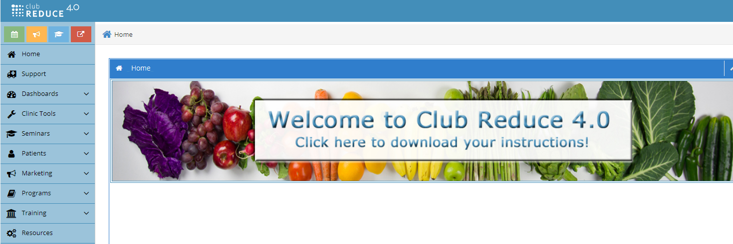
Make Use Of Your Club Reduce Resources

Slide 21
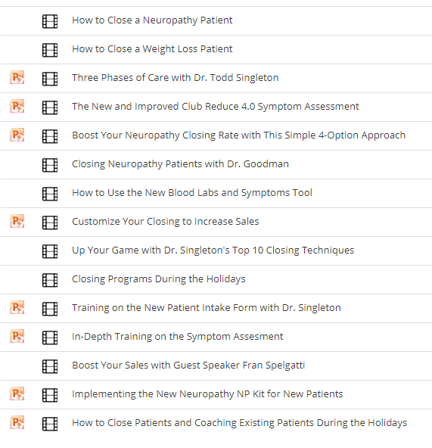
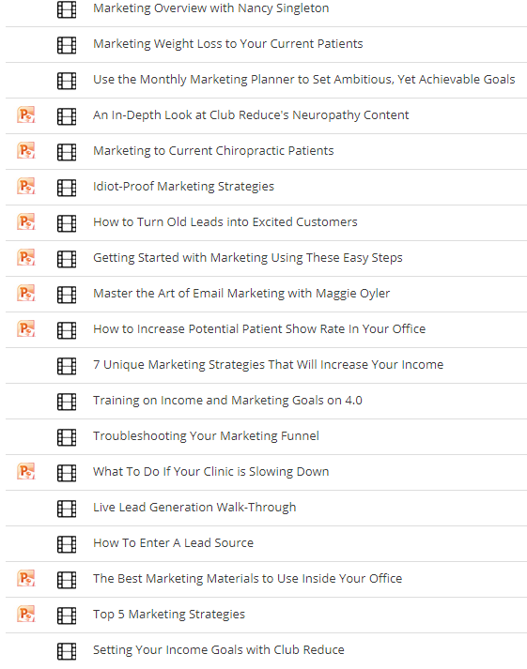
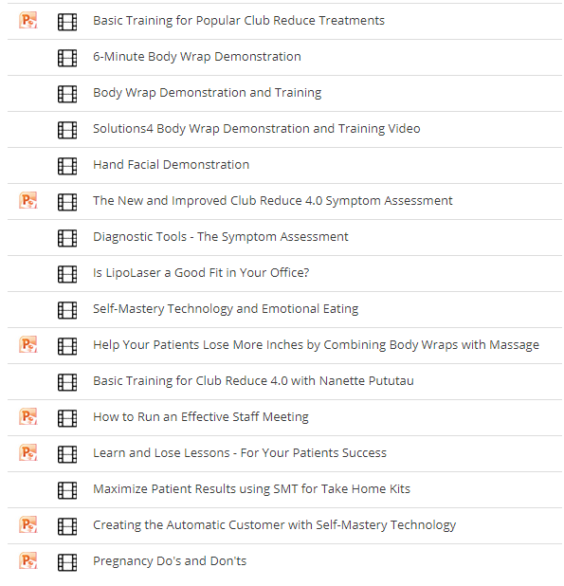
Remember the Webinars!
Closing
Marketing
Tools and Services

Slide 22
Questions? We are Here to Help!
Support@ClubReduce.com
801-590-0880

